Slide 1
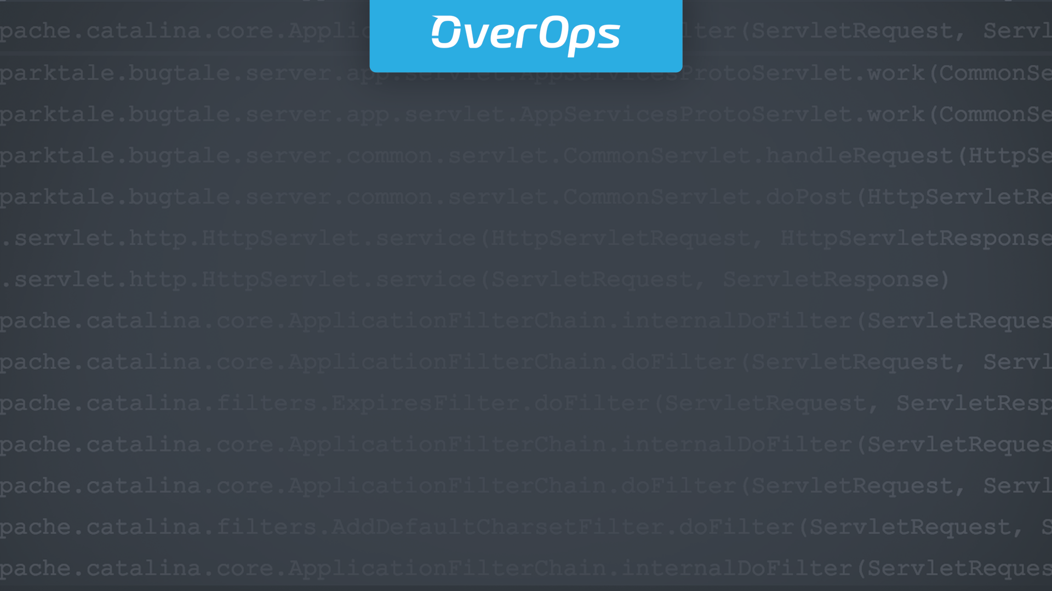

How Comcast Automates Deployments
Intro for
Customer Name

Slide 2

Hi!
Nice to meet you, I’m Gonzalo Merayo,
Monitoring Engineer
Know When, Where and Why Code Breaks in Production

Slide 3
Faster Innovation – Code Breaks More Frequently
Moving to CI/CD
and Microservices
New code deployed continuously
into staging and production.
10-1000s JVMs + microservices.
Code breaks.
Notes:
TALK TRACK:
So let us briefly address the problem we are addressing to see if there is a potential fit for you and then I will dig into how fix it!
So, what we are seeing out there is that our customers are telling us that they are under tremendous pressure to innovate and innovate at a faster rate. Many are even moving toward a CI/CD methodology, and to a microservice architecture in an effort to deploy new code at a faster rate.
However, with this increased rate of innovation, with more complex architecture and a faster rate of releases, are customers are telling us that they are also experiencing challenges with the threat of code breaking in production. In other words, moving fast has a tendency to break fast too! The old adage “haste makes waste” seems to hold true here ☺
QUESTIONS TO ASK:
Before we go deeper , I would love to know more about your release strategy…...How often do you guys deploy code into staging or production?
May I ask, is the person who owns that strategy in this meeting? Who is that person? It would seem to me that this person would very much like to hear what we are about to say ☺
What have been some of the main challenges involved in that effort?
May I ask, why are you not releasing more frequently….is it a staff efficiency issue, or business issue, or process issue, etc etc? Are you not more more quicly b/c of your code breaking?

Slide 4
Late to Detect Critical Issues
Millions of log noisy events
hiding critical errors.
Current tooling is not detecting all critical application issues.
Issues detected by customer
with negative impact.
Notes:
TALK TRACK:
(1) And what they are finding is that their current tooling and processes are simply not supporting this increased rate of innovation, just like what Tal and our colleagues experienced while they were at Autodesk. This is especially true when it comes to detecting the problem before the customer is negatively impacted.
(2) There is just too much noise out there and when a new or critical error is introduced into staging or production, that it is not detected amidst thousands, if not millions, of noisy events. And that more times then not, approximately 75% or higher, it is the end user or customer of the application or service that first detects the problem when the application or service is no longer acting reliably or it is no longer available.
QUESTIONS TO ASK:
I imagine your logs have massive volume, with thousands or millions of log events and errors per hour…...Is that the case?
Do you use Splunk or ElasticSearch to aggregate your logs or what is your log analyzer?
May I ask, do you use it for other use cases, such as security, or do you only use it to help you with Application Operations?
And do you have any idea how much GB of Log Data are you ingesting / managing per day for your App Layer?
Let’s say you deployed a new release today into staging or production, and take even the most basic, rudimentary example: Say you introduced a new... NullPointerException. Between all those thousands or millions of log events: how do you detect it (--pause--) how do you know something broke (--pause--) - how do you even know that it happened?
What % of errors are identified by your customers, rather then you detecting it first?
Is it a revenue generating app or mission critical app that you guys are working on?
What happens if functionality is broken.....is it a:
(a) customer satisfaction issue
(b) brand issue
(c) revenue issue
8. May I ask, is the person who gets the most in trouble in the App fails in this meeting? Who is that person? It would seem to me that peson might very much like to hear what we are about to say ☺

Slide 5
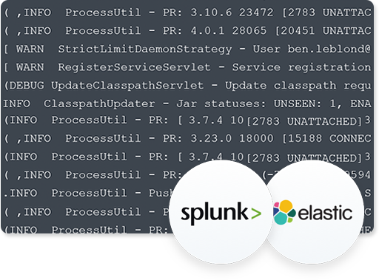
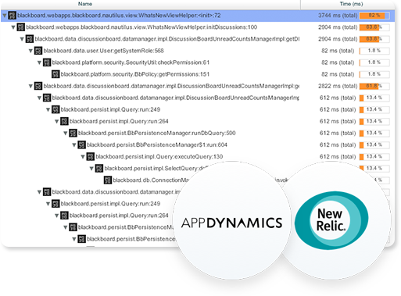
Long Mean-Time-to-Identify
Logs: haystack, limited variable
information. Hard to reproduce.
APM: performance + bottlenecks.
High-level information.
Limited Visibility Into Why Code Breaks
Notes:
TALK TRACK:
(1) Our customers are telling us that their current tooling is simply not up to the task, and it is most evident when it comes to trying to identify the root cause to resolve these errors as fast as possible.
(2) They are finding that their Log Analyzers, while great, simply do not provide enough meaningful and actionable information around the variable state associated with the error and as a result it is time to consuming when trying reproduce the error, determine root cause and then move on to resolving the issue.
(3) Additionally, while they enjoy the benefits their APM tooling provides them regarding performance and addressing bottlenecks, our customers know that these APM solution are not designed to “scratch this itch,” and only provide high level information re reliability and availability issues associated with code breaking in production.
(4) As a result, our customers tell us that Customer Support, Operations and the Development teams spend more time then would like going back and forth, working together, trying to figure what occurred and that in some instances our customers are telling us that their developers are spending anywhere between 20% to 40% of their time trying to debug in production.
QUESTIONS TO ASK:
May I ask, are your teams sifting through logs to determine root cause like our customers did?
Roughly speaking, what % of time does your team spend troubleshooting staging and production today? Is it 10% or 20% or 30%?
How many developers do you have?

Slide 6
Demo

Slide 7
OverOps Business Value
Staff
Efficiency
Reliability &
Availability
Release
Frequency
Notes:
TALK TRACK:
(1) So in summary, our customers tell us that they see 3 possible business values due to OverOps ability to proactively detect all new errors and exceptions and then reduce MTTI by 90%+ and they are:
(2) We provide Increased Reliability and this enables our customers to increase customer satisfaction, brand & Revenue
(3) Additionally, we dramatically improve Staff Efficiency by reducing MTTI by 90%...... our customers can reallocate that additional capacity to do many things, including addressing development backlog, or avoid hiring additional staff to save operational expenses.
(4) And finally, they see OverOps helping them Increase Release frequency and support their CI/CD initiative by removing the negative the negative consequences associated with moving so quickly…. breaking in production! In other words, “move fast, break fast and fix fast”
QUESTIONS TO ASK:
I have to ask, If OverOps worked as advertised, and we could help you proactively detect issues and then reduce MTTI by over 90%, what do you see the business value to you folks ?
Is this about protecting Brand & Revenue for you guys?
Or is it more about improving staff efficiency?
And if we could give you back 75% of the time your folks spend debugging in production, what would you do with that time?
Would you avoid hiring more folk?
Or would you address your engineering backlog?
Or is this all about releasing faster and supporting your CI/CD initiative?

Slide 8






Government + Enterprise
Finance + Health
Consumer
Content + Ad-tech
Notes:
TALK TRACK:
(1) When you look at our customers, it is exciting to see that OverOps is experiencing broad market adoption with customers across all verticals, from finance, to e-commerce, to healthcare to media, etc etc.
.
And our customers have some key things in common. First, our customers all have mission critical applications that they want to protect. And, second, virtually all of our customers already have Log Analyzers and APM tools and yet despite having their solutions, our customers elected to also invest in OverOps due to our unique capability to tell them when, where and why their code breaks in production.

Slide 9
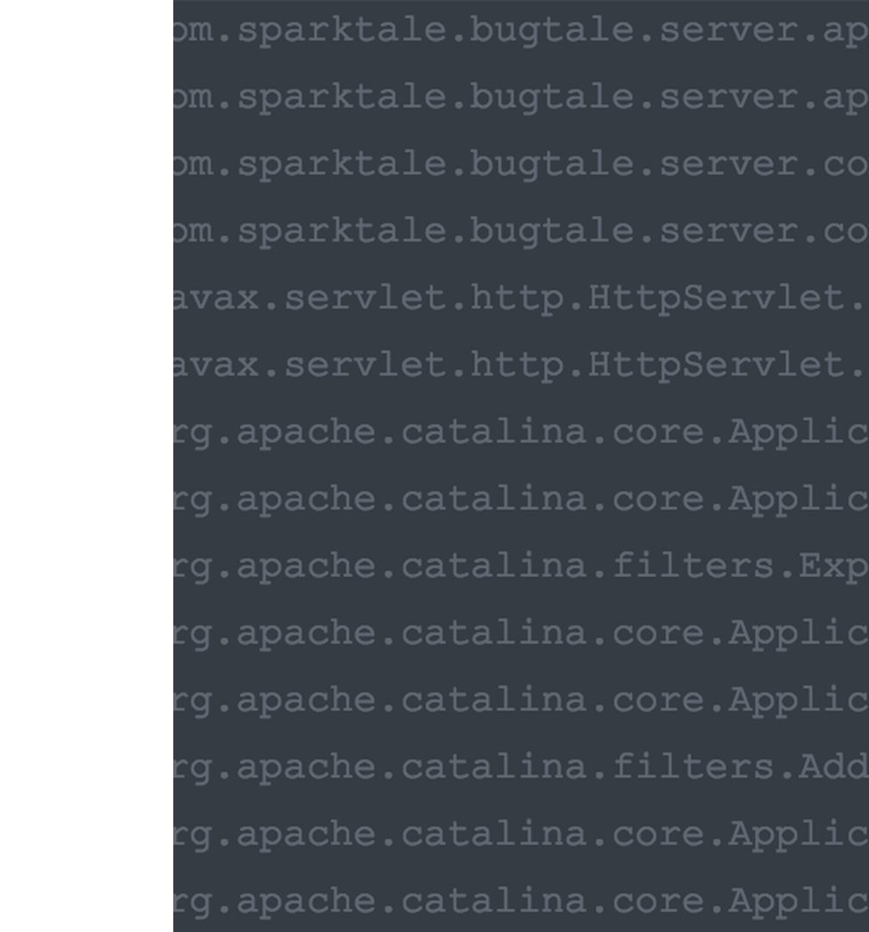
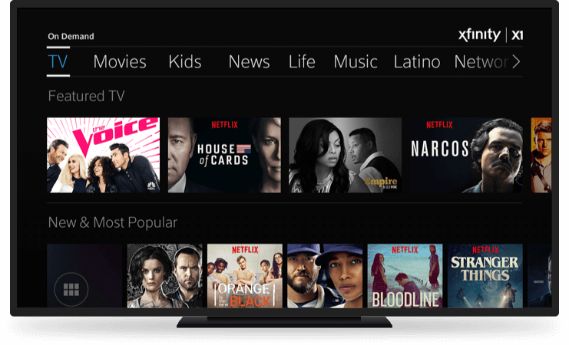
Part 2
How Comcast Automates Deployments

Slide 10

Hi!
Nice to meet you, I’m John McCann,
Executive Director of Product Engineering
Notes:
Name, title
I’m an engineering director X1 Platform for XFINITY TV, Comcast’s flagship video product
I oversee development, QA and operations of the user experience for X1, including the on-screen guide, content discovery and video consumption functionality
I work in Philadelphia, PA with literally the best engineering team I’ve ever come across in my career.

Slide 11

Notes:
A little bit about X1
X1 is next generation / flagship video product for XFINITY TV. It provides our customers access to an enormous library of video content, including
- Live TV, On Demand, DVR, Netflix, music videos and soon YouTube
X1 replaces legacy set-top box experience with a modern look and feel and advanced features like
Voice search
Personalized recommendations
Parental controls
X1 is built entirely on cloud based technologies.
Everything from the user interface to the DVR scheduling software runs on services in both public and private clouds
Every set-top box that is powered on is connected to our cloud-based user interface application through multiple websocket connections
Architecture is comprised of
The front-end user interface (responsible for all pixels on screen)
Dozens of backend services that provide access to metadata, personalization features, back office data, DVR functionality and video on demand data

Slide 12
XFINITY TV by the numbers
22.5M
50%
20M
Residential Video Customers
Are X1 Devices
On Demand Video Views per Day
Notes:
Provide a sense of scale
22.5 million residential video customers
Of those customers 50% are running X1 devices
20 million on-demand video views per day across our entire footprint
User interface runs on nearly 10,000 instances in the public and private cloud, and we deploy a new version of the software just about every week.

Slide 13
How We Got Here
Notes:
A little bit about our voyage
Much like many other software projects, we came from rather humble beginnings.

Slide 14
Monolithic Stack
Notes:
In the early days of X1 we deployed a single, monolithic stack.
Made up of dozens of different components written by different teams using different technologies
Deployments took hours
Dedicated team just to prepare and deploy releases

Slide 15
Isolated Silos
Ops
Dev
Monitoring
QA
Support
Notes:
Teams were organized into isolated silos by role
Developers reported to dev managers, QA reported to QA managers, ops reported to ops managers, and so on
Teams didn't communicate or collaborate as effectively as they could have, making simple jobs complicated and error prone

Slide 16
In-Place Deployments
Prod A
Prod B
Notes:
We essentially had two identical production environments, and we did in-place software upgrades of an entire environment at a time
If a deployment failed, there was no way to roll back
If a data center experienced an outage we were hard down
If we lost a blade, it was a Sev1

Slide 17
Reactionary Monitoring
Incident
Alert
Notes:
Our monitoring and alerting was reactionary –
Something would break, we’d create an alert for it, rinse and repeat
No way to proactively monitor the application for new ways that it could fail

Slide 18
Enough!
Notes:
And after much pain we finally said enough is enough

Slide 19
Dismantle,
Decouple
Notes:
What did we do about it
We spent some development cycles dismantling the monolithic deployments into separate services and microservices

Slide 20
Cross-functional “Pods”
Dev
Monitoring
QA
Support
Ops
Notes:
Organizational problem
We reorganized the technology team into small teams, or “pods” that consist of developers, QA, and product managers.
Each pod is responsible for end-to-end ownership of their area of the product, including development QA, operations, monitoring and support
Empower teams to make choices, no more top down
Hold teams responsible for the success or failure of their services and features

Slide 21
Automated, Parallel Deployments
Notes:
We developed a home-grown deployment automation solution based on the philosophy that production environments should be treated as immutable (cattle not pets, more on this later)
We had a few requirements for our deployment automation
Roll out new releases very quickly and safely
Scale quickly to new data centers

Slide 22



Software Stack
Notes:
We’re a Linux / Java shop primarily, that uses Cassandra as the persistence later for most of the backing data. Had to work with this software stack

Slide 23
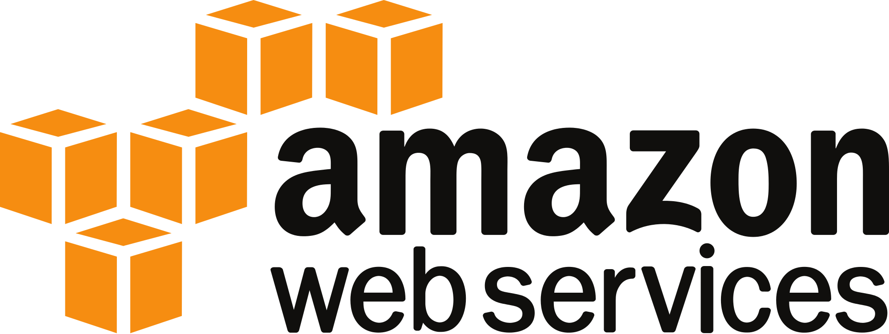
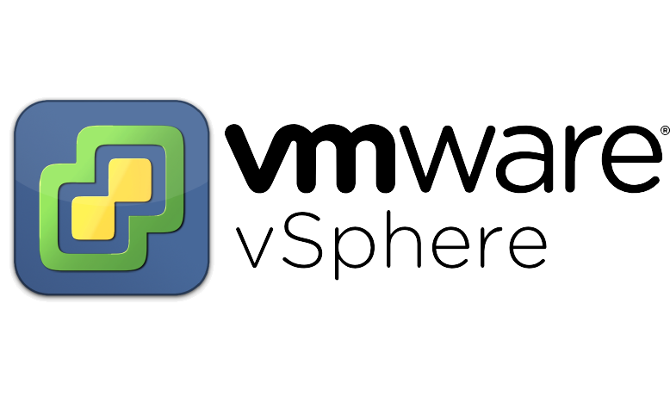
Cloud Providers
Notes:
Our solution had to work on multiple different cloud technologies, public and private. We run on OpenStack, AWS and VMWare clouds.
Require a solution that will run on a heterogeneous infrastructure

Slide 24


Monitoring Tools
Notes:
And the deployment automation had to automatically install and configure multiple monitoring agents, specifically
OverOps – application / JVM level monitoring
Zabbix - OS / instance monitoring
Splunk – Logging

Slide 25
Deployment Automation
Notes:
What we came up with looks a bit like this
An abstraction layer that provides a consistent API for working with the various clouds we run on
Scala, Aka, Cassandra
Puppet + hiera
A flexible orchestration layer that knows how the application should be scaled and configured
Activiti BPM (Business Process Management)
Relational database
A set of tools that provide a user interface and access to a dashboard to give the teams an overview of their production environments in a glance
Ruby / Sinatra
Bootstrap
And there was much rejoicing…

Slide 26
The Release Cycle Ends When New Code is Deployed to Production
Notes:
But we weren’t quite done …
We had automated deployments but …
we fell victim to the common misconception that the release cycle ends when code is deployed to production ….

Slide 27
The Release Cycle Ends When New Code is Deployed to Production
...
WRONG
Notes:
Wrong

Slide 28

The Release Cycle Ends When New Code is Deployed to Production
...
That’s When Monster Errors Come to Life
WRONG
Notes:
That’s when things just start to get interesting, and the so-called monsters come out…

Slide 29
Monitoring Solution
Monitoring Solution
Notes:
So what we did next was put together a suite of monitoring tools that give us access to all the known and unknown ways an application can fail.
We use Zabbix, Splunk and a new homegrown realtime telemetry system for building alerts on all the known failure points.
And OverOps is what clues us into all of the things that fail in new and exciting ways. Essentially it allows us to cover all our bases.

Slide 30
Monitoring Before Splunk
$ ssh jmccann@tvxxre-c6-dwnexj.x1.xcal.tv
$ tail -f /var/log/xreGuide.log
...
2017-06-13 13:01:14,729 t=x-10 INFO c=c.c.s.s.StartupInitHelper Step 1: init DeviceSystemApi
2017-06-13 13:01:14,729 t=x-10 INFO c=c.c.x.a.ServiceManagerApi initializing API=System_6 with timeout=20000
2017-06-13 13:01:14,730 INFO c=c.c.x.a.ServiceManagerApi sending call command name=init params={System_6,} callGUID=61ccc590-5038-11e7-a1e6-005056870c99
$ ssh jmccann@tvxxre-c5-q4zcf9.x1.xcal.tv
$ tail -f /var/log/xreGuide.log
...
2017-06-13 13:01:14,729 t=x-10 INFO c=c.c.s.s.StartupInitHelper Step 1: init DeviceSystemApi
2017-06-13 13:01:14,729 t=x-10 INFO c=c.c.x.a.ServiceManagerApi initializing API=System_6 with timeout=20000
2017-06-13 13:01:14,730 INFO c=c.c.x.a.ServiceManagerApi sending call command name=init params={System_6,} callGUID=61ccc590-5038-11e7-a1e6-005056870c99
$ ssh jmccann@tvxxre-p5-ipg9hx.x1.xcal.tv
$ tail -f /var/log/xreGuide.log
...
2017-06-13 13:01:14,729 t=x-10 INFO c=c.c.s.s.StartupInitHelper Step 1: init DeviceSystemApi
2017-06-13 13:01:14,729 t=x-10 INFO c=c.c.x.a.ServiceManagerApi initializing API=System_6 with timeout=20000
2017-06-13 13:01:14,730 INFO c=c.c.x.a.ServiceManagerApi sending call command name=init params={System_6,} callGUID=61ccc590-5038-11e7-a1e6-005056870c99
$ ssh jmccann@tvxxre-c6-fjbhkh.x1.xcal.tv
$ tail -f /var/log/xreGuide.log
...
2017-06-13 13:01:14,729 t=x-10 INFO c=c.c.s.s.StartupInitHelper Step 1: init DeviceSystemApi
2017-06-13 13:01:14,729 t=x-10 INFO c=c.c.x.a.ServiceManagerApi initializing API=System_6 with timeout=20000
2017-06-13 13:01:14,730 INFO c=c.c.x.a.ServiceManagerApi sending call command name=init params={System_6,} callGUID=61ccc590-5038-11e7-a1e6-005056870c99
Notes:
Thinking back a bit to what life was like before Splunk –
Dozens of terminal windows tailing and grepping different logs on different servers

Slide 31
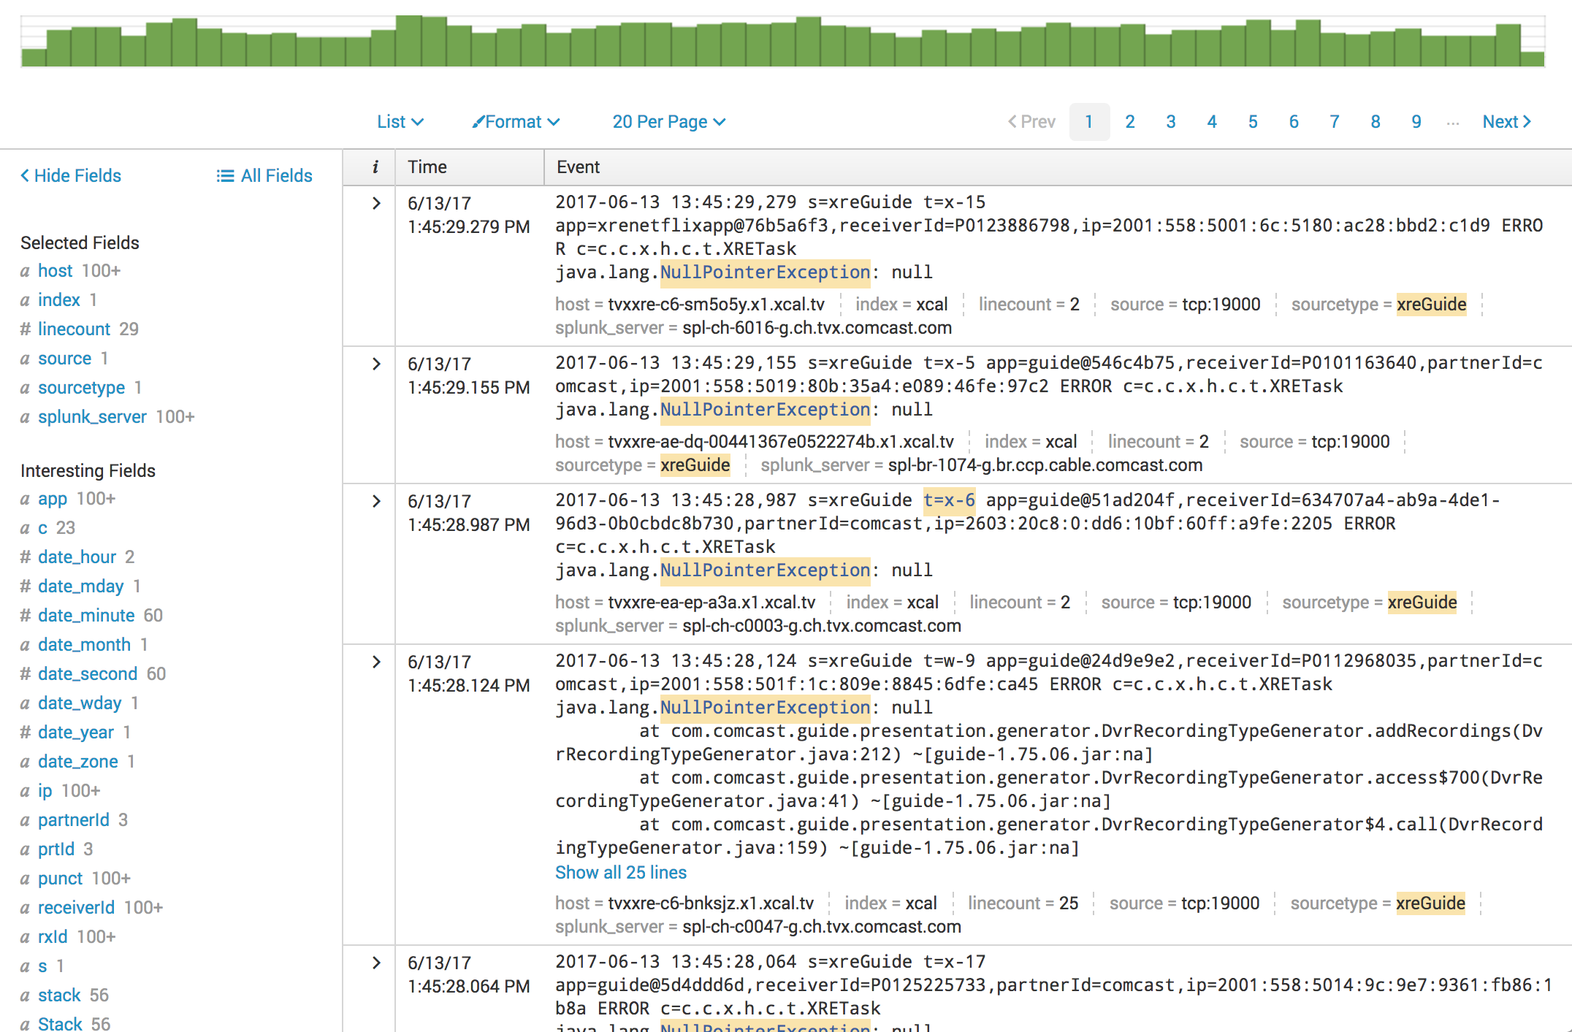
Monitoring Before OverOps
Notes:
Splunk changed the game pretty dramatically,
But one of the fundamental challenges with Splunk alerts is that you kinda have to know what you’re looking for when you set up a alert
It has dashboards, but no detailed way to see all of the ways your app is breaking
OverOps fills the game in for us here and rounds out…

Slide 32
Automated Release Pipeline
Notes:
A complete automated release pipeline. The pipeline starts with
Each stage of the pipeline has some automated way to detect regressions
Development and continuous integration (we use bamboo) – unit tests validate
Release automation (we use jenkins) – automated sanity tests run
Deployment automation - automated stack valication
Traffic shaping to a canary (community) group, and then to customers, a percentage at a time
Continuous monitoring used to make decisions about whether to
Proceed or
Rollback

Slide 33
Core Principles
Notes:
When putting together this solution we started to embrace a set of core principles that relevant to any highly scaled, customer facing applcation

Slide 34
Core Principle:
Traffic Shaping
Notes:
Traffic shaping is critical
You never release a feature to all customers at once – new releases first go to a community or canary groupt, and then to customers, a percentage at a time

Slide 35
Core Principle:
Fail Fast
Notes:
The second core principle is fail fast
If anything looks fishy you roll back immediately to get customers healthy, and investigate later

Slide 36
Core Principle: Immutable Environments
Notes:
We embrace immutable environments. New versions of the software go onto new instances created just for that release, and we don’t touch the instances once they are created
Some people refer this as treating production as “cattle, not pets”
We don’t deploy in place

Slide 37
Core Principle: Immutable Environments
Notes:
Instances running old versions of the software are terminated

Slide 38
Core Principle: Immutable Environments
Notes:
And replaced with new ones.
Then traffic is directed to the new instances.

Slide 39
Why OverOps for X1?
Notes:
So why to we use OverOps for X1?
Let’s look at an example…

Slide 40
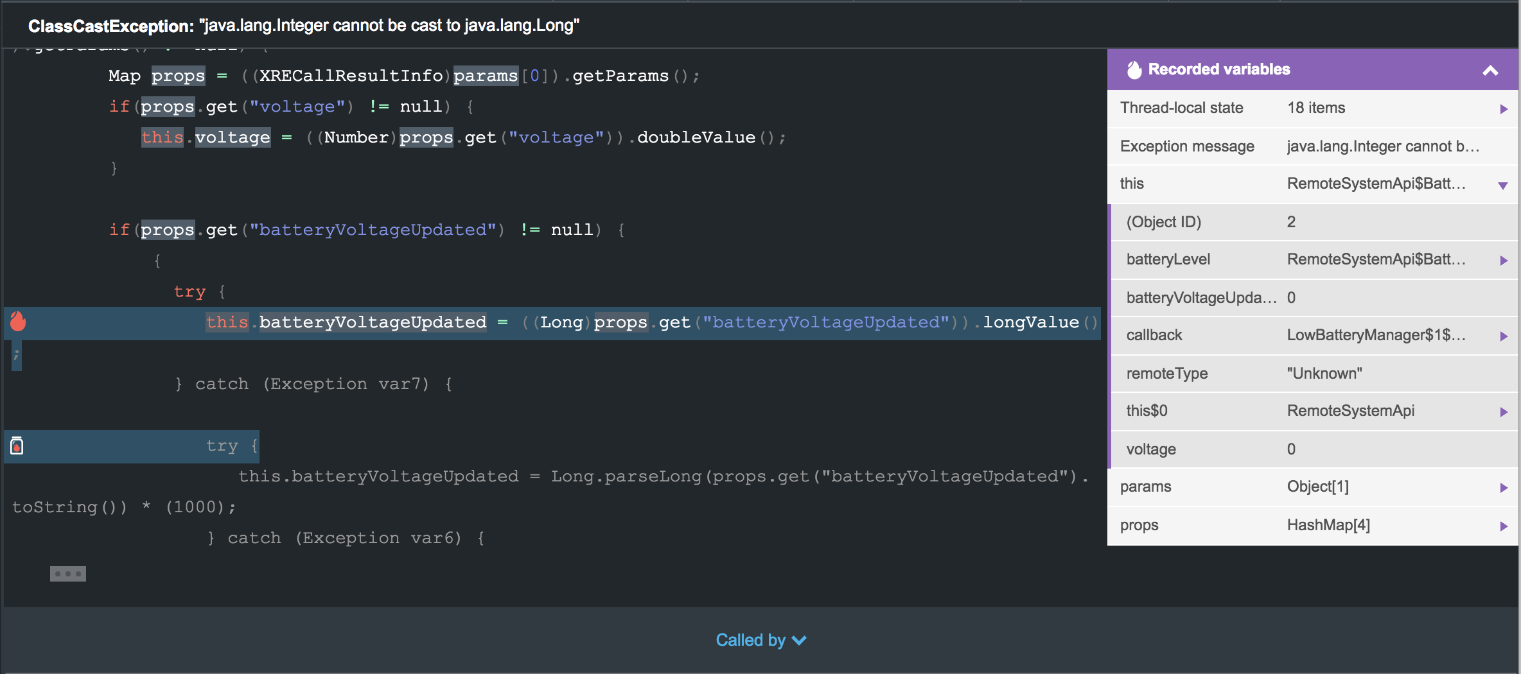
Example: TBD
Example: Remote Battery Voltage
Notes:
Here’s one real world example of a problem in production that OverOps helped us solve.
We monitor the battery levels of the remote controls we give out with our set-top boxes, and we notify the user when it’s time to replace the batteries in their remote. You’d be astounded how many calls our call centers take for customers who report that their service isn’t working, when all they need to do is replace the batteries in their remote controls.
At some point the set-top firmware released a version that reported very low battery levels as 0, but the value was being serialized as an Integer rather than a Long. When the user interface attempted to unmarshall the value, it would toss an exception. So customers who were supposed to be getting a notification to change their remote batteries were not getting it.
This exception appeared in OverOps immediately when the problem started, and OverOps helped find exactly what data coming from the set-top box was producing this exception, and it helped us quantify magnitude of the problem and the user impact.
We were able to quickly diagnose the problem and get it fixed right away.

Slide 41
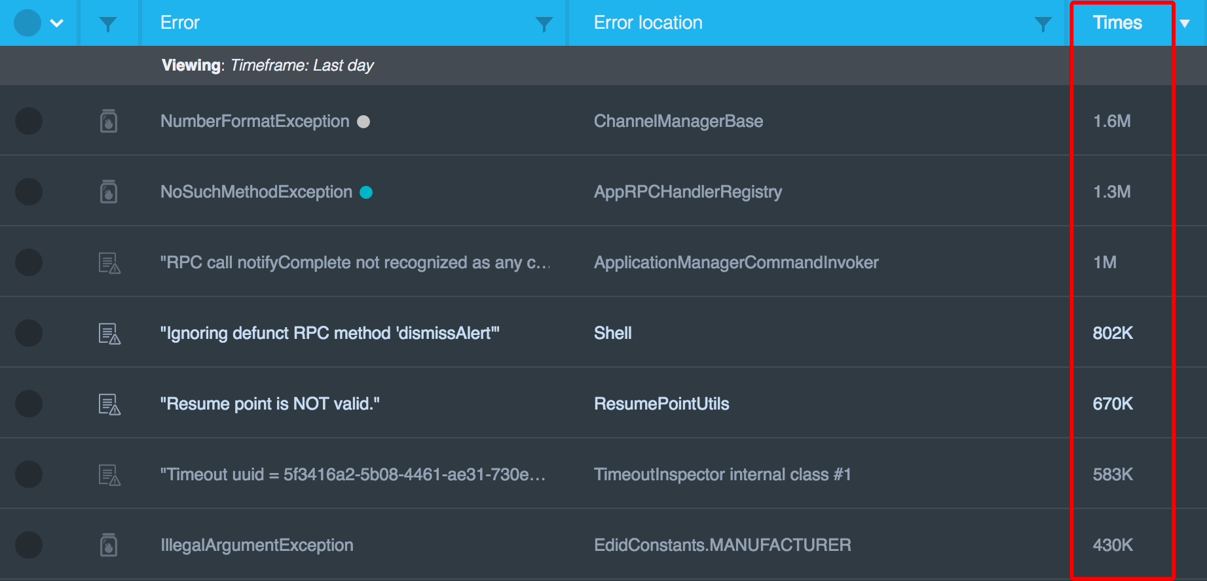
The Long Tail
Notes:
The other thing that I personally find valuable in OverOps is tracking down the long tail of issues that may not affect a large number of customers, but could result in a negative user experience for some customers.
OverOps is great at listing the top errors and exceptions…

Slide 42
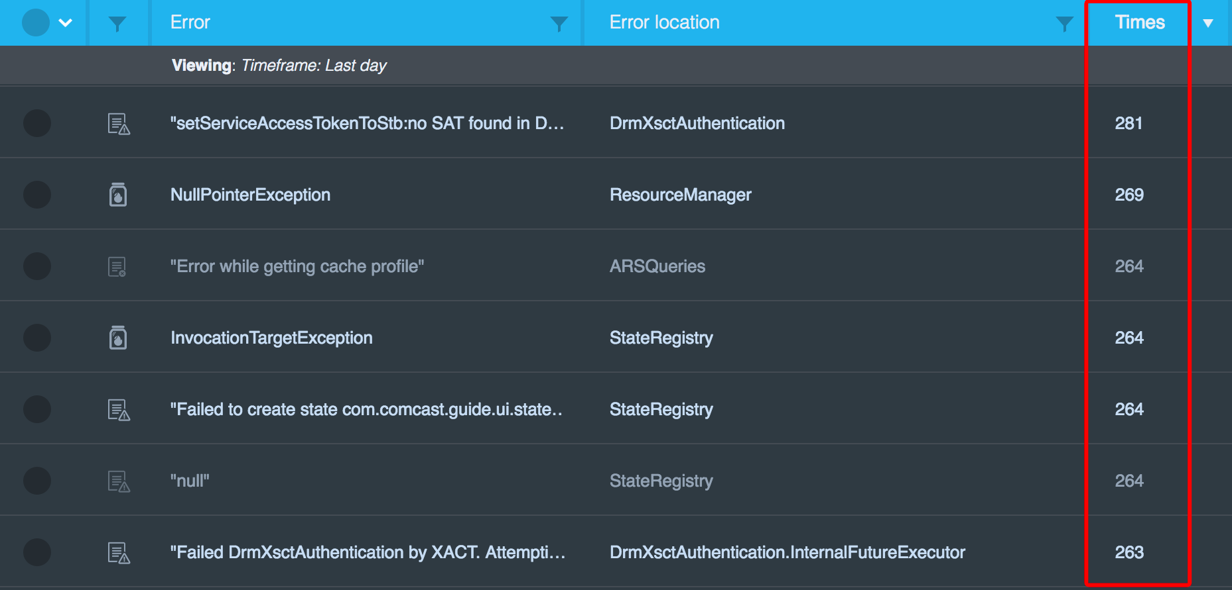
The Long Tail
Notes:
… but it also allows engineering teams to see all the details about the long tail
These types of issues never set off any alarms, and generally get buried in terabytes of Splunk logs.
With OverOps, it’s easy to figure out which ones are customer impacting, and address those first.

Slide 43
OverOps for X1
1
2
3
Issues carry a sufficient level of detail to identify the root cause
Newly introduced problems are uncovered more quickly
Visibility into the long tail of problems that are often overlooked
“With OverOps, we're finding and fixing issues that otherwise would have gone undetected.”
Notes:
To summarize
Here’s why we use OverOps for X1:
The issues OverOps reports have the level of detail a developer needs to figure out how to fix it.
New problems that surface in production can be discovered quickly with a bit of vigilance on the part of the dev team
And it provides visibility into the long tail of issues that may otherwise have gone undetected.
If you’re interested in learning more or trying out OverOps, I suggest you get in touch with these fine gentleman here or visit their booth

Slide 44
Questions?
Thanks!
We’re hiring:
john_mccann@comcast.com
www.overops.com
Made with ❤️ in Philadelphia
Notes:
So that’s it for me – I’d be happy to answer any questions you all may have.
And if you’re a developer looking for a job in the Philadelphia area, shot me a note!

