Slide 1
Pulsar
Realtime Analytics At Scale
Tony Ng, Sharad Murthy
June 11, 2015

Slide 2
Big Data Trends
Bigger data volumes
More data sources
  DBs, logs, behavioral & business event streams, sensors …
Faster analysis
  Next day to hours to minutes to seconds
Newer processing models
  MR, in-memory, stream processing, Lambda …

Slide 3

What is Pulsar
Open-source real-time analytics platform and stream processing framework

Slide 4
Business Needs for Real-time Analytics
Near real-time insights
React to user activities or events within seconds
Examples:
  Real-time reporting and dashboards
  Business activity monitoring
  Personalization
  Marketing and advertising
  Fraud and bot detection
Collect Events
Optimize App Experience
Users Interact with Apps
Analyze & Generate Insights

Slide 5
Systemic Quality Requirements
Scalability
  Scale to millions of events / sec
Latency
  <1 sec delivery of events
Availability
  No downtime during upgrades
  Disaster recovery support across data centers
Flexibility
  User driven complex processing rules
  Declarative definition of pipeline topology and event routing
Data Accuracy
  Should deal with missing data
  99.9% delivery guarantee

Slide 6
Pulsar Real-time Analytics
  Complex Event Processing (CEP): SQL on stream data
  Custom sub-stream creation: Filtering and Mutation
  In Memory Aggregation: Multi Dimensional counting

Slide 7
Pulsar Real-time Analytics Pipeline
BOT
Detector
Real Time Metrics & Alert Consumer
Enriched
Events
Enriched
Sessionized Events
Producing
Applications
Collector
Sessionizer
Event
Distributor
Metrics
Calculator
Real Time Data Pipeline
HDFS
Batch Loader
Kafka
Other Real Time
Data Clients
Real Time
Dashboard
Metrics Store
Batch Pipeline

Slide 8
Pipeline Data
Other Real Time
Data Clients
Mutated
Streams
Unstructured
Avg Payload - 1500 – 3000 bytes
Peak 300,000 to 400000 events/sec
100+
Avg latency < 100 millisecond
100,000+
Producing
Applications
Collector
Sessionizer
Event
Distributor
Metrics
Calculator
Event
Enrichment
1+ Billion sessions
Real Time Data Pipeline
HDFS
Batch Loader
Kafka
Real Time
Dashboard
Metrics Store
Batch Pipeline
8 – 10 Billion events/day

Slide 9
Pulsar Framework Building Block (CEP Cell)
Inbound
Channel-1
Processor-1
OutboundChannel
JVM
Inbound
Channel-2
Processor-2
Spring Container
Event = Tuples (K,V) – Mutable
Abstractions: Channels, Processors, Pipelining, Monitoring
Declarative Pipeline Stitching
Channels: Cluster Messaging, File, REST, Kafka, Custom
Event Processor: Esper, RateLimiter, RoundRobinLB, PartitionedLB, Custom

Slide 10
Multi Stage Distributed Pipeline

Slide 11
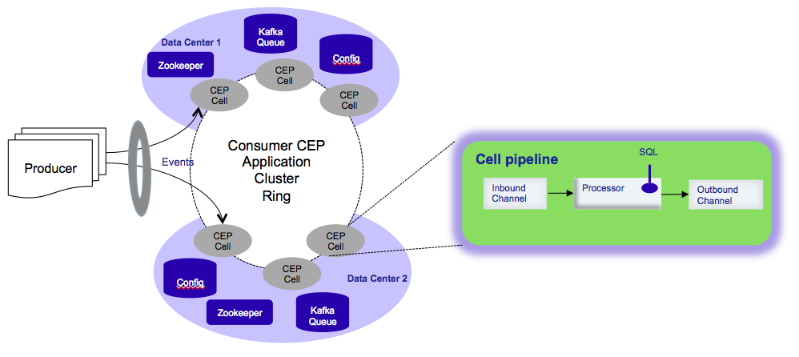
Pulsar Deployment Architecture

Slide 12
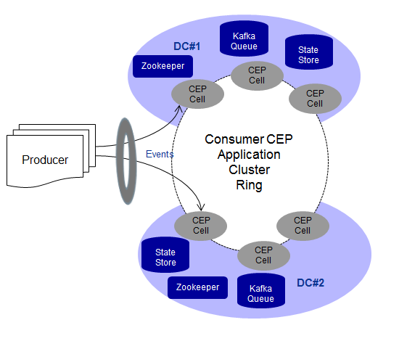
Availability And Scalability
Elastic Clusters
Self Healing
Pipeline Flow Control
Datacenter failovers
Dynamic Partitioning
  Consistent Hashing
Rate Limiting

Slide 13
Messaging Models
Netty
Producer
Consumer
Producer
Consumer
Push Model
(At most once delivery semantics)
Kafka
Queue
Pull Model
Pause/Resume
(At least once delivery semantics)
Producer
Consumer
Kafka
Replayer
Queue
Hybrid Model

Slide 14
Event Filtering and Routing Example
insert into SUBSTREAM select roundTS(timestamp) as ts, D1, D2, D3, D4
from RAWSTREAM where D1 = 2045573 or D2 = 2047936
or D3 = 2051457 or D4 = 2053742; // filtering
@PublishOn(topics=“TOPIC1”) // publish sub stream on TOPIC1
@OutputTo(“OutboundMessaging”)
@ClusterAffinityTag(column = D1); // partition key based on column D1
select * FROM SUBSTREAM;
Topic1
CEP
OutboundMessaging
Topic2
OutboundKafkaChannel

Slide 15
Aggregate Computation Example
// create 10-second time window context
create context MCContext start @now end pattern [timer:interval(10)];
// aggregate event count along dimension D1 and D2 within specified time window context MCContext
insert into AGGREGATE select count(*) as METRIC1, D1, D2 FROM SUBSTREAM group by D1,D2 output snapshot when terminated;
@OutputTo(“OutboundKafkaChannel”)
@PublishOn(topics=“DRUID”)
Select * from AGGREGATE;
SUBSTREAM
OutboundKafkaChannel
Kafka
DRUID
CEP
OutboundMessaging

Slide 16
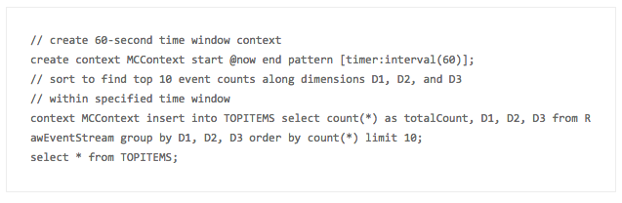
TopN Computation Example
TopN computation can be expensive with high cardinality dimensions
Consider approximate algorithms
  sacrifice little accuracy for space and time complexity
Implemented as aggregate functions e.g. select topN(100, 10, D1 ||','||D2 ||','||D3) as topn from RawEventStream;

Slide 17

Pulsar Integration with Druid
Druid
  Real-time ROLAP engine for aggregation, drill-down and slice-n-dice
Pulsar leveraging Druid
  Real-time analytics dashboard
  Near real-time metrics like number of visitors in the last 5 minutes, refreshing every 10 seconds
  Aggregate/drill-down on dimensions such as browser, OS, device, geo location
Real Time Pipeline
Collector
Sessionizer
Distributor
Metrics
Calculator
Kafka
DRUID
DRUID
Ingest
adhoc
queries

Slide 18
Key Differentiators
Declarative Topology Management
Streaming SQL with hot deployment of SQL
Elastic clustering with flow control in the cloud
Dynamic partitioning of clusters
Hybrid messaging model
  Combo of push and pull
< 100 millisecond pipeline latency
99.99% Availability
< 0.01% steady state data loss

Slide 19
Future Development and Open Source
Real-time reporting API and dashboard
Integration with Druid and other metrics stores
Session store scaling to 1 million insert/update per sec
Rolling window aggregation over long time windows (hours or days)
GROK filters for log processing
Anomaly detection

Slide 20
More Information
GitHub: http://github.com/pulsarIO
  repos: pipeline, framework, docker files
Website: http://gopulsar.io
  Technical whitepaper
  Getting started
  Documentation
Google group: http://groups.google.com/d/forum/pulsar

