Slide 1
Asif
Daniel
Structure, Personalization, Scale: A Deep Dive into LinkedIn Search

Slide 2
Overview
What is LinkedIn search and why should you care?
What are our systems challenges?
What are our relevance challenges?

Slide 3
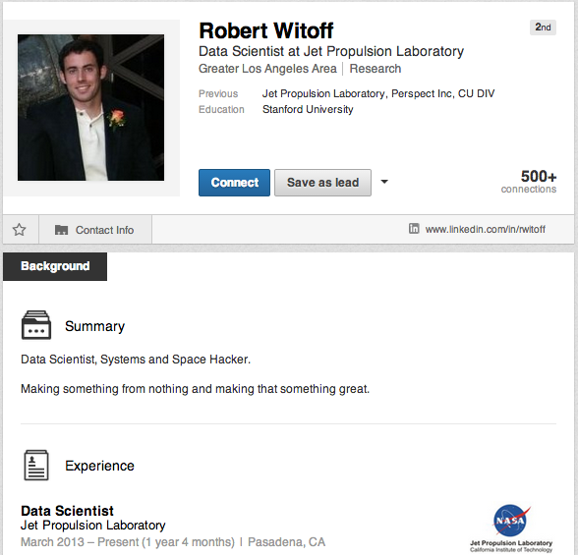
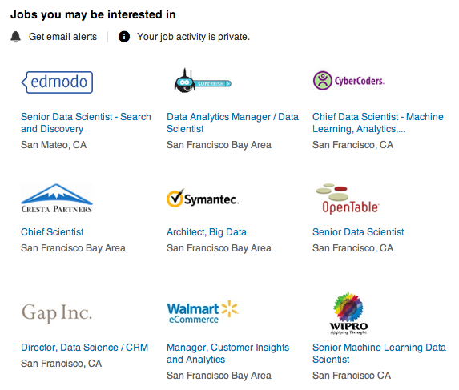
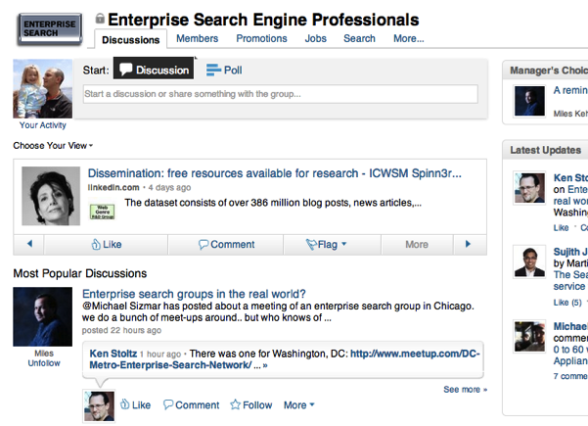
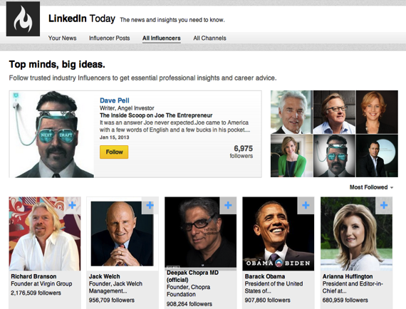

Slide 5
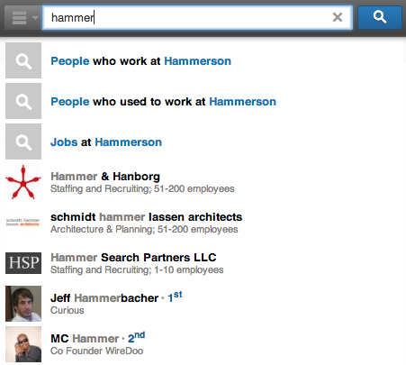
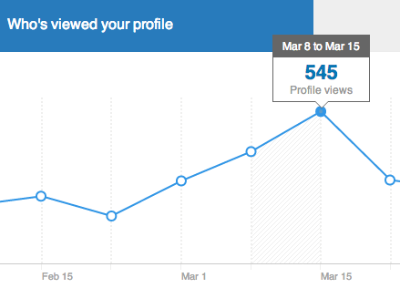
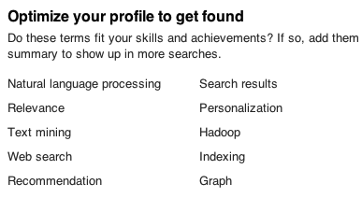
Search helps members find and be found.

Slide 6
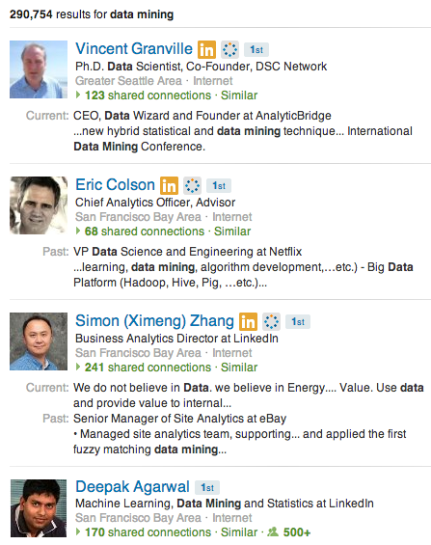
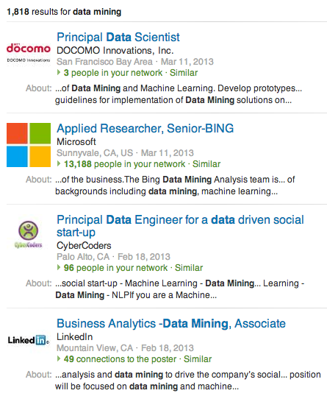
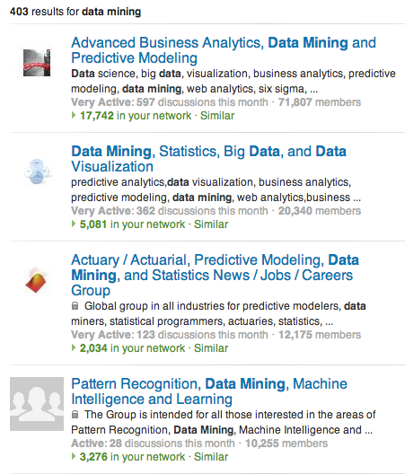
Search for people, jobs, groups, and more.

Slide 7
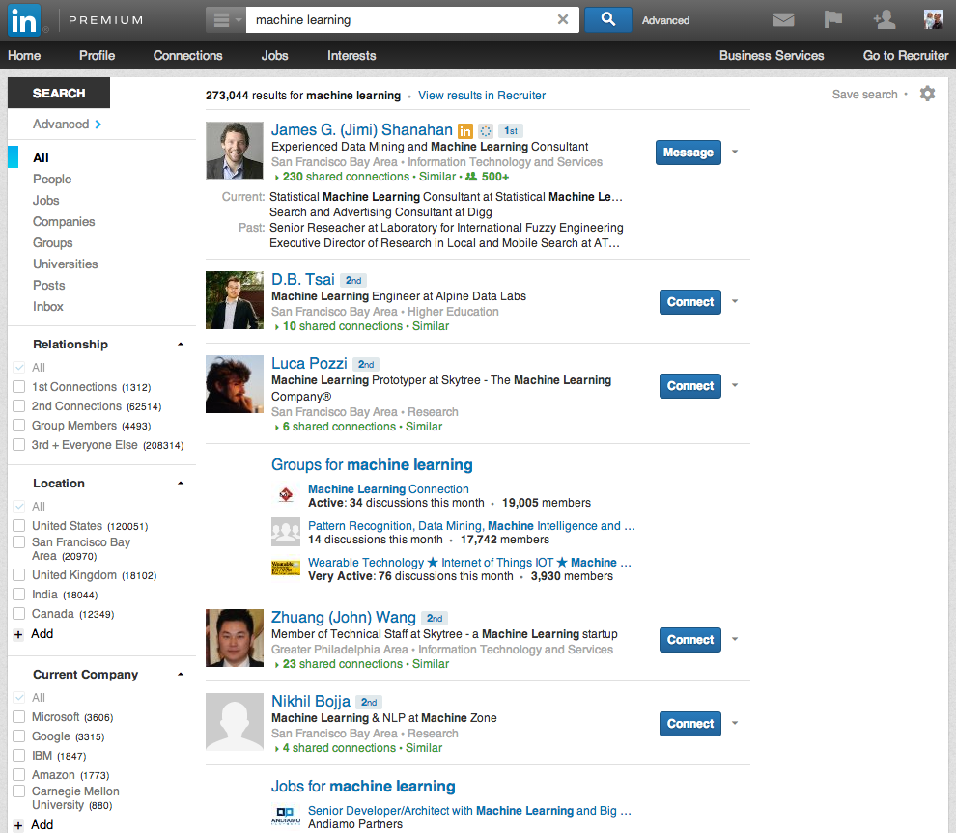

Slide 8
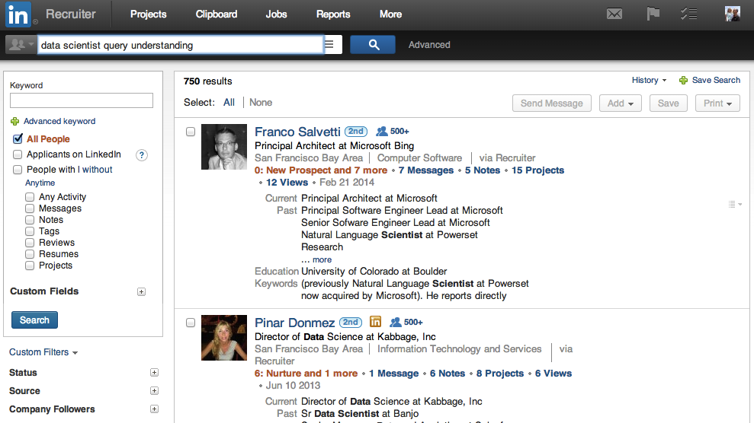
A separate product for recruiters.

Slide 9
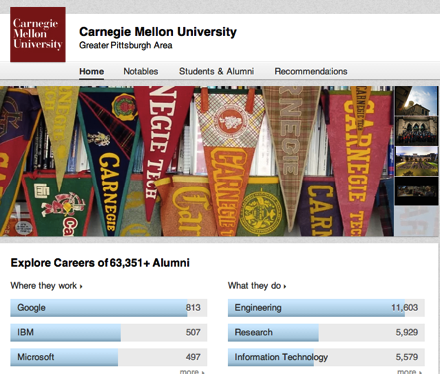
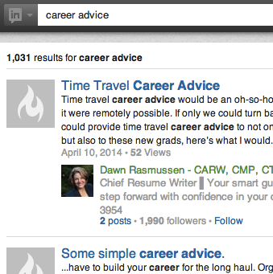
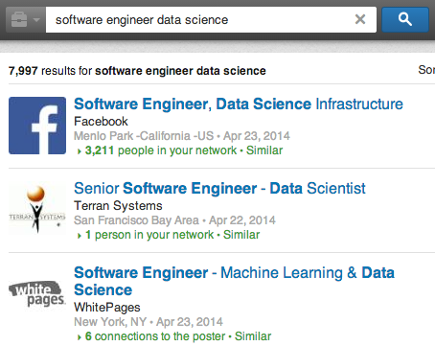
Search is the core of key LinkedIn use cases.

Slide 10
What’s unique
Personalized
Part of a larger product experience
Many products
Big part
Task-centric
Find a job, hire top talent, find a person, …

Slide 11
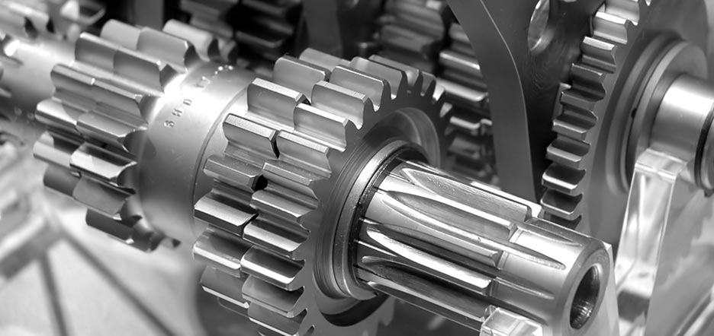
Systems Challenges

Slide 12
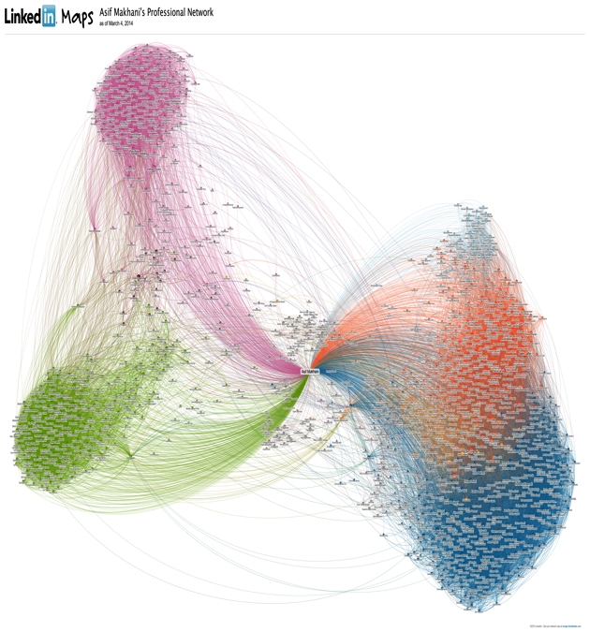
Evolution of LinkedIn’ Search Architecture
2004:
No Search Engine
Iterate through your network and filter
2004

Slide 13
2007: Introducing Lucene (single shard, multiple replicas)
Lucene
Lucene
Lucene
Lucene
(Single Shard)
Updates
Queries
Results
2004
2007

Slide 14
2008: Zoie - real-time search (search without commits/shutdown)
Lucene
Lucene
Lucene
Updates
Zoie
Queries
Results
Lucene
2004
2007
2008
Updater
Updater

Slide 15
2008: Content Store (aggregating multiple input sources)
Source 1
Content Store
Lucene
Lucene
Source 2
Lucene
….
Zoie
Queries
….
Results
Lucene
Source N
2004
2007
2008
Updater
Updater

Slide 16
2008: Sharded search
Broker
Queries
Source 2
Results
Source 1
….
Source N
Content Store
Sharded
….
2004
2007
2008
Updater
Updater

Slide 17
2009: Bobo – Faceted Search
Broker
Queries
Results
Source 2
Source 1
….
Source N
Sensei
Content Store
….
Bobo
Zoie
Lucene
2004
2007
2008
2009
Updater
Updater

Slide 18
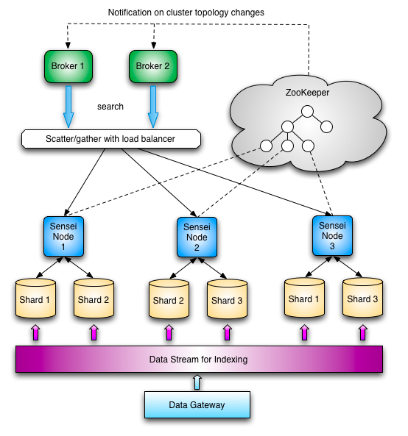
2010: SenseiDB (cluster management, new query language, wrapping existing pieces)
2004
2010
2007
2008
2009
Updater
Updater

Slide 19
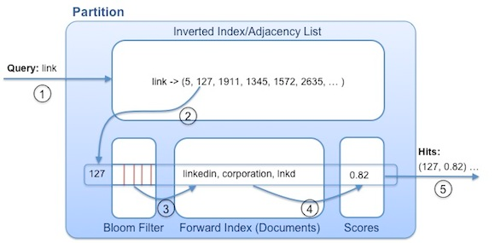
2011: Cleo (instant typeahead results)
2004
2010
2011
2007
2008
2009
Updater
Updater

Slide 20
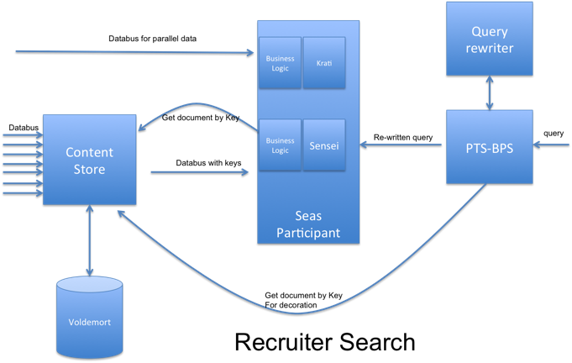
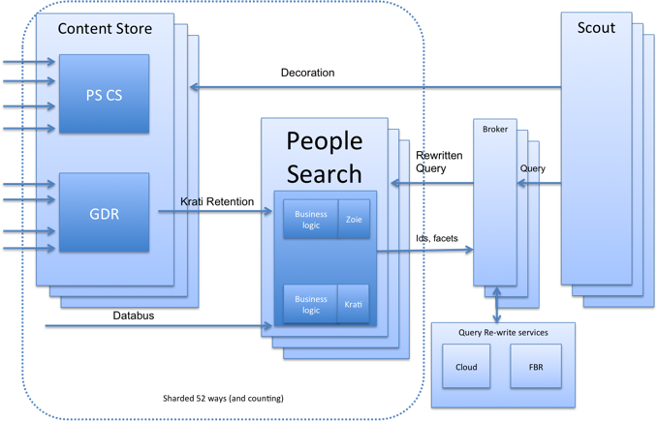
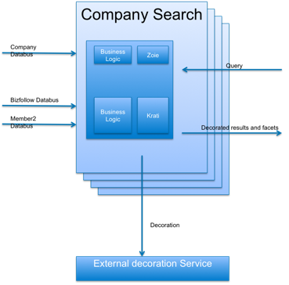
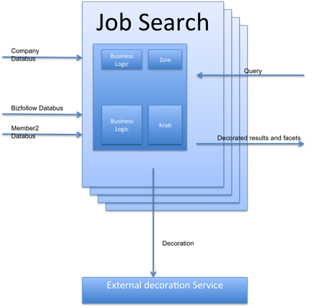
2013: Too many stacks
Group Search
Article/Post Search
And more…
2004
2010
2011
2007
2008
2009
2013
Updater
Updater

Slide 21
Challenges
Index rebuilding very difficult
Live updates are at an entity granularity
Scoring is inflexible
Lucene limitations
Fragmentation – too many components, too many stacks
Economic Graph
Opportunity

Slide 22
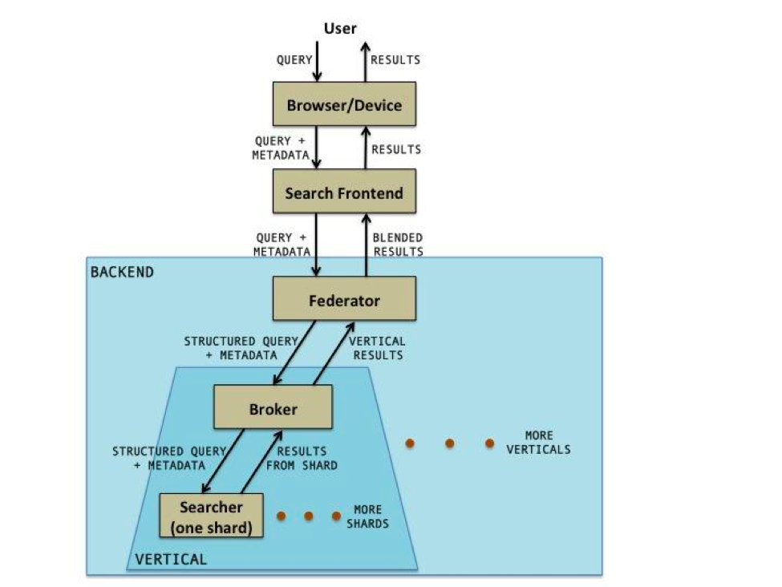
2014: Introducing Galene
2004
2010
2011
2007
2008
2009
2013
2014
Updater
Updater

Slide 23
Life of a Query
Search Shard
User Query
Query Rewriter/ Planner
Results Merging
Search Results
Search Shard

Slide 24
Life of a Query – Within A Search Shard
Top Results
Rewritten Query
Retrieve a Document
Score the Document
Top Results From Shard
INDEX

Slide 25
Life of a Query – Within A Rewriter
Rewriter State
Query
Rewriter Module
Rewriter Module
Rewriter Module
Rewritten Query
DATA MODEL
DATA MODEL
DATA MODEL

Slide 26
Life of Data - Offline
Raw Data
Derived Data
DATA MODEL
DATA MODEL
DATA MODEL
DATA MODEL
DATA MODEL
INDEX

Slide 27
Improvements
Regular full index builds using Hadoop
Easier to reshard, add fields
Improved Relevance
Offline relevance, query rewriting frameworks
Partial Live Updates Support
Allows efficient updates of high frequency fields (no sync)
Goodbye Content Store, Goodbye Zoie
Early termination
Ultra low latency for instant results
Goodbye Cleo
Indexing and searching across graph entities/attributes
Single engine, single stack

Slide 28
Galene Deep dive

Slide 29
Primer on Search

Slide 30
Lucene
An open source API that supports search functionality:
Add new documents to index
Delete documents from the index
Construct queries
Search the index using the query
Score the retrieved documents

Slide 31
The Search Index
Inverted Index: Mapping from (search) terms to list of documents (they are present in)
Forward Index: Mapping from documents to metadata about them

Slide 32
BLAH BLAH BLAH DanielBLAH BLAH LinkedIn BLAH BLAH BLAH BLAH
1.
BLAH BLAH AsifBLAH LinkedIn BLAH BLAH BLAH BLAH BLAH BLAH BLAH
2.
Daniel
Asif
LinkedIn
1
2
Inverted Index
Forward Index

Slide 33
The Search Index
The lists are called posting lists
Upto hundreds of millions of posting lists
Upto hundreds of millions of documents
Posting lists may contain as few as a single hit and as many as tens of millions of hits
Terms can be
words in the document
inferred attributes about the document

Slide 34
Lucene Queries
term:“asif makhani”
term:asif term:daniel
+term:daniel +prefix:tunk
+asif +linkedIn
+term:daniel connection:50510
+term:daniel industry:software connection:50510^4

Slide 35
Early termination
We order documents in the index based on a static rank – from most important to least important
An offline relevance algorithm assigns a static rank to each document on which the sorting is performed
This allows retrieval to be early-terminated (assuming a strong correlation between static rank and importance of result for a specific query)
Also works well with personalized search
+term:asif +prefix:makh +(connection:35176 connection:418001 connection:1520032)

Slide 36
Partial Updates
Lucene segments are “document-partitioned”
We have enhanced Lucene with “term-partitioned” segments
We use 3 term-partitioned segments:
Base index (never changed)
Live update buffer
Snapshot index

Slide 37
Snapshot Index
Live Update Buffer
Base Index

Slide 38
Going Forward
Consolidation across verticals
Improved Relevance Support
Machine-learned models, query rewriting, relevant snippets,…
Improved Performance
Search as a Service (SeaS)
Exploring the Economic Graph

Slide 39
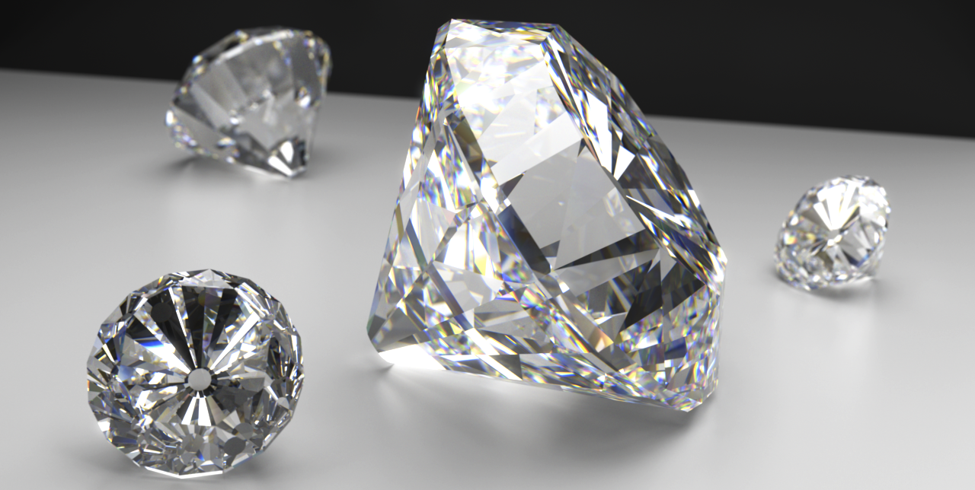
Quality Challenges

Slide 40
The Search Quality Pipeline
spellcheck
query tagging
vertical intent
query expansion
New document
Features
Machine learning model
New document
Features
Ordered list
Machine learning model
Ordered list
New document
Features
score
Ordered list
Machine learning model
score
score

Slide 41
Spellcheck
PEOPLE NAMES
COMPANIES
TITLES
PAST QUERIES
n-grams
marissa => ma ar ri is ss sa
metaphone
mark/marc => MRK
co-occurrence counts
marissa:mayer = 1000
marisa meyer yahoo
marissa
marisa
meyer
mayer
yahoo

Slide 42
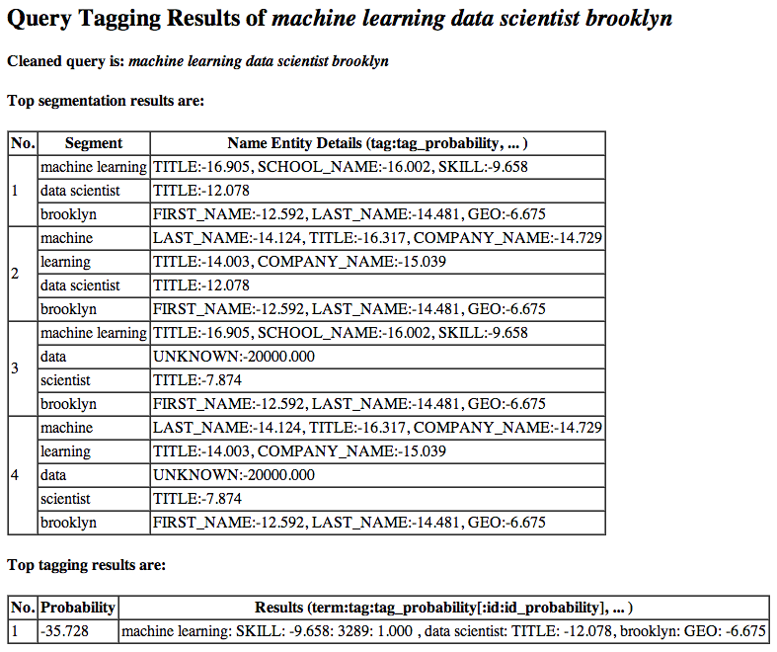
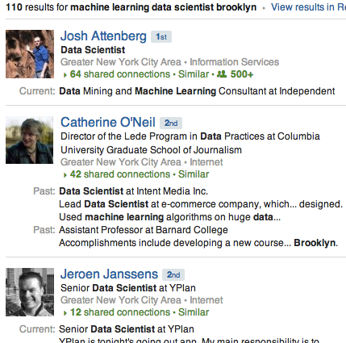
Query Tagging
machine learning data scientist brooklyn

Slide 43
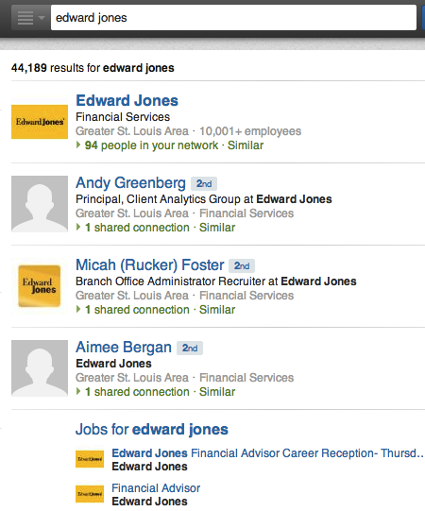
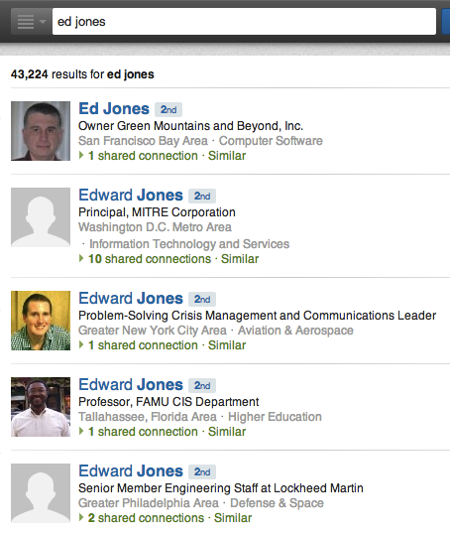
Vertical Intent: Results Blending
[company]
[name search]
[employees]
[jobs]

Slide 44
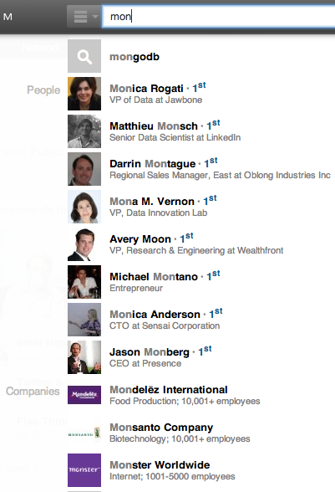
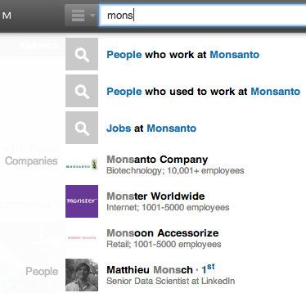
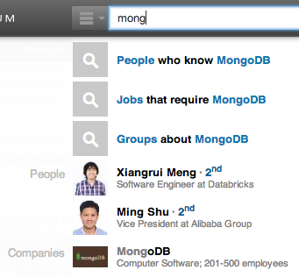
Vertical Intent: Typeahead
P(monsanto | mons): 50%
P(mongodb | mong): 80%
P(mongodb | mon) = 5%

Slide 45
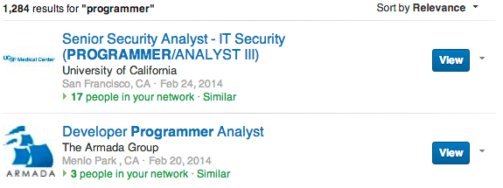
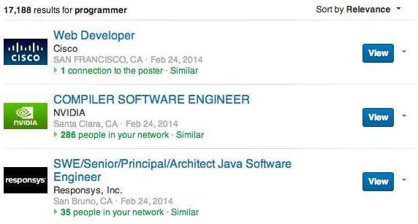
Query Expansion

Slide 46
Ranking
New document
Features
Machine learning model
New document
Features
Ordered list
Machine learning model
Ordered list
New document
Features
score
Ordered list
Machine learning model
score
score

Slide 47
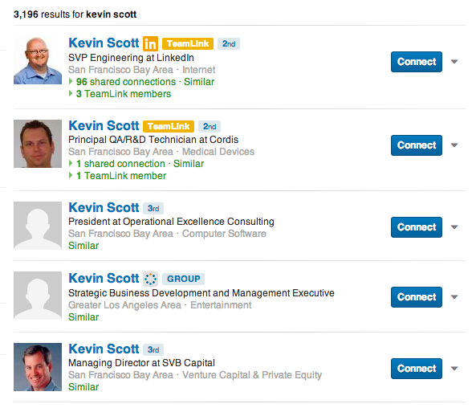
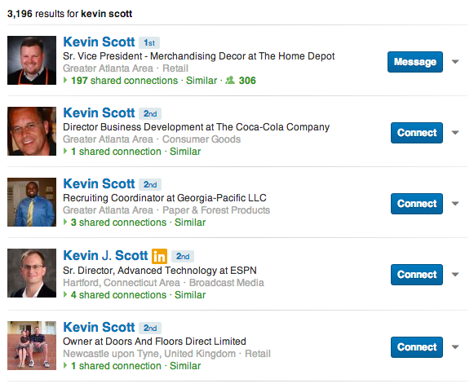
Ranking is highly personalized.
kevin scott

Slide 48
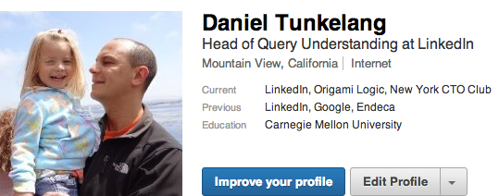
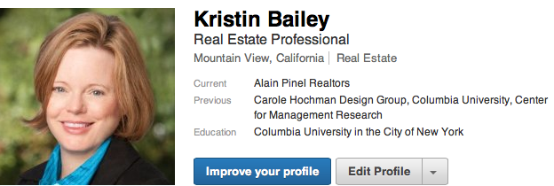
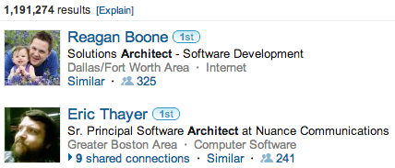
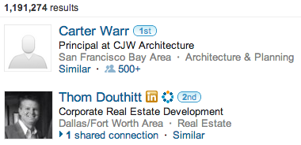
Not just for name search.

Slide 49
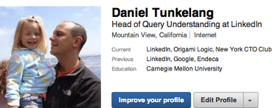
Relevance Model
Features
Machine learning model
keywords
document

Slide 50
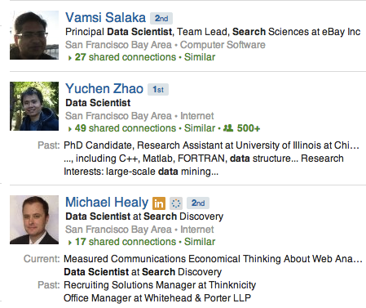
Examples of Features
Search keywords matching title = 3
Searcher location = Result location
Searcher network distance to result = 2
…

Slide 51
Model Training: Traditional Approach
Documents for training
Features
Machine learning model
Human evaluation
Labels

Slide 52
Model Training: LinkedIn’s Approach
Documents for training
Features
Machine learning model
Human evaluation
Search logs
Labels

Slide 53
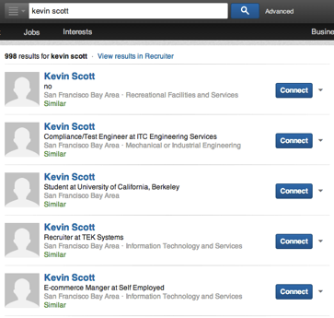
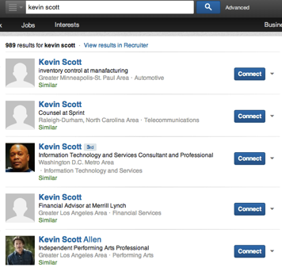
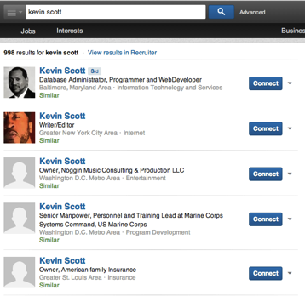
Fair Pairs and Easy Negatives
Flipped
Sample negatives from bottom results
But watch out for variable length result sets.
Compromise, e.g., sample from page 10.
[Radlinski and Joachims, 2006]

Slide 54
Model Selection
Select model based on user and query features.
e.g., person name queries, recruiters making skills queries
Resulting model is a tree with logistic regression leaves.
Only one regression model evaluated for each document.
X₂=?
X₂=0
X₂=1
X₁₀< 0.1234 ?
Yes
No

Slide 55
Summary
What is LinkedIn search and why should you care?
LinkedIn search enables the participants in the economic graph to find and be found.
What are our systems challenges?
Indexing rich, structured content; retrieving using global and social factors; real-time updates.
What are our relevance challenges?
Query understanding, personalized machine-learned ranking models.

Slide 56
Asif Makhani Daniel Tunkelang
amakhani@linkedin.com dtunkelang@linkedin.com
https://linkedin.com/in/asifmakhani https://linkedin.com/in/dtunkelang

