Slide 1
Personal Agility
SDC 2013
March 2013
The human dynamics of high performance teams

Slide 2
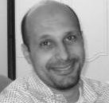
Amr
Elssamadisy
ThoughtWorks
Agile adoption experience with teams and organizations from a 3-man team to a 1200-person department distributed across 12 time-zones.
Notes:
Raphaël
I have worked on software devloment tools for 6 years.
Moved to project and program management
Switching to Agile program management and Agile adoption for 2 years

Slide 3
Our Task
What is the biggest part of software development?
How do we work together in Agile teams?
What blocks us from writing great software together?
Putting it all together: Personal Agility
Further Reading.

Slide 4
Success with Agile
Results are significant.
Quality improved.
Feedback cycle short and visible.
Speed of development increases.
Ability to respond to change is increased.
Improvements are very significant.
If you need to measure, you are not getting the improvements that high performance teams deliver.
Tom Demarco recanted “you can’t control what you can’t measure”.

Slide 5
Exercise: What if…. ?

Slide 6
Learning is the bottleneck

Slide 7
How can you break the learning cycle?
Cycle time?
Clear (testable) goal?
Taking time to learn?
What else?

Slide 8
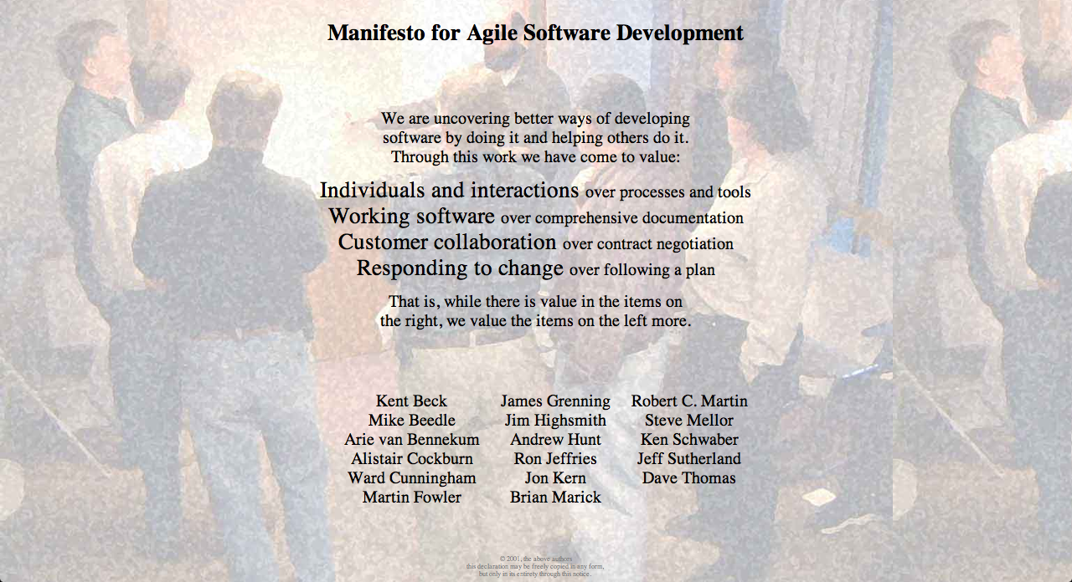
Individuals and interactions
over processes and tools
Agile Manifesto
Notes:
FIRST ITEM - INDIVIDUAL - EXAMPLE
I’m sure most of you already read the Agile Manifesto.
Do you remember what is the first item of this manifesto?
Here it is : Individuals and interactions over processes and tools.
I have been involed for year in defining, designing, implemeting a full software development set of tools and when I read this for the first time it has been difficult.
Before going to that topic I would like to share with you an experience which might also resonate to some of you.

Slide 9
Basic Building Blocks
Individual
Self-organizing team
Co-operating groups of self organizing teams

Slide 10
Invisible impediments
Ownership
Way of being
Trust – 2 types
Confronting

Slide 11
Exercise: Remember Individual Frustrations

Slide 12
The Responsibility Process
Responsibility
Obligation
Quit
Shame
Justify
Lay Blame
Denial
www.ChristopherAvery.com
Notes:
NOT A CHARACTER TRAIT - MENTAL PROCESS - SELF APPLIED - SUCESSFULL TEAMS / RESPONSIBLE MEMBERS - USEFULL TO PUT ACTION IN PERSPECTIVE
Those two examples illustrate the Responsibility Process described by Christopher Avery.
His conclusion is that responsibility is not just a character trait. It is a mental process.
Every one we can practice and decide to go up to the responsibility level.
Obviously this can only be self-applied.
From my own experience after having presented this model we used it a lot to comment on reactions setting them in the responsibility process levels.
Not everybody have changed but a lot of people are reconsidering their answer when it is put in perspective with this model.
We observed that succesful teams have responsible team members, and this is one pillar of Agile adoption, but it is only one.

Slide 13
From Dependency to Partnership
Team A (UI)
Team B (DB)
Team B is late
What will Team A do if Team B prevents them from delivering the product on time?
Blame ➔ Justify ➔ Ownership
Notes:
A / B - B Late - A BLAME - A JUSTIFY - COMMON - AGILE > OWNERSHIP > COLLABORATE - AMR?
When a team A is dependent on a team B to deliver a software piece, if team B is delivering late, team A will try to see how to help instead of blaming team B or justify their own delay.
It pushes a partnership model in place of a dependency model.

Slide 14
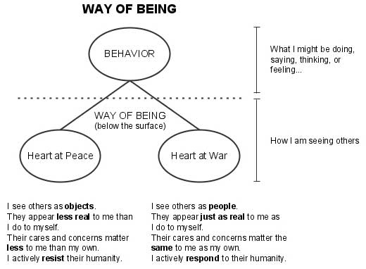
Way of Being

Slide 15
Way of Being
Heart at Peace (Sincere, Respectful) | Heart at War (Insincere, Disrespectful)
I see others as people | I see others as objects
They appear just as real to me as myself | They appear less real to me than I do myself
Their cares and concerns matter the same as my own | Their cares and concerns matter less to me than my own
I actively respond to their humanity | I actively resist their humanity

Slide 16
Trust and Agreements
Trust that you will do/deliver on what you say.
Agreements are key.
Handle you agreements miss.
Confront others’ missed agreements
Vulnerability based trust (safety)

Slide 17
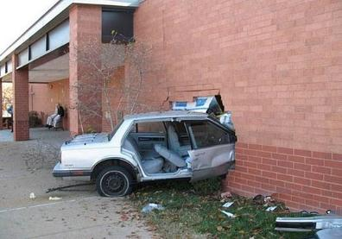
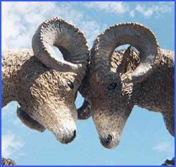
Confronting
Agile methods expose problems quickly.

Slide 18
making and keeping agreements
self organizing teams
ownership
building trust
types of trust
confront
Notes:
A FEW OTHERS - INDIVIDUAL DECISION - EXAMPLE ( TDD MANAGER)
We could mention some others and the list in not complete.
The interesting thing is that they all come from an individual decision to apply them and this is why we are calling it personal agility.
But again it is not enough for a sucessful agile adoption.
An example we faced is a dev team who discussed with our coaching team.
They decide to apply the Test Driven Development practice.
Everybody in the team agreed but the N+2 manager challenged the estimates to implement the features and obliged to team to spend less time writing the tests.
As you can imagine it has been a failure.
This illustrates that in adition to practices and individual behaviors the environment need to be ready for a successful agile adoption.
_____________
Another one to explain?
Building trust
…
Confront
Main idea is that we can not build a strong relationship if people simulate an agreement.
Then when we disagree it is important to confront ideas.
How to push it?
Voting process
Thumb Up: I’m 100% behind you
Thumb side ways: I’m not sure but I accept to follow you anyway and make my best to suceed with you
Thumb down: I disagree AND I have a counter proposal that can open a discussion until everybody is thumb Up or Sideways

Slide 19
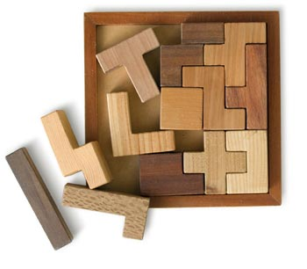
Putting all together

Slide 20
Personal Agility

Slide 21
Questions

Slide 22
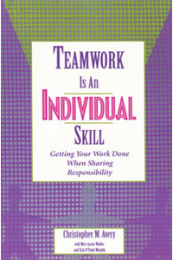
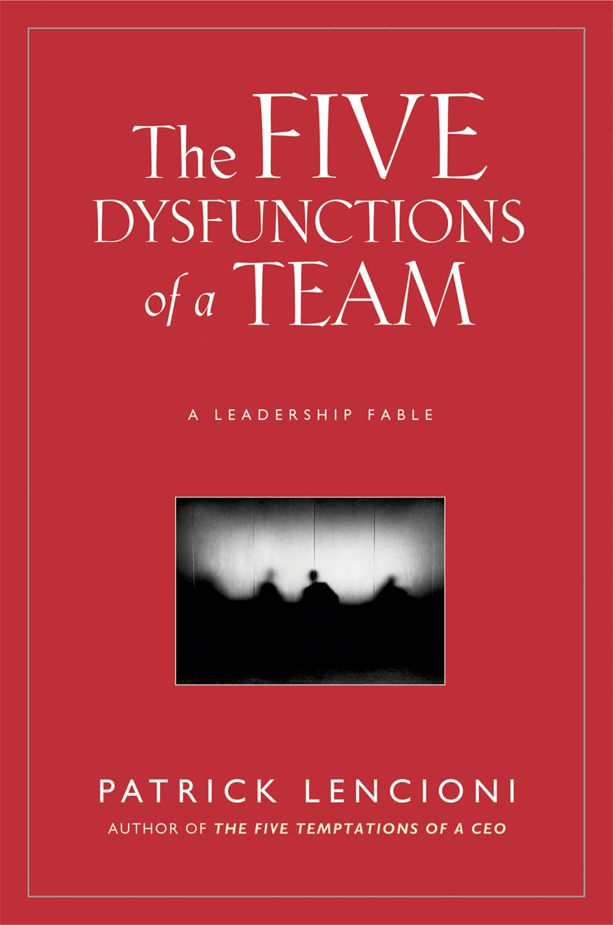
Further Reading
 | Several articles in this shared directory. |  | Agile Adoption Patterns  Elssamadisy.
 | Teamwork is an Individual Skill  Avery |  | Anatomy of Peace  Arbinger Institute
 | Crucial Conversations  Patterson. |  | Five Dysfunctions of a Team  Lencioni

Slide 23
Contact Information
amr.e@thoughtworks.com

