Slide 1
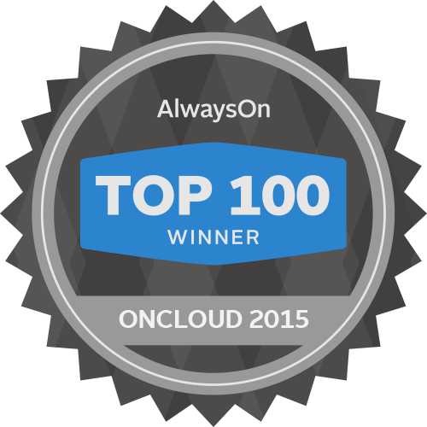
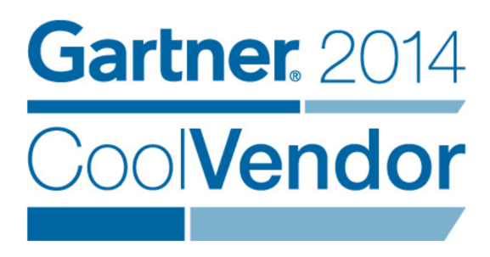
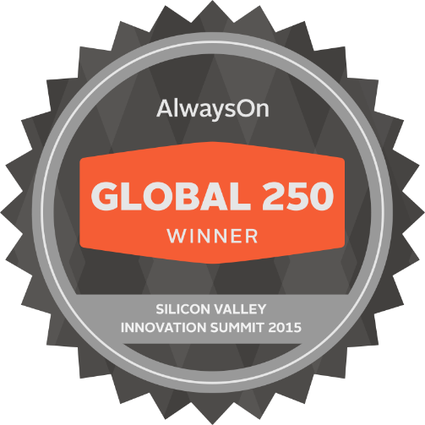
Ignite in Sberbank:
In-Memory Data Fabric for
Financial Services
Dmitriy Setrakyan
Committer & PMC, Apache Ignite
Founder and Chief Product Officer, GridGain
www.gridgain.com
#gridgain or #dsetrakyan

Slide 2
Agenda
Ignite In-Memory Data Fabric
Data Consistency
Query Capabilities
Compute Capabilities
Aggressive SLAs
Financial Services Use Cases
Sberbank Use Case
Big Data & Fast Data
Disk & Memory
Converged Data Platform
Q & A

Slide 3
Apache Ignite: We Are Hiring!
Very Active Community
Great Way to Learn Distributed Computing
How To Contribute:
https://ignite.apache.org/community/contribute.html#contribute
https://cwiki.apache.org/confluence/display/IGNITE/How+to+Contribute
Notes:
Direct API for Fork/Join

Slide 4
In-Memory Data Fabric:
Strategic Approach to IMC
Supports Applications of various types and languages
Open Source – Apache 2.0
Simple Java APIs
1 JAR Dependency
High Performance & Scale
Automatic Fault Tolerance
Management/Monitoring
Runs on Commodity Hardware
Supports existing & new data sources
No need to rip & replace

Slide 5
In-Memory Data Fabric: More Than Data Grid

Slide 6
Use Case: Financial Services
High Performance and Throughput
Low Latencies
Multiple Ways to Talk to Data
Strong Data Consistency
ACID Transactions
Collocation of Compute & Data
Strong Querying Capabilities
Aggressive SLAs

Slide 7
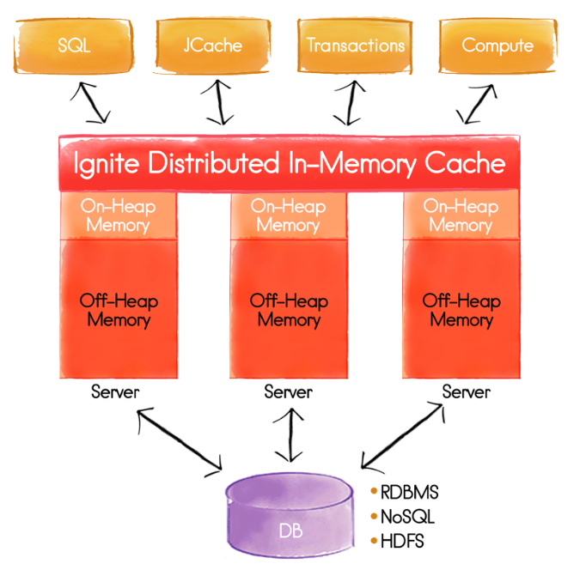
Apache Ignite Data Grid
Need to Move Money on top of Data Grid
Fault Tolerance and Scale
ACID Transactions
ANSI-99 SQL Querying
Integration with RDBMS
No Need to Replace the Database
Read-Through and Write-Through
Write-From DB
Deadlock Management
Deadlock-Free Transactions
Deadlock Detection

Slide 8
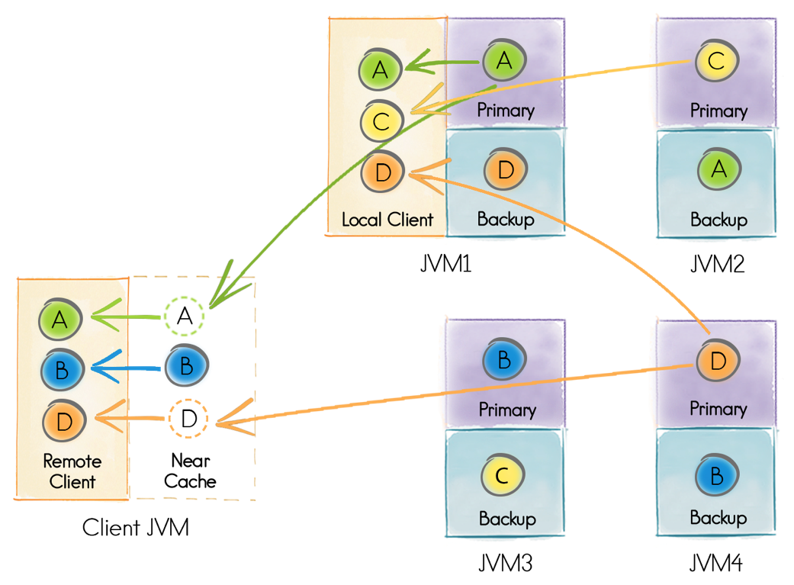
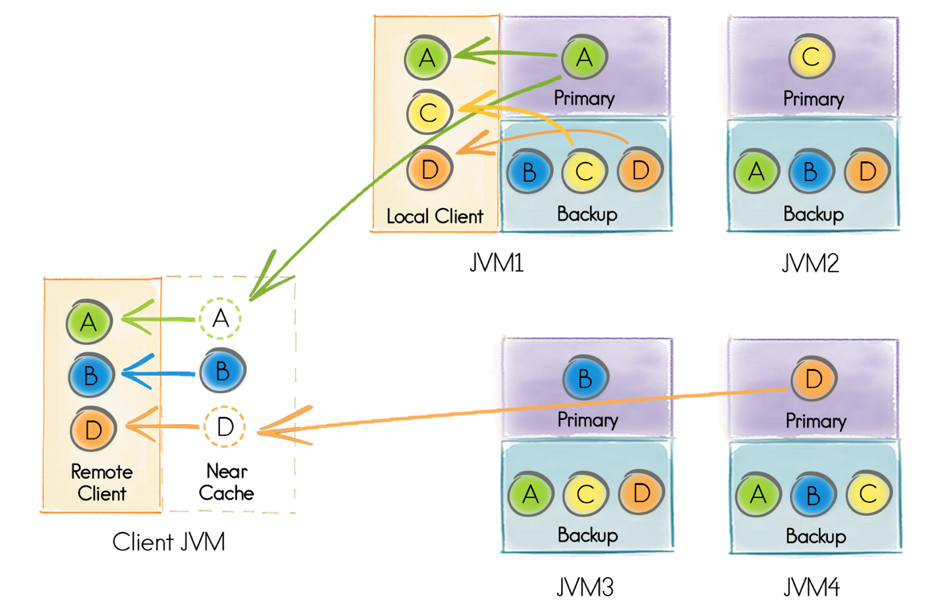
Data Grid: Distributed Caching
Partitioned Cache
Replicated Cache

Slide 9
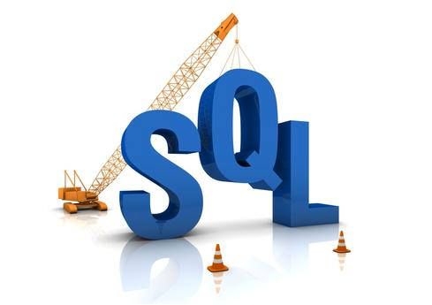
Data Grid: Query Capabilities
ANSI-99 SQL
ODBC & JDBC Drivers
Always Consistent
Fault Tolerant
In-Memory Indexes (On-Heap and Off-Heap)
Automatic Group By, Aggregations, Sorting
Cross-Cache Joins, Unions, etc.
Ad-Hoc SQL Support
Collocated and Non-Collocated Joins

Slide 10
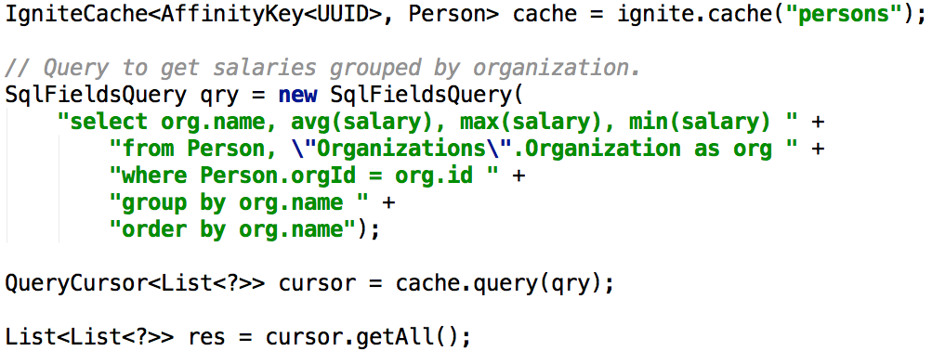
SQL Cross-Cache GROUP BY Example

Slide 11
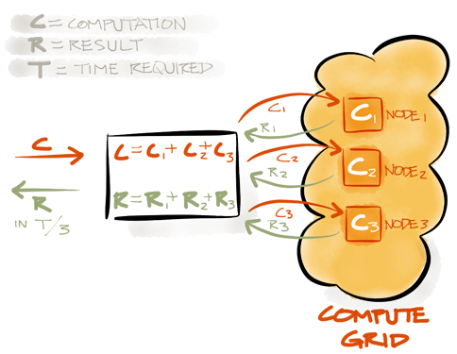
Compute Grid: Collocate Compute & Data
Collocate Compute & Data
Direct API for ForkJoin
Distributed Closures
Execute Logic on the Cluster
Zero Deployment
Custom Cluster Groups
Load Balancing
Automatic Failover
Notes:
Direct API for Fork/Join

Slide 12
Apache Ignite for BI and Analytics

Slide 13
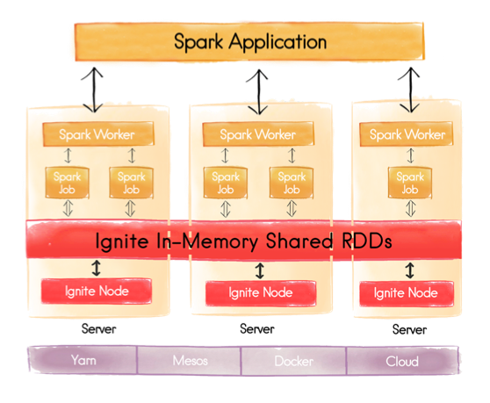
Share RDDs Across Spark Jobs
IgniteRDD Deployment Modes
Share RDD across tasks on the host
Share RDD across tasks in the application
Share RDD globally
Embedded vs External Deployments
Faster SQL
In-Memory Indexes
SQL on top of Shared RDD
Notes:
Direct API for Fork/Join

Slide 14
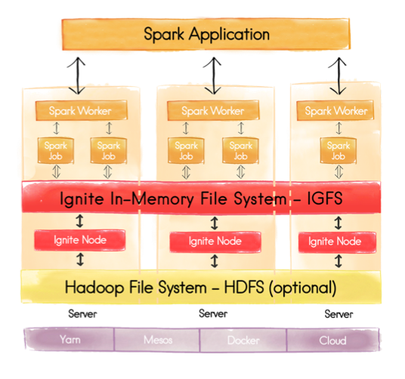
Ignite In-Memory File System
Ignite In-Memory File System (IGFS)
Hadoop-compliant
Easy to Install
On-Heap and Off-Heap
Caching Layer for HDFS
Write-through and Read-through HDFS
Performance Boost
Notes:
Direct API for Fork/Join

Slide 15
Sberbank Use Case

Slide 16
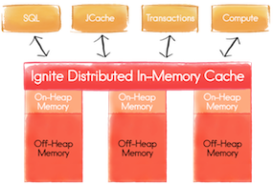
Use Case:
Largest bank in Russia and Eastern Europe, and the third largest in Europe
Sberbank Requirements
Migrate to data grid architecture
Move to open source
Scale & Collocation
Distributed SQL & ACID Transactions
Multiple Ways to Talk to Data
Less 5 min data center restarts
Why Apache Ignite
More than a Data Grid
Best performance
10+ competitors evaluated
Fault tolerance & scalability
ANSI-99 SQL Support
Transactional consistency
Jointly Developing
Disk-Only Data Sets
Query Disk & Memory Together
GridGain
Security
Deposit
Withdrawal
Statement
Deposit
Withdrawal
Statement
130 Million Customers
Disk Store
Disk Store
Disk Store
1000+ Servers

Slide 17
Fast Data vs Big Data
Fast Data
OLTP mostly
Smaller Operational Data Set
High Throughput (ops/sec)
Low Latencies
Consistent or Transactional
Big Data
OLAP mostly
Larger Historical Data Set
Read-Mostly
Throughput Not Important
Low Query Latencies
Good-enough for interactive analytics
Notes:
Direct API for Fork/Join

Slide 18
How To Bridge The Gap?
Fast Data
Add Disk-Only Data Sets
Add Disk-Only Processing
Big Data
Add Shared Memory Store
Add Transactions
Notes:
Direct API for Fork/Join

Slide 19
What is a Converged Data Platform?
Fast Data + Big Data
Distributed and Scalable
Real Time Data-To-Action
Hybrid Transactional and Analytical Processing (HTAP)
Combine RAM and SSD/Flash
No ETL
Fast Data in Memory
Big Data on Disk
Query Historical and Analytical Data
Transactions on Historical and Analytical Data
Notes:
Direct API for Fork/Join

Slide 20
Lambda Architecture: Fast Data + Big Data
Fast Data + Big Data
Converged Data Platform
Lambda Architecture
Transactions + Analytics (HTAP)
Distributed and Scalable
Fast Data in Memory
Big Data On Disk
Query Historical and Analytical Data
Transactions on Historical and Analytical Data
Aggressive SLAs
Full Cluster Restart in Under 5 mins
Notes:
Direct API for Fork/Join

Slide 21
Ignite 2.0 – Path to Converged Data Platform
More SQL
Non-Collocated Joins
Data Modification Language (DML)
Dada Definition Language (DDL)
More Disk
Disk-only Data Sets
Query Across Disk & Memory
Backups & Snapshots
Instantaneous Restarts
Notes:
Direct API for Fork/Join

Slide 22
ANY Questions?
Thank you for joining us. Follow the conversation.
ignite.apache.org
www.gridgain.com
#dsetrakyan
#gridgain

