Slide 1
Apache Beam: The Case for Unifying Streaming API's
Andrew Psaltis
HDF / IoT Product Solution Architect
@itmdata June 13, 2016

Slide 2
Today if a byte of data was 1 gallon of water we could fill an average house in 10 seconds, by 2020 it will take only 2.
Notes:
The message here is we are drowning or about to be drowning in a see of data. Look at all of the talks today and throughout this conference that are about streaming or IoT.
TI Smart Tag - 10 low-power sensors, including light, microphone and magnetic sensors
IR Temp
Ambient Temp
Humidity
Barometer
Accelerometer
Magnetometer
Gyroscope
Lit Sensor
RSSI

Slide 3
< 1% of the data being generated by the 30,000 sensors on an offshore oil rig is currently used
SOURCE: McKinsey Global Institute analysis
Notes:
for real-time control or anomaly detection;
more can be used for optimization and prediction
Let’s take a look at how we are trying to solve these problems today.

Slide 4
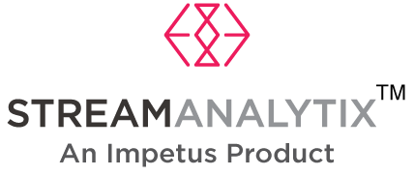
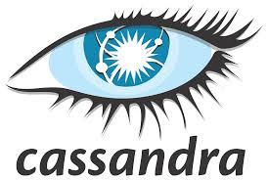
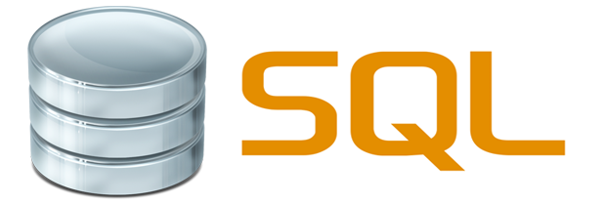
Simplified Current Architecture
Your Big Data
Application
Notes:
Processing engines at the bottom – for sure I have left off many, this is just a representative few that you may work with.
Then on-top of that we have various applications. This layer has your custom “Big Data” application, applications like Apache Zeppelin, or Tableau for reporting, or perhaps StreamAnalytix.
For sure there is a lot more involved then this simplified diagram shows – but at the 50K foot view this is how things are built today – we have data storage / processing technologies at the bottom and then we put applications (our own or 3rd party on top of them).
Now let’s look a little bit closer at the storage / processing layer, with our focus just on the streaming related technologies.

Slide 5
Distributed Streaming Processing Engine
API Soup
Quarks | Gearpump | Concord | Heron | Pulsar | Spark | SQLStream | EsperTech | Google Cloud | S4 | Flink |DataFlow | Storm | Samza | Impetus |Kafka Streams
Apache Apex |Storm | Amazon Kinesis | MemSQL | Bottlenose Nerve Center | Striim | Azure Stream Analytics | Informatica | Oracle Stream Analytics |
WS02 Complex Event Processor | IBM InfoSphere Streams | Cisco Connected Streaming Analytics | SAS Event Stream Processing | WS02 Complex Event Processor | TIBCO StreamBase | Software AG Apama Streaming Analytics | MongoDB | Ignite | XAP
Notes:
The previous slide only had a handful of the dspe’s, but in reality there are more –
<animate> here are some
<animate> and there are more
<animate> and still more, and at the pace that new ones come out, there may be another one that was just released.
Even with this assortment, I am sure there may be some that I missed.
What does this all give us though? A big bowl of soup with each of these having their own API.
Ask audience: Do you build API’s for your services? How many build REST API’s? How many build proprietary APIs?
Looking at all of these DSPE’s we are creating Vendor Lock In. Each one of these has s different API, each team working on these spends countless hours developing their API and developers using these API’s spend more time learning them and the concepts.
Discuss Energy company situation --- spoke with an IT manager at a mid-west energy company – they are used to processing data 1x a month in a nice fixed structure that get’s loaded into their DW. Now they are going to be deploying smart meters. The commercial customer will send readings every 5 minutes (~8500 msg/month) and the residential customers every 15 min (~3000 msg/month). The data will be for the entire house, no longer a fixed record format. She was at a loss for what to do and in know way could hire Spark developers

Slide 6
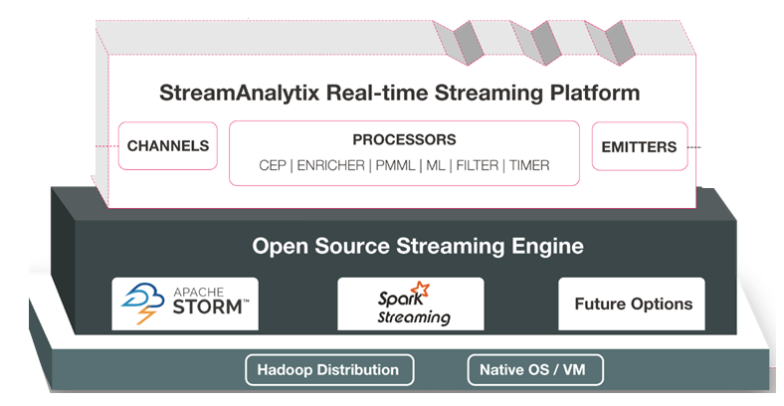
What if we wanted to add support for
Apache Apex?
Notes:
This is a partial representation of the StreamAnalytix product offering – to the left is their data ingestion and above the platform are various UI’s from devops to Business Analyst, and the ability to build custom UI’s.
This is the type of tool that our friend at the energy company is going to need. But what if you worked on the Open Source Streaming Engine part of this platform, what do you think life would be like if you needed to add Apache Apex or any of the other 25+ engines out there to this?

Slide 7
Notes:
This is what the developers would be doing after being asked to add Apache Apex and other engines to the StreamAnalytix platform. Not only is this very expensive for the company, but it is very fragile and unsustainable!
The only way we can get to a place as a community where we can support these type tool vendors, application developers building their own amazing technology, and business users is with a common API and common way to think about these systems. That common way IS APACHE BEAM!. If we adopt this idea, get rid of the API vendor lock-in and develop an open market for data processing engines, there will be plenty of room left for innovation and differentiation. Instead of focusing on market dominance via API lock-in, engines can compete in areas such as performance, latency, scalability, ease-of-operational-maintenance, automatic tuning, etc. Overall this will be a very good thing for the industry as a whole.
Now let’s look closer at Apache Beam and how it will enable us to reach these goals.

Slide 8
The Evolution of Apache Beam
Colossus
BigTable
PubSub
Dremel
Google Cloud Dataflow
Spanner
Megastore
Millwheel
Flume
Apache Beam
MapReduce
Slide by Frances Perry & Tyler Akidau, April 2016
Notes:
Google published the original paper on MapReduce in 2004, which fundamentally change the way we do distributed processing. This paper described a generalized solution for specifying logic that runs in parallel across multiple machines while shielding the author from dealing with low level details like moving data between machines and handling fault tolerance.
<animate> At this point, things diverge a little bit. Inside Google, engineers kept innovating but within a relatively homogeneous environment. In this environment there were limited file formats to deal with, only a handful of languages, and standardized tooling. This meant Googlers were able to focus on refining the core methodology. Google continued to publish papers about these new ideas -- which meant non-Googlers got lots of pdfs to read, but not much concrete to play with.
<animate> Outside Google, the open source community created it’s own MapReduce implementation in Hadoop. An entire data processing ecosystem developed, and occasionally some of this was influenced by those Google papers.
<animate> In 2014, Google announced Google Cloud Dataflow, which was based on technology that evolved from MapReduce, but included newer ideas like FlumeJava’s improved abstractions and Millwheel’s focus on streaming and realtime execution. Google Cloud Dataflow included both a new programming model for writing both batch and streaming data processing pipelines, as well as a fully managed service for executing them.
<animate> In January 2016, Google, along with a handful of partners donated this programming model to the Apache Software Foundation, as the incubating project Apache Beam.

Slide 9
The Apache Beam Vision
End users: who want to write pipelines in a language that’s familiar.
SDK writers: who want to make Beam concepts available in new languages.
Runner writers: who have a distributed processing environment and want to support Beam pipelines
Beam Java
Other
Languages
Beam Python
Beam Model: Pipeline Construction
Local
Apache Flink
Cloud Dataflow
Apache Spark
Beam Model: Fn Runners
Execution
Execution
Execution
Slide by Frances Perry & Tyler Akidau, April 2016
Notes:
Now that we understand the evolution of Beam, lets discuss the vision.
The goal in Beam is to fully support three different categories of users.
End users who are just interested in writing data processing pipelines. They want to use the language that they want to use and choose the runtime that works for them, whether it’s on premise, on a hand-tuned cloud cluster, or on a fully managed service. A a unified programming model for expressing batch and streaming use cases makes this possible
But, we have more differentiators here!
We want to support SDK writers too. This allows others in the open source community to create Beam SDKs in other languages or even narrower domain-specific extensions or DSLs. If you are an developing a new project that exposes APIs, you can consider connecting it with Beam. You will automatically get Beam’s ability to run on many different backends, not just your own. Today there is a JAVA SDK that was developed as part of the Cloud Dataflow, others, including Python will follow.
Finally, we want to support runner writers. If you are an Apache project that has a distributed processing backend, you can consider writing a Beam runner for it. All the variety of Beam SDKs can then run on your backend.
Today there is support for:
Apache Flink (thanks to data Artisans)
Apache Spark (thanks to Cloudera and PayPal)
Google Cloud Dataflow (fully managed service)
Local runner for testing
As you may see here one of key differentiators – the goal is not to provide yet another processing backend; put to have the portability to run on many existing processing backends.
Now instead of having our API soup and vendor-lockin we have a single API to learn – in essence this becomes the JDBC for processing engines!

Slide 10
The Beam Model: Asking the Right Questions
What results are calculated?
Where in event time are results calculated?
When in processing time are results materialized?
How do refinements of results relate?
Slide by Frances Perry & Tyler Akidau, April 2016
Notes:
What makes the Beam model special?
It uses higher level abstractions that let you focus on your application logic -- not how to cram your application logic into an underlying framework.
And it unifies batch and streaming into the same API by clearly separating 4 key questions...
What results are calculated? Are you computing sums, joins, histograms, or machine learning models?
Where in event time are results calculated? How does the time each event originally occurred affect results? Are results aggregated for all time, in fixed windows, or as user activity sessions?
When in processing time are results materialized? Does the time each element arrives in the system affect results? How do we know when to emit a result?
And finally, how do refinements relate? If we choose to emit results multiple times, is each result independent and distinct, do they build upon one another?

Slide 11
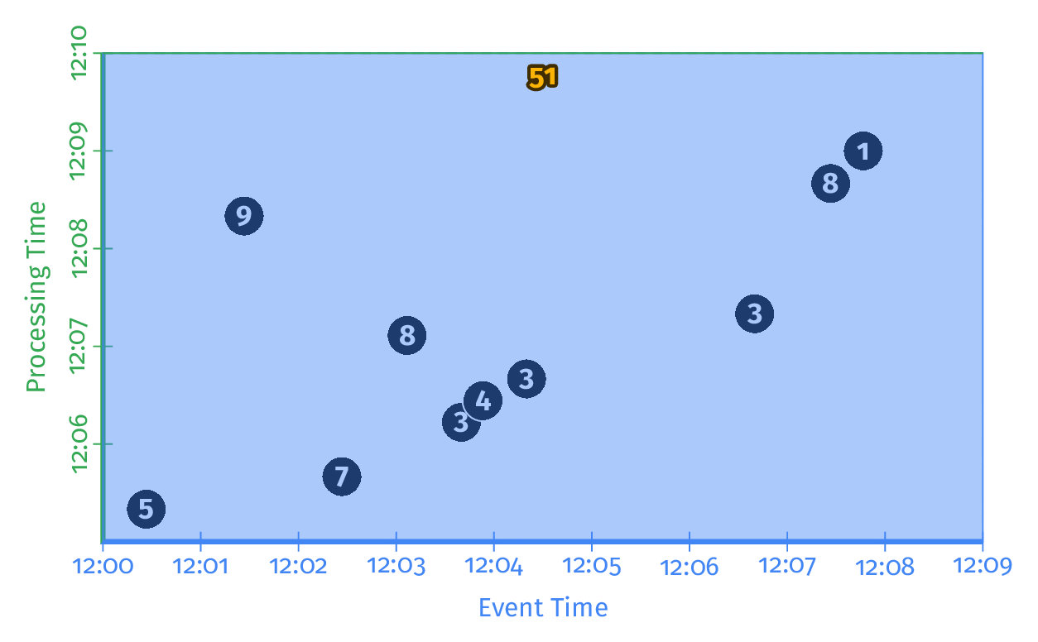
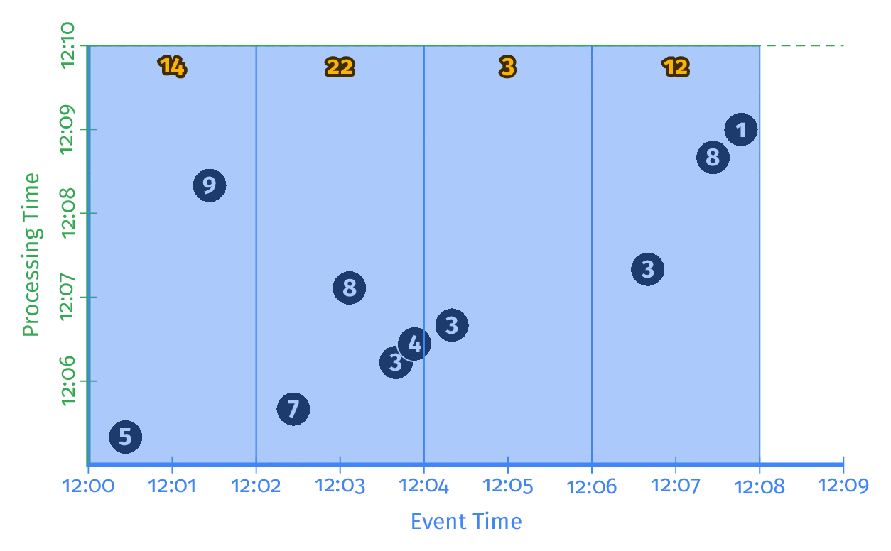
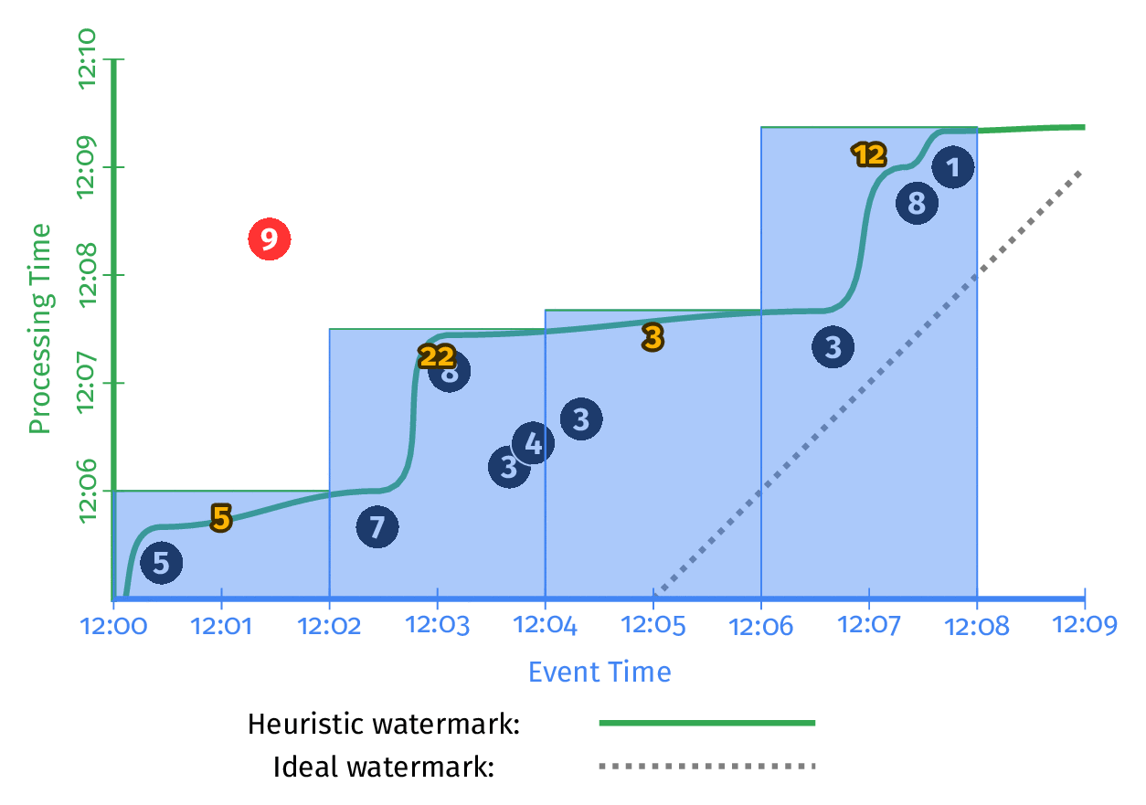
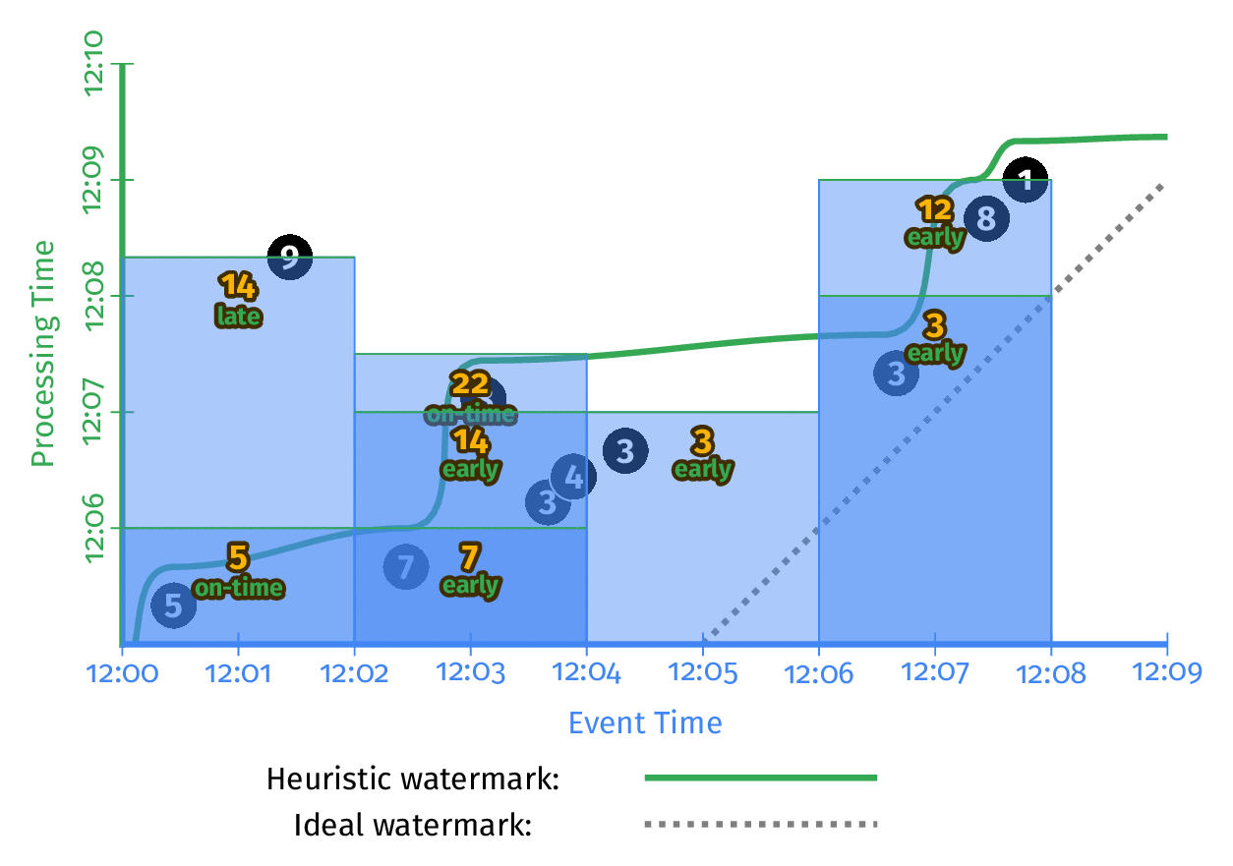
Customizing What Where When How
3
Streaming
1
Classic
Batch
2
Windowed
Batch
4
Streaming + Accumulation
Slide by Frances Perry & Tyler Akidau, April 2016
Notes:
By clearly separating What / Where / When / How considerations, the original authors were able to come up with clean abstractions that don’t leak implementation details to the users.
As a result, we have the first truly unified model, which can easily support different scenarios, like: classic batch, windowed batch, standard streaming, or advanced streaming scenarios, just one of which is streaming in the accumulation mode.
By tweaking a line here or there, we can trivially switch between these scenarios, without rewriting the code.
Just like the MapReduce model fundamentally changed the way we do distributed processing by providing the right set of abstractions, we think that this model will change the way we unify batch and streaming processing in the future.
The next question is – Great, I need to learn one more model, I was just getting comfortable with Spark or Storm or Flink or Pick your favorite. Don’t worry, as this unfolds you will see that it is not that bad and it is the last model you will have to learn.

Slide 12
PCollection
Represents a collection of data, which could be bounded or unbounded in size.
Notes:
a PCollection as "pipeline" data. Dataflow's transforms use PCollections as inputs and outputs; as such, if you want to work with data in your pipeline, it must be in the form of a PCollection. Each PCollection is owned by a specific Pipeline object, and only that Pipeline object can use it.
A PCollection has several key aspects in which it differs from a regular collection class:
Immutable. Once created, you cannot add, remove, or change individual elements.
Does not support random access to individual elements.
Belongs to the pipeline in which it is created. You cannot share a PCollection between Pipeline objects.

Slide 13
PTransform
PTransform: represents a computation that transforms input PCollections into output PCollections.
Notes:
In this example we are using TextIO.Read to read a set of input text files. TextIO.Read returns a PCollection where each element is one line from
the input text (a set of Shakespeare's texts).

Slide 14
Pipeline
Pipeline: manages a directed acyclic graph of PTransforms and PCollections that is ready for execution.

Slide 15
PipelineRunner
PipelineRunner: specifies where and how the pipeline should execute.

Slide 16
Word Count using GearPump
Notes:
In this example we are going to use GearPump to do a word count
First we setup a Processor to handle the splitting of the words in the text. In this case we are gong to set the parallelism to a two
The split class looks like the following:

Slide 17
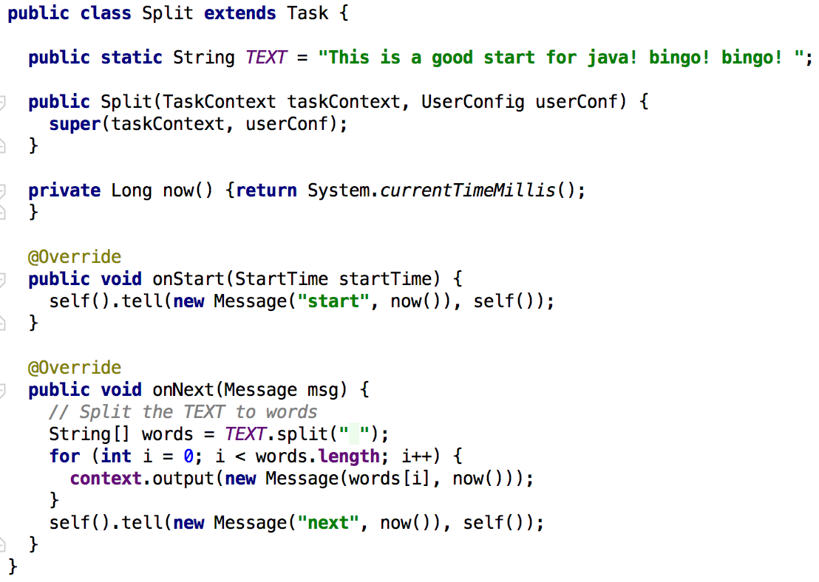
Notes:
Here we are defining the text and then in the onNext method we are splitting the text and emitting a message for each word.

Slide 18
Notes:
Next we are going to setup the Processor that will take care of summing the words.

Slide 19
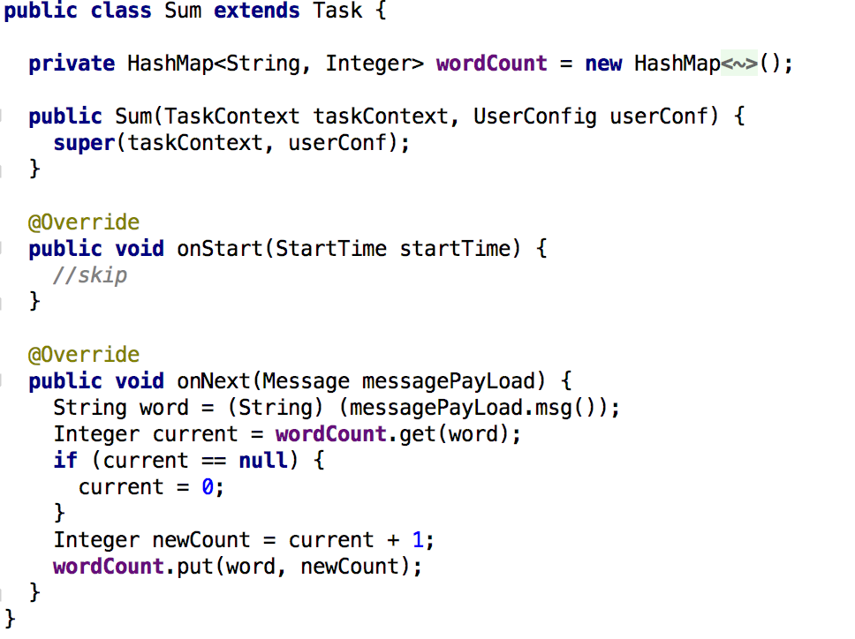
Notes:
Here in the onNext we are incrementing a counter for each unique word that is seen.

Slide 20
Notes:
With the split and sum setup, we now proceed to setup the graph, not surprising, just like many of the frameworks in this space there is a DAG used for setting up the flow.
After the graph is set, we create a streamapplication, passing it in the configuration.
Then finally we are ready to submit the app.
For this API, we need to think about Graphs, Processors, and Partitioners – if you have used Storm before, I think you can squint here a little and see an API that is somewhat reminiscent of that.
Now let’s do a similar word-count example, this time using Kafka Streams.

Slide 21
Word Count using Kafka Streams

Slide 22
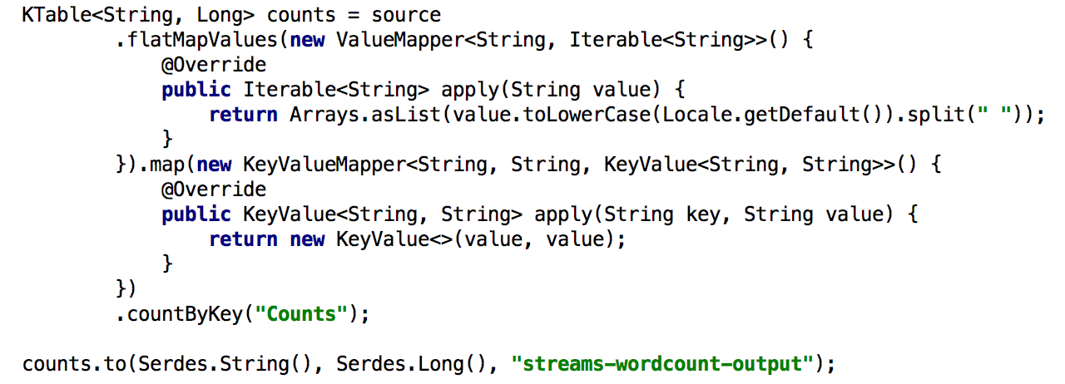
Notes:
In this example we are using Kafka Streams.
First we setup some of the basic properties
<animate>Then we cerate the builder and get access to the source object
<animate> Now in a very Spark-esque way if you have used Spark, we are now chaining together the operations we are going to perform on the data.
<animate> With the source set, we now setup an ouput operations on the resulting Ktable.
<animate> finally we now can start the streaming application
For this API, we need to think about the StreamBuilder, Ktable – this is quite a bit different from GeaPump

Slide 23
Word Count using Apache Beam

Slide 24
Notes:
<animate> Here are are appplying a root transform to the pipeline; in this case, TextIO.Read to read a set
of input text files. TextIO.Read returns a PCollection where each element is one line from the input text (a set of Shakespeare's texts).
<animate> Apply a ParDo transform to our PCollection of text lines. This ParDo invokes a DoFn (defined in-line) on each element that tokenizes the text line into individual words.
The ParDo returns a PCollection<String>, where each element is an individual word in Shakespeare's collected texts. ParDo is similar to what happens inside the "Mapper" class of a Map/Shuffle/Reduce-style algorithm
<animate>: Apply the Count transform to our PCollection of individual words. The Count transform returns a new PCollection of key/value pairs, where each key represents a unique
word in the text. The associated value is the occurrence count for that word.
<animate> Apply a MapElements transform that formats our PCollection of word counts into a printable string, suitable for writing to an output file.
<animate>: Apply a write transform, TextIO.Write, at the end of the pipeline. TextIO.Write writes the contents of a PCollection (in this case, our PCollection of
formatted strings) to a series of text files in Google Cloud Storage.

Slide 25
What if we want to change the runner for Beam?
Notes:
Outside of setting a few different options specific to the runner, which can be passed in as command line arguments that is all there is to changing the runner. The rest of the application stays the same. I think you would agree that this is a very powerful model. Let’s take a look again at the high-level architecture he had before, this time with Beam being used.

Slide 26
Simplified Future Architecture
with Beam
Your Big Data
Application
Apache Beam
Quarks | Gearpump | Concord | Heron | Pulsar | Spark | SQLStream | EsperTech | Google Cloud | S4 | Flink |DataFlow | Storm | Samza | Impetus |Kafka Streams
Apache Apex |Storm | Amazon Kinesis | MemSQL | Bottlenose Nerve Center | Striim | Azure Stream Analytics | Informatica | Oracle Stream Analytics
WS02 Complex Event Processor | IBM InfoSphere Streams | Cisco Connected Streaming Analytics | SAS Event Stream Processing | WS02 Complex Event Processor | TIBCO StreamBase | Software AG Apama Streaming Analytics | MongoDB | Ignite | XAP
Notes:
Putting Beam as the abstraction layer between all of these processing engines, just changed our world from having an alphabet soup of processing engines to a bowl with a single letter. For those of us working on products above Beam, we now get to spend our time on the value added features and products we need to build and not learning a myriad of APIs. And for those of us who work on the engines, now we can focus on the truly differentiating features and not all of the headaches related to API design.
This exact idea has recently been proven out by Twitter – they successfully switched from Storm to Heron, their new open source stream processing framework, with 0 end user (application developer) impact. Heron is 100% re-written, mostly in native code. However, they kept the Storm API and were able to completely replace the underlying engine. Using Beam we will get the same ability to switch engines with code changes that can be driven by configuration.

Slide 27
Why Apache Beam?
Unified - One model handles batch and streaming use cases.
Portable - Pipelines can be executed on multiple execution environments, avoiding lock-in.
Extensible - Supports user and community driven SDKs, Runners, transformation libraries, and IO connectors.
Slide by Frances Perry & Tyler Akidau, April 2016
Notes:
To summarize -- why Apache Beam.
It is unified. One expressive model that handles all scenarios.
Portable -- pipelines can be executed on multiple execution environments. No lock-in for any cloud provider, or any processing backend.
Extensible -- easy APIs allow more more SDKs, runners, IO connectors, transformation libraries, or domain-specific extensions.

Slide 28
Learn More!
Apache Beam (incubating) http://beam.incubator.apache.org
The World Beyond Batch 101 & 102 https://www.oreilly.com/ideas/the-world-beyond-batch-streaming-101 https://www.oreilly.com/ideas/the-world-beyond-batch-streaming-102
Why Apache Beam? A Google Perspective http://goo.gl/eWTLH1
Join the mailing lists! User discussions - user-subscribe@beam.incubator.apache.org Development discussions - dev-subscribe@beam.incubator.apache.org
Follow @ApacheBeam on Twitter
Slide by Frances Perry & Tyler Akidau, April 2016

Slide 29
The future of streaming and batch is Apache Beam. The choice of runner is up to you.
Source:
https://cloud.google.com/blog/big-data/2016/05/why-apache-beam-a-google-perspective

Slide 30
Thank You

