Slide 1
TypeScript: Scaling Up JavaScript
Jonathan Turner – Program Manager, TypeScript

Slide 2
This talk
Introduction to TypeScript
What is TypeScript?
Basic features of TypeScript
Converting a JavaScript project to TypeScript
Gradual conversion of JavaScript
Benefits of TypeScript
TypeScript in the World
TypeScript community
Adoption of TypeScript

Slide 3
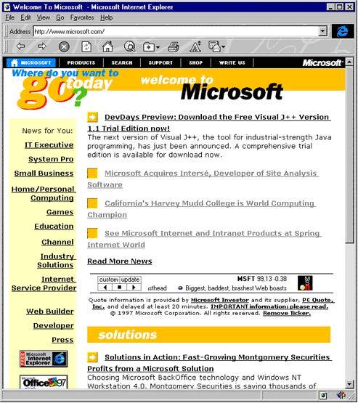
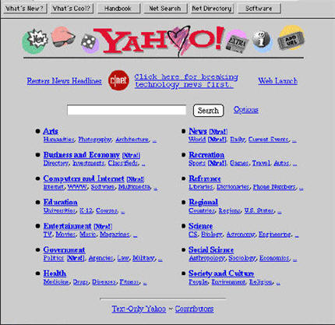
Back in the day…

Slide 4
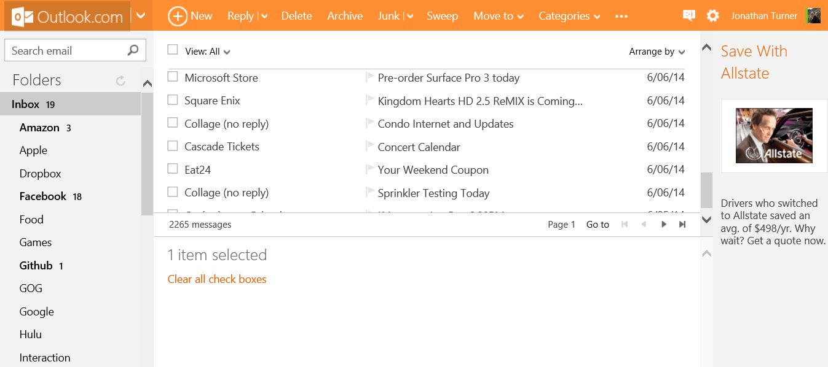
…to today

Slide 5
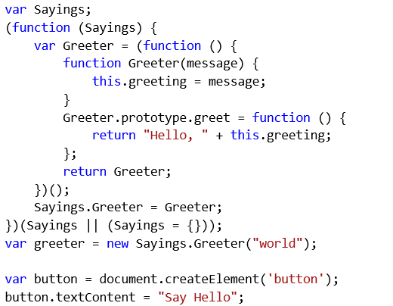
A Look at JavaScript

Slide 6
A Look at JavaScript: Dynamic Types

Slide 7
A Look at JavaScript: Constructors

Slide 8
A Look at JavaScript: IIFES

Slide 9
What is TypeScript?
TypeScript is a typed superset of JavaScript that compiles to plain JavaScript. Any browser. Any host. Any OS. Open Source.

Slide 10
TypeScript
Starts with JavaScript
All JavaScript code is TypeScript code, simply copy and paste
All JavaScript libraries work with TypeScript
Optional static types, classes, and modules
Enable scalable application development and excellent tooling
Zero cost: Static types completely disappear at run-time
Ends with JavaScript
Compiles to idiomatic JavaScript
Runs in any browser or host, on any OS

Slide 11
Demo: Basic Features of TypeScript

Slide 12
Basic Features of TypeScript
Interfaces
All JavaScript objects can be described with interfaces
Implicitly met based on shape
Classes
Allows using common OOP idioms
Compatible with future versions of JavaScript
Generics
Lightweight reusable code with no runtime overhead
Modules
Group related interfaces/classes/functions together
Move code out of the global namespace

Slide 13
Demo: Converting JavaScript to TypeScript

Slide 14
TypeScript 1.0
Compiler
Open Source, written in TypeScript.
Tooling
Officially supported in Visual Studio and integrated into Visual Studio Online via Monaco
And More
Lots of samples, TypeScript handbook, language specification

Slide 15
TypeScript Community
Community response
Over 6000 CodePlex posts, 200 forks, 2100 StackOverflow questions, 480 feature requests
Ecosystem
500+ .d.ts typings for a wide range of JavaScript libraries, including typings of DOM, jQuery, node.js, WinRT, WinJS
TypeScript support in tools
ASP.NET, node.js, WebStorm, Eclipse, Sublime, grunt, Chutzpah
Road-tested
Used by Bing, Visual Studio, Monaco, Azure, Xbox, Adobe, Palantir, SitePen, eBay Classifieds Group, and more

Slide 16
Conclusion
Large scale JavaScript development is hard. TypeScript makes it easier.

Slide 17
Questions?
http://www.typescriptlang.org
http://typescript.codeplex.com

