Slide 1
Big Data in Capital Markets
Alex Raitt
Clive Saha
June 11th 2014

Slide 2
Today’s Presentation
What are the challenges of adopting big data technologies in capital markets firms?
Emerging best practices and patterns.
What should you look out for when you actually implement a big-data solution?
What are some of the real use cases being applied today?
But first, lets level set on what we mean by big data…

Slide 3
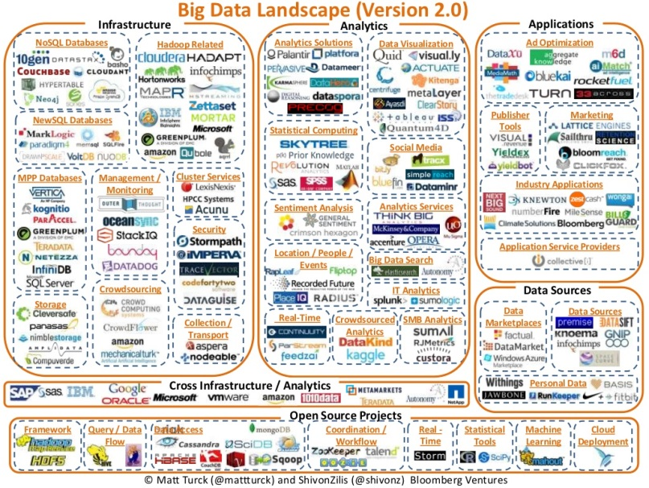
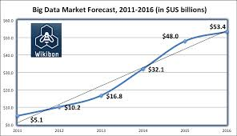
Big Data as a Technology Umbrella
Put aside the hype, and the anti-hype
The term “Big Data” has evolved into a technology umbrella
It’s about:
Data – but not just Volume, Variety and Velocity of course
adding more sophisticated analytics and tools to get the meaning from data
AND, its about:
Tackling more complicated problems!
Cool technology!
Being at the forefront of the digital revolution
(IDC) Average $8 million spend
Notes:
[Alex + Clive]
How the term ‘big data’ evolved
What its evolved into – the landscape
What that means for us – 1) not just about the size, velocity, sources etc. 2) A ‘label’ describing analytics, infrastructure and a smorgasboard of technologies. (verbally give anecdotes).

Slide 4
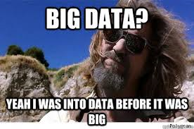
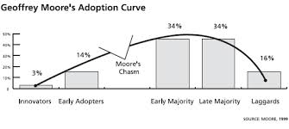
Capital Markets – So What Happened?
Big IT Budgets
Years of experience managing data
Perfect industry for rapid adoption?
Education – business and IT.
Evolution from point-solutions to big data as a part of EDM. COEs.
On the cusp of more mainstream adoption…
No ☹
Evolved from consumer businesses – many use cases not directly applicable
Capital Markets typically doesn’t have a data volume or unstructured data problem.
Large legacy technology investment – lack of technology agility.
Not run like a technology company, IT is a support function
Capital Markets Is Here…
But…
Notes:
[Alex ]
Evolved from the internet and consumer businesses –use cases are not directly imitable
CM firms don’t (with some exceptions) have a data volume problem, or large amount of unstructured data.
Typical separation of business and technology – a different structure than internet firms, makes innovation difficult when it requires all parties.
A large legacy technology investment – reduces technology agility.

Slide 5
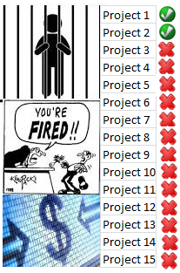
Today – Barriers To Adoption
Understanding big data fundamentals, not mimicry
Critical Mass in the Community
The control, regulation and compliance burden
Applied to the domain
Mostly structured data
Often real-time
Transactional
Auditable
Notes:
[Alex ]
We are in the cusp on exiting the adoption chasm, what’s needed is:
IT and business to educate themselves on the fundamentals – rather than imitate
Time to get past the regulatory and compliance burden
A critical mass of beneficial use cases to the industry
Yesterday, lots of buzz, and a solution looking for a problem.
Today:
Still lots of buzz! But some healthy big data fatigue.
a polarization of big data infrastructure vs analytics.
A series of point solutions, now evolving into design patterns and shared services. [anecdotes]
A realization that big data is part of a holistic enterprise data management strategy.

Slide 6
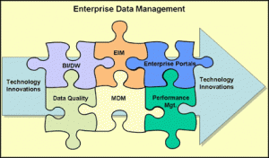
Today – Emerging Themes
Big Data!
Healthy Big Data Fatigue…
Centers of excellence, adoption evangelists.
Big data design patterns.
Infrastructure
ARGH, Tool Obsession!
Maturity – big data as part of your EDM
Solution Polarization
Notes:
[Alex ]
We are in the cusp on exiting the adoption chasm, what’s needed is:
IT and business to educate themselves on the fundamentals – rather than imitate
Time to get past the regulatory and compliance burden
A critical mass of beneficial use cases to the industry
Yesterday, lots of buzz, and a solution looking for a problem.
Today:
Still lots of buzz! But some healthy big data fatigue.
a polarization of big data infrastructure vs analytics.
A series of point solutions, now evolving into design patterns and shared services. [anecdotes]
A realization that big data is part of a holistic enterprise data management strategy.

Slide 7
Some Practices & Design Patterns
Hadoop as an ETL Tool / Data Refinery
Hadoop as a BI Tool. Or Not?
Reasons To Export:
End user app
Entitlements
Interactive response
Drill-down
But:
Need to define data needed
Not good for data exploration
Impala and others starting to erode the need to export
Ref Data
Coordinator
Pull all the upstream data in native format
Includes semi- and unstructured data
Validate and transform to normalized format
~70% Wall Street Hadoop installations
Ref Data
BI
refinery
Trades
Variable formats
Extract
Trades
Variable formats
App?
Biz
Mkt Data
transform
Mkt Data
Impala
HDFS
HDFS
Other
unstructured
Staging
Refined
Other
unstructured
Dev
Multi-asset Datastore
Big Data Governance
Swap
Complex relational model, impedance mismatch
Very complex relational model
Product specific attributes as blobs
Growing use of noSQL to store
Evolving into a hyrbid – relational for common, document for economic details
Big data has all the same governance issues:
Security
Versioning
Quality / Adjustments
Meta-data
Traceability
Required in the business – Basil II, Pillar 2 – many others. Huge driver for change.
Can’t think in app silos
Need more support from tools/venders
Custom implementations
Must have a governance strategy – ideally firm-wide.
Evolving need for a business CDO
Fixed Leg
SQL friendly
Real-time/streaming
Floating Leg
Equity Option
- underlying
But
performance
community momentum
Many more, and new ones
Many others…

Slide 8
Some Anti-patterns
1. Very fine-grained jobs!
2. Magic Products!
Upload Corporate Data
Press Button
1
2
My Jobs
3
Amazing
Insights!
New Big Data Product!
Business User
Trade Capture and Execution
Booking and Confirmation
Clearing
Settlement
Finance
NoSQL
NoSchema
NoProblem?
4. noSQL Magic!
3. Hadoop Mania!

Slide 9
How to know if you need big data ?
How big is your dataset ?
How structured is it ?
What are your latency/throughput requirements ?
What are the audit/compliance requirements ?
Does your team have the right skills to handle a very different coding/deployment model ?

Slide 10
Data sizes
10000
1000
100
Machine count
10
1
1 GB
1 TB
50 TB
1 PB
On Disk
Dataset size
In RAM
Notes:
1 PB is Google, Facebook, YouTube etc.
100 TB – Flickr, giant image sets for medical imaging, satellite imagery, large-ish video collections
50 TB – All equity data, uncompressed market data in string formats, FpML etc.
Amazon has machines with 200 gb usable ram, motherboards now have space for upto 700 gb ram per single machine.

Slide 11
Structured vs unstructured data
Unstructured Data
Slow to process
Lots of it – all of the internet…
Cheap to get
Ideal for NoSQL key value
store.
Structured Data
Much faster to process
Much less of this around
Can be expensive to find
Ideal for relational databases
that can exploit the structure.
Notes:
Key insight here is that

Slide 12
Semi-structured data
How much structure do you really need ?
What is a good structure when you are ingesting multiple data sources which might all be structured?
99% of processing done on unstructured data is to infer structure from it. So if you have structured data then why bother ?
Notes:
Financial sources tend to be more structured, NoSql can be good when you are combining multiple data sources etc.

Slide 13
Data access in the cloud
Big data solutions assume cloud infrastructure where data is distributed.
Large monolithic databases are a bad fit for this model.
Moving data around is slow – the idea is to have lots of caching so you’re not continuously requesting data.
Storing data in a fault-tolerant way can be much more complicated in the cloud.
Notes:
A relational db in the cloud is usually a bad idea – single point of failure, cloud hardware is usually less reliable etc. Instead have many small dbs or caches close to the compute nodes. But this makes fault-tolerance and recovery from backups etc. more complicated as well.

Slide 14
How important is the data ?
Reliability is expensive – whether it’s a monolithic relational db writing to a SAN or highly replicated data in a cluster.
Financial institutions are good at this and have a lot of tooling around it.
Big data tooling is still catching up.
Compliance and security are hard constraints that will dictate what you build and what you use.
Notes:
When mongo came out it didn’t do persistent writes by default. Make sure you are very familiar with the exact semantics of what your nosql solution offers before jumping in.

Slide 15
Performance
Faster is always more expensive
SSD is a game changer – think of it as slow RAM instead of fast disk drive
Larger machine count -> +throughput
Faster machines/storage -> -latency
Low latency on large datasets can be prohibitively expensive. Look for hybrid solutions eg lambda architectures as popularized by Storm.
Notes:
Only if queueing is affecting latency will more parallelism and more machines help latency. Lambda architecture = fast small real time layer in ram, slow large layer running off disk.
Real-time systems typically need low latency, batch systems typically need high throughput.

Slide 16
Audit/ Compliance
Finance has a large regulatory burden.
Compliance may control what algorithms you can deploy- because of burden of explanation. This in turn may affect your performance and storage needs.
Compliance can also control where you deploy.
Notes:
Where you deploy – talk about how entire racks can be seized, be sure providers actually will inform you if this happens.

Slide 17
New development model
Developers need to deeply understand network topology. The bigger the problem, the more it’s a systems problem.
Deployment/restarts happen much more frequently. Must be heavily automated.
The new generation of analytics is based on tables – R, Matlab etc. Need expertise in transforming these into OO code.
Model coupling can force close deployment coupling.

Slide 18
Some conclusions
Know your data – how much is there, what you’re going to do with it, how much is it going to grow ?
Plan for 10-20x growth – large systems are a bad fit for small datasets and vice versa.
Take advantage of size – small size can enable sophisticated algorithms.
Take advantage of existing investments – every project does not need “big data” tooling to succeed.
Now let’s look at some real world use-cases…

Slide 19
Use Case – Hadoop Archive
Trading System A
Trading System B
Broker-dealers are required to retain transaction information for 7+ years.
Tape archive often used for historical data – but its not perfect:
Changing tape formats over years
Restore fails quite common
Slow
Cheap? Not so much when you factor in retrieval costs.
Analysis
Data Nodes
One alternative put into practice: Hadoop HDFS over commodity hardware:
redundancy built in and easier to spot data corruption.
quick
Opens up the data for historical analysis
Write once, read many
Can adjust replication factor
Adjusted block size to optimize the namespace
Result?:
Costs were higher than desirable
But outweighed by analysis capability

Slide 20
Use Case – Client Review
After clients are on boarded, they are subject to periodic review – internal ratings etc.
Enhancing the review capability with big data by:
Leveraging more external data sources
Visualization tools
Results:
More comprehensive client information
Higher degree of data ingestion automation
Single repository for review data
Better BI reports/visualizations for review meetings
Looking at add additional sources:
Legal, crane data, industry benchmarks, etc.
Internal
client data
Unified Information Access
Client DB
Rel. Mgr
API
Rating Agencies
Tableau
BI/Vizualiation
Risk Officer
Ingestion Workflow
client website
Universal Indexing
prospectus
Connectors
SEC
filings
News
articles
External
Combining structured and unstructured information

Slide 21
Use Cases – Customer Relations and Prospecting
Use big data technology to manage clients and find new clients using external data.
Sentiment analysis to reduce client turnover.
Relationship / membership mining to prospect for new clients..
Adjusted bottom 10%
Email
PB Client
Voice
X
prototype
Sphinx 4
Hug Squad!
X
Sentiment Analysis
Word Bag MR
PB Cust DB
Top 10% clients
Warm Leads
Social Media
Correlation Engine
Other…
Sales & marketing
Notes:
Avoid modelling different complex financial instruments in a relational DB
Scale
Specific use cases

Slide 22
Use Case – Enterprise Credit Risk
Derivatives counterparty risk modeled with a monte carlo simulation – simulate thousands of different markets – paths - (e.g., different interest, FX rates).
Procedurally, something like this:
Data can be modeled with well defined ‘aggregate boundaries’ – e.g. Trade, Counterparty. OO/KV store good for efficiency.
More sophisticated map distribution depending on pricing analytics, trade population etc.
Opportunity for elastic compute.
Equity Systems
ETL
1
A
Fixed Income
2
B
3
……
trades, ctpy
Paths
……
Commodities
Counterparties
HBase
n
FX
exposures
MAP
REDUCE
Market & Reference data

Slide 23
Use Case – Clustered Pricing
Price discovery for illiquid securities a challenge
A common approach is to use matrix pricing:
Current and Historic
Ref Data
Liquid Securities
Market Data
Ratings
secret sauce #1
Model attributes ~10
Develop distance measure (secret sauce #2)
Sec 2
Sec 3
Sec 1
Sec 4
102
105
98
100
ETL
Illiquid Securities
Isec A
1
Isec B
Term
A
2
3
Isec C
B
C
Rating
Enhance using a clustering approach
Prices!
Modified fuzzy K-Means clustering
Better prices!
1
3
2
C
A
B
Notes:
Multi-sources
Cross LOB
Sentiment analysis

Slide 24
What’s Next For Capital Markets
Big Data Ubiquitous
Beyond MapReduce
Big Data to drive Operational Efficiency
Analytics
Notes:
[Alex + Clive ]
A merging and blurring of data technologies and what’s considered “big data” – a good thing.
Hadoop 2 (GA release – Oct 2013) has potential for increased capital markets adoptions: - other compute models (e.g. storm), multiple apps
We believe a CM is going through a sea change, adoption of bd tech necessary to efficienly implement regulations, and streamline offerational efficiency

Slide 25
Thank you
Questions?
Notes:
[Alex + Clive ]
A merging and blurring of data technologies and what’s considered “big data” – a good thing.
Hadoop 2 (GA release – Oct 2013) has potential for increased capital markets adoptions: - other compute models (e.g. storm), multiple apps
We believe a CM is going through a sea change, adoption of bd tech necessary to efficienly implement regulations, and streamline offerational efficiency

