Slide 1


IN-MEMORY NOSQL
Generating NoSQL from SQL
Tools and techniques
Peter Milne
Director of Application Engineering
QCon
NYC
June 2014
Aerospike aer . o . spike [air-oh- spahyk]
noun, 1. tip of a rocket that enhances speed and stability

Slide 2
SQL to NoSQL
Where is the wisdom we have lost in knowledge? Where is the knowledge we have lost in information?
-T.S.Elliot 1934
Don’t let:
Information oversaturate your Knowledge
Knowledge distract you from Wisdom

Slide 3

Structured Query Language - History
IBM - 1970s
Originally called SEQUEL
Relational Software (Oracle) – 1979
IBM DB2 - 1983
…followed by everyone else
Notes:
SEQUEL (Structured English Query Language)1

Slide 4
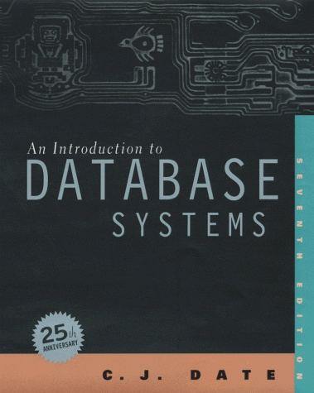
Learning Databases
C. J. Date
Relational theory
Relation Calculus
Structured Query Language
Rows and Columns

Slide 5

The World is not Rows and Columns
Some data fits neatly into the relational model, some data does not
Object to Relational Mapping
Graphs
Documents

Slide 6

NoSQL - BigData
Big Data
NoSQL
Map Reduce
Analytics
  Batch
  Real-time
Complex Event Processing
Finding Signal in Noise

Slide 7

Barriers to learning something new
Fashions
Ritual
Tradition
Dogma – Right vs Wrong
  Open systems
  RISC
  Normal Form
  Object Oriented
  Patterns
  Java
  Agile
Notes:
Anecdote: Rational ClearCase at NAB

Slide 8
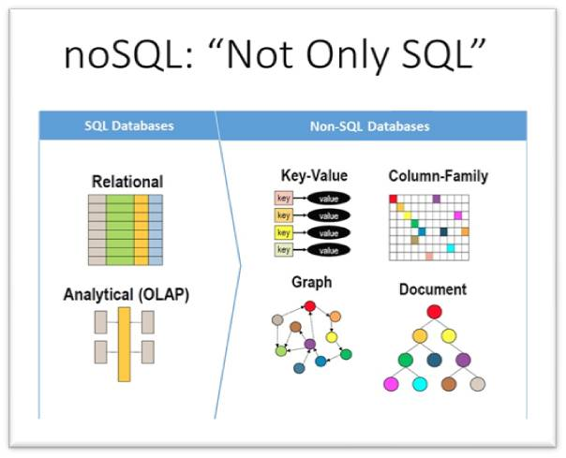
NoSQL myths
NoSQL is new… is it?
There is no schema, that’s bad… are you sure?
No joins, I can’t live without joins… maybe you can.
It uses an API not a query language… does it?

Slide 9
NoSQL – Query languages
Many NoSQL/Big Data technologies provide query languages similar to SQL. These are “familiar” and easy to learn
AQL – Aerospike Query Language
CQL - Cassandra Query Language
N1QL – Couchbase Query language
Using a query language overcomes the barrier to learning NoSQL

Slide 10
What if we could
Generate NoSQL from SQL

Slide 11
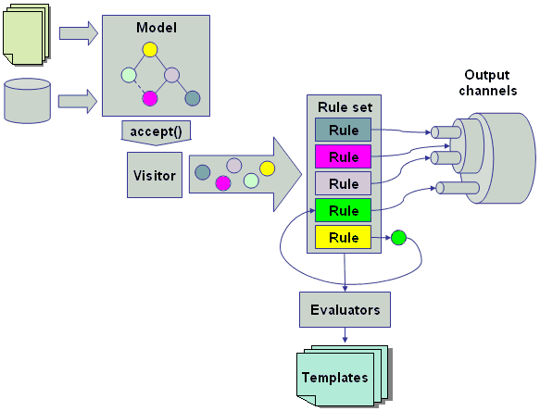
Generating NoSQL from AQL (SQL)
Goals
Translate AQL to Aerospike API calls
  Generate the semantic equivalent API calls in sequence
Complete code
  Immediately runnable
Well formed, easily readable code
  Average developer can use it and learn from it.
  Avoid complex “framework” hierarchies
Retain the original AQL as a comment
Language independent
  Easily add new target languages

Slide 12


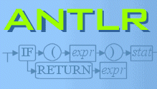
ANTLR
Terence Parr
Grammar DSL
Parser generator
ANTLR runtime
String Templates

Slide 13
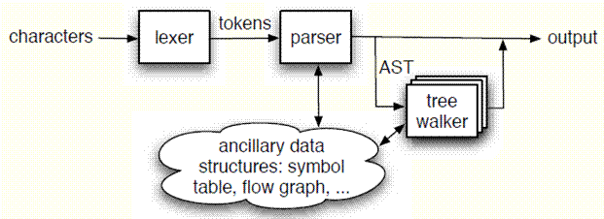
ANTLR - Grammars
Lexer Grammar
Parser Grammar
Tree Grammar

Slide 14
AQL Grammar
Generate a parser from the Grammar
The parser – LL(*)
  Like a compiler
  Checks syntax
  Generates Abstract Syntax Tree
AST Node
Grammar rule
Token
Notes:
LL parser is a top-down parser for a subset of context-free languages.
It parses the input from Left to right, performing Leftmost derivation of the sentence.

Slide 15
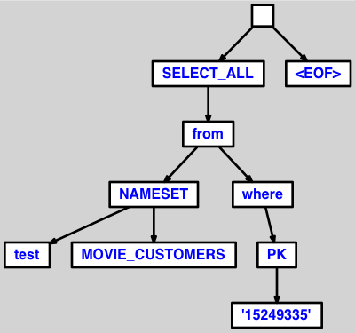
Abstract Syntax Tree - AST
Syntax/Grammar checking
Simpler Tree
Only the important semantic elements are retained
“An abstract syntax tree (AST), or just syntax tree, is a tree representation of the abstract syntactic structure of source code written in a programming language. Each node of the tree denotes a construct occurring in the source code. The syntax is "abstract" in not representing every detail appearing in the real syntax.”
- WIkipedia

Slide 16
Tree Grammar – for code generation
Walk the AST
Generate Code
  String Templates
Tree Grammar rule
AST Node
String Template Function

Slide 17
String Templates
Template language
  Fill in the blanks
One template for each language
  Java
  C#
  …etc
Function name
deleteStmt(source, nameSpace, setName, primaryKey) ::= <<
// <source>
this.client.delete(this.writePolicy,
new Key("<nameSpace>", "<setName>", Value.get(<primaryKey>)));
>>
Java code
Value substitution

Slide 18

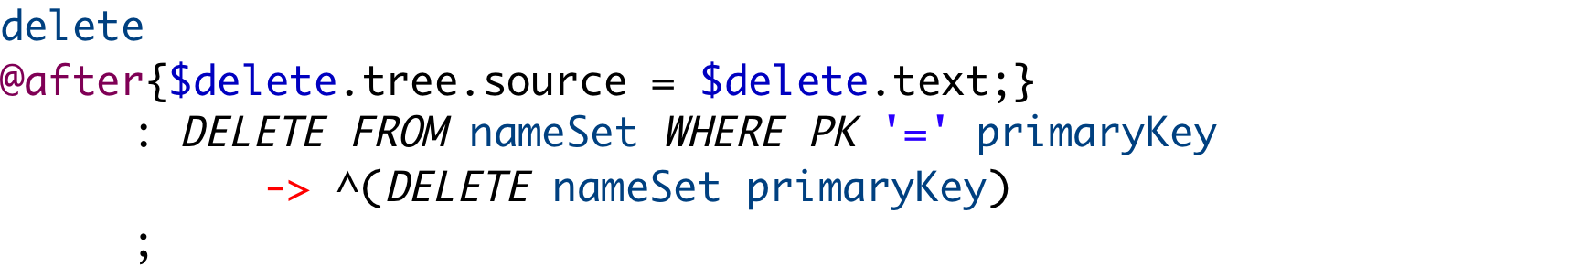
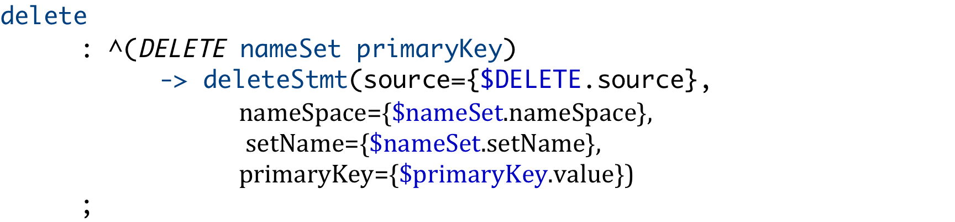
Complete example
Original AQL
AQL Grammar
Tree Grammar
deleteStmt(source, nameSpace, setName, primaryKey) ::= <<
// <source>
this.client.delete(this.writePolicy,
new Key("<nameSpace>", "<setName>", Value.get(<primaryKey>)));
>>
String Template
Generated Java

Slide 19
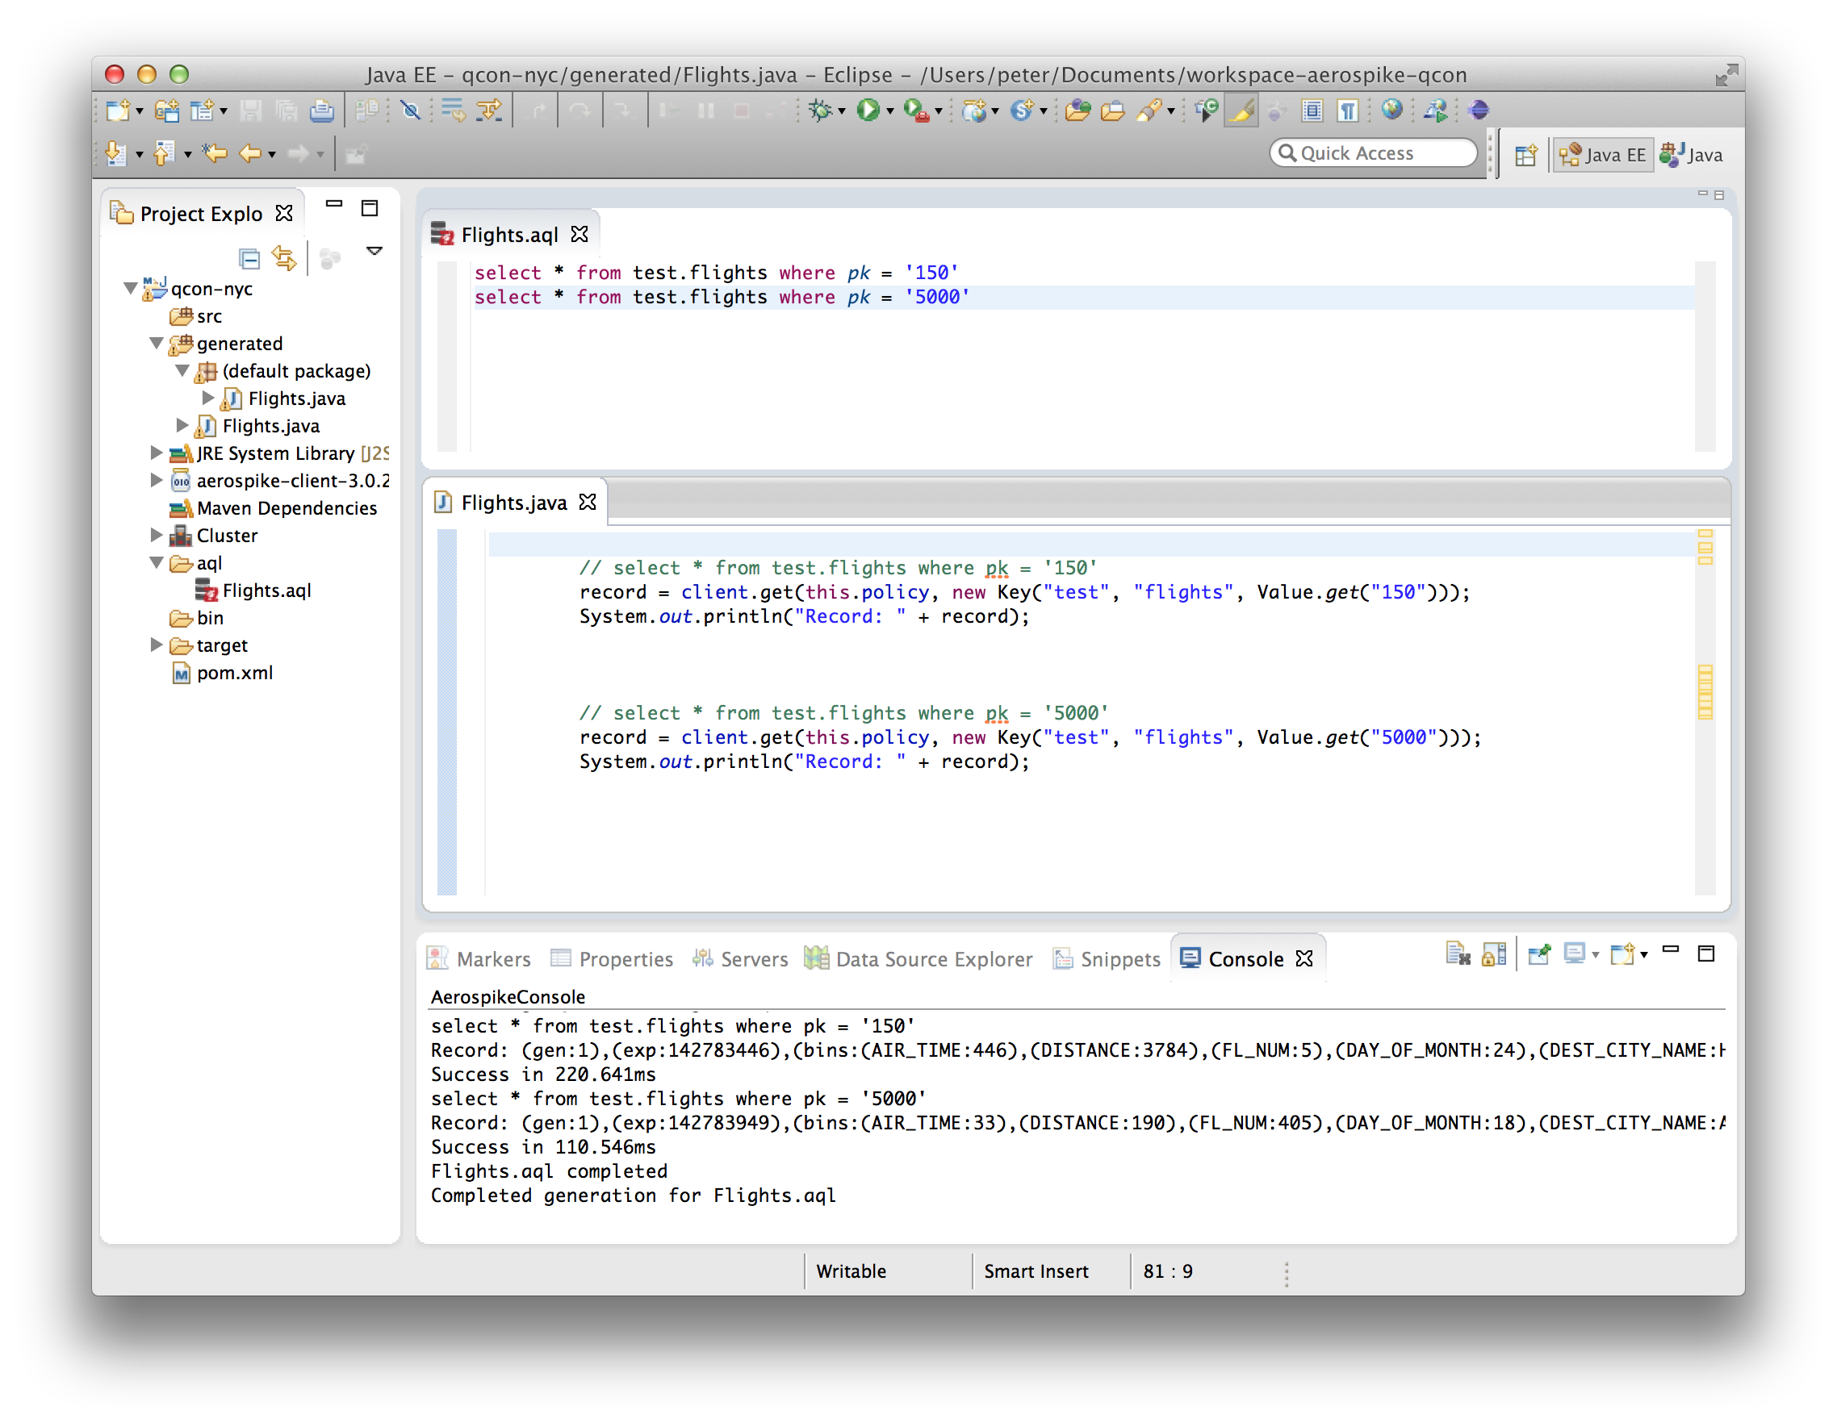
Eclipse Plugin for Aerospike

Slide 20

My Brain is Full

Slide 21
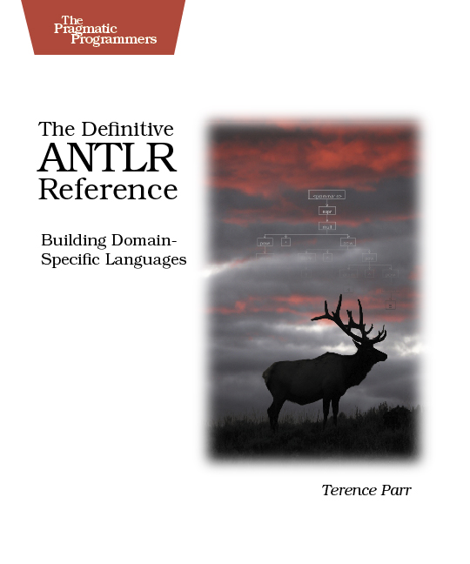

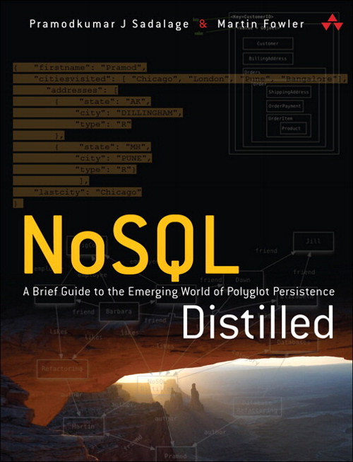
Books & Papers
http://pragprog.com/book/tpantlr/the-definitive-antlr-reference
http://www.aerospike.com/wp-content/uploads/2012/07/VLDB-Paper.pdf
http://www.informit.com/store/nosql-distilled-a-brief-guide-to-the-emerging-world-9780321826626

Slide 22


Software
Aerospike
  http://www.aerospike.com/free-aerospike-3-community-edition/
Tools
  Eclipse - http://www.eclipse.org
  ANTLR- http://www.antlr.org
  StringTemplate (ANTLR) http://www.stringtemplate.org
  Aerospike Plugin - https://github.com/aerospike/eclipse-tools

Slide 23

  QUESTIONS?
  peter@aerospike.com
  www.linkedin.com/pub/peter-milne/1/147/a86/
  www.aerospike.com

