Slide 1
Zero to Testing in JavaScript
Basics of testing in JS

Slide 2
About me
Software developer for Xfinity.com
Online: thewebivore.com, @pamasaur
Co-organizer of Philadelphia JavaScript Developers
Testing fanatic

Slide 3
Agenda
My testing story
Writing your first JavaScript test
Testing frameworks
Working testing into your workflow

Slide 4
My testing story

Slide 5
My Testing Story
Code Retreat
TDD
Pairing
Throw-away code
Testing at work
Now: test coverage drops break the build
Notes:
And I organize Code Retreat! ;)

Slide 6
What’s the deal with testing?
When you break it, it breaks!
Secondary line of documentation defense
Design tool
Notes:
How many of you have written a test? Ever? Design tool is debatable, and I’ll touch on TDD/BDD

Slide 7
What do you call code without tests?
Legacy code.

Slide 8
Testing front-end code
The debt in your /js folder
Front-end code has logic too!
If you have logic, you need tests
Notes:
“Do I need tests?”
“Do you want to have an app in two years? Then yes”

Slide 9
BDD/TDD
Behavior Driven Development
Test-Driven Development
“Write tests to inform how you write your code”
BDD: Describe, it, before, after, beforeEach, afterEach
TDD: Suite, test, setup, teardown

Slide 10
Test Ever vs. Test Never

Slide 11
Writing your first JavaScript test

Slide 12
Writing your first JavaScript test
Setting up your base
Writing the test*
Making it pass*
* The order of these is debatable

Slide 13
Jasmine
jasmine.github.io
Download a standalone version on GitHub from pivotal/jasmine
Or use RubyGems for a Ruby environment
Notes:
I’ll go into these tools more in depth after we write our test, but I wanted to touch on the two I’ll show. BDD style

Slide 14
Mocha
visionmedia.github.io/mocha
Node!
npm install –g mocha
Notes:
More on them later

Slide 15
Anatomy of a test
Describe [thing you’re testing]
It [does something you expect it to do]
Rinse and repeat.

Slide 16
Example test walk-through
with Mocha

Slide 17
var assert = require('assert');
describe("An area of my application", function() {
it("should know that 2 and 2 is 4", function(){
assert.equal(4, 2+2);
});
});
Notes:
This is the whole test, and we’ll walk through it piece by piece

Slide 18
var assert = require('assert');
describe("An area of my application", function() {
it("should know that 2 and 2 is 4", function(){
assert.equal(4, 2+2);
});
});
Notes:
Require your necessary libs
Node/browserify require system

Slide 19
var assert = require('assert');
describe("An area of my application", function() {
it("should know that 2 and 2 is 4", function(){
assert.equal(4, 2+2);
});
});
Notes:
Use your words! BDD = “the video player” TDD = “VideoPlayer”

Slide 20
var assert = require('assert');
describe("An area of my application", function() {
it("should know that 2 and 2 is 4", function(){
assert.equal(4, 2+2);
});
});
Notes:
Just javascript functions.

Slide 21
var assert = require('assert');
describe("An area of my application", function() {
it("should know that 2 and 2 is 4", function(){
assert.equal(2+2, 4);
});
});
Notes:
Make an assertion or expectation
Assert and expect are about the same. Assert is more like (this, that), expect is a sentence (BDD)

Slide 22
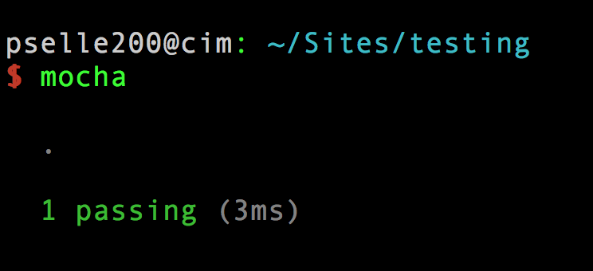
Notes:
BOOM

Slide 23
Testing concepts: Unit testing
Test your code
Notes:
Test code YOU wrote … you should use well tested frameworks

Slide 24
Spies, stubs, and mocks
Spy: an object that records its interactions
Stubs: fake objects
Mocks: fake objects with expected behavior
Generally, you can SPY on a function, STUB an object, and MOCK a service.

Slide 25
Live coding?
Write a test with me!
Notes:
Don’t forget the reporter trick

Slide 26
Testing Tools

Slide 27
Test describers
Jasmine
Mocha
QUnit
node-tap
YUI Test
Notes:
I like Jasmine. Mocha is nice for a greenfield project/for immediate CLI integration, and it also lets you choose your assertion library.
JSUnit is no longer actively supported or maintained, but it's kind of the OG of JS unit testing.

Slide 28
Assertions
Chai
should.js
Expect.js
better-assert
Notes:
People have preferences on these ... I'm somewhat ambivalent, as the words (expect, assert, should) are often used interchangeably and have more to do with your style (BDD/TDD) which doesn't matter if you aren't testing yet.

Slide 29
Spies, stubs, and mocks
Sinon.js
Jest from Facebook
Notes:
Jasmine has its own spies, as do other test frameworks; Sinon is nice if you run into the limitations of those frameworks.

Slide 30
Test runners
Karma
Teaspoon
YUI Yeti
Notes:
Jasmine also has a test runner - a lot of these things cross categories, and it's a little difficult to understand where each piece fits.

Slide 31
Bringing testing into the fold
3 tips for making testing a regular part of your world

Slide 32
#1: Teach testing
Attend talks like this!
Practice (ex. Code Retreat)
Pair programming

Slide 33
#2: Code coverage
Istanbul
Blanket.js
hrcov (Mozilla)
JSCover
Notes:
Fascinating data, and can help you monitor code quality over time

Slide 34
#3: Code review
Quality assurance
Mentoring
Don’t accept without tests!
Notes:
Code review is great for 1m reasons, and enforcing testing is just one of them

Slide 35
What’d we learn?
Writing a JavaScript test
Tools in JavaScript for testing
Ways to create a testing culture

Slide 36
Thank you!
Find me online at
@pamasaur
thewebivore.com (blog)
turing.cool (podcast)
bleedingedgepress.com (upcoming book on JS frameworks)

