Slide 1

Leveraging OpenSPL for Financial Risk Computation
June 11, 2014

Slide 2
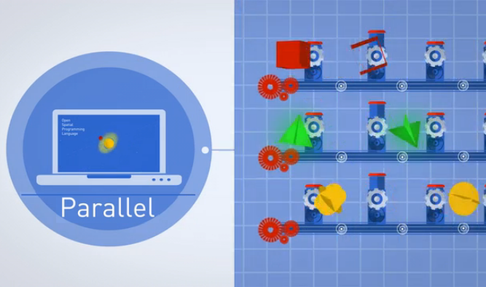
Agenda
CME Group overview
Demand for solution
Let’s look at the problem of heavy data
Transforming the mindset… with a possible solution
Basics of OpenSPL
Challenges
Summary

Slide 3
CME Group
CME Group is the world’s leading and most diverse derivatives marketplace – handling 3 billion contracts worth approximately $1 quadrillion annually, on average. We bring buyers and sellers together through our CME Globex electronic trading platform and our trading facilities in Chicago and New York.
Global Products
CME Group exchanges offer the widest range of global benchmark products across all major asset classes, including futures and options based on interest rates, equity indexes, foreign exchange, energy, agriculture commodities, metals, weather and real estate.
Clearing
CME Group operates CME Clearing, one of the world’s leading central counterparty clearing providers.
We are the guarantor of every transaction that happens in our markets, providing unparalleled safety and soundness for our customers.
Electronic Trading
Through our CME Globex electronic trading platform, users worldwide are able to access the broadest array of the most liquid financial derivatives markets available anywhere. In addition, CME Globex offers speed of execution, transparency anonymity and market integrity. This makes up around 80% of all trades at CME.

Slide 4
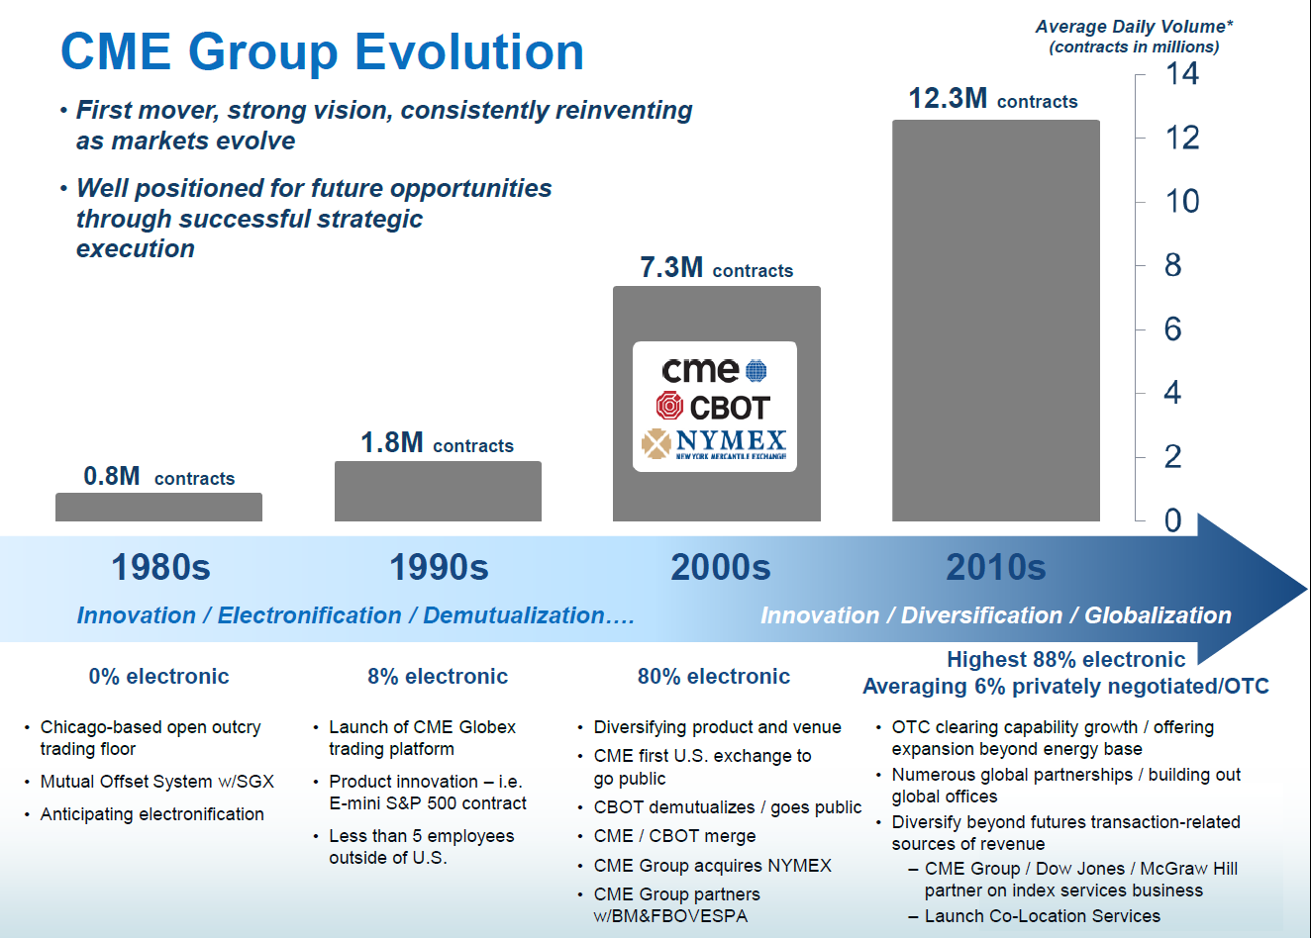

Slide 5
An Era of Convergence across Multiple Industries Enabled by Technology
* Devices | Mobility | Single Mobile Device
Telephone, Video, Television, Movies, Music, Books, … | Internet | Digital Streaming Media
Infrastructure, Software, … | Internet | Cloud Computing
Trading Order Entry | Market Controls | Enhanced Pre-Trade Risk Management
Software | Hardware | High Performance Computing
OTC and Portfolio Margining | Central Counterparty Clearing | Enhanced Post-Trade Risk Management

Slide 6
Next Generation Risk Management Enables the Future of Financial Industry Convergence
Scalability
Analytics
Efficiency
Predictability
Market Integrity
High-resolution mark to market processes
Real-time, event-driven monitoring
Complex computational modeling
Risk management controls (Credit Controls)
Increasing growth and frequency of financial market data
Reduced total cost of ownership (TCO)

Slide 7
FPGA Dataflow Engines (DFEs) Enable the Next Generation of Financial Risk Management
Area | Software | Hardware
Challenges | Interrupts Resource Starvation | Code complexity Skillset availability
Architecture | Something | Block
Design | [Insert Your Best Practice] | RTL Diagrams w/ Flow Control
Code Entry | Java | VHDL/Verilog
Unit Tests | JUnit | Simulation Test Vectors
Design Debugging | Java Debug | Simulation Design Test
Test / QA | Java | Hardware
Deployment | Binary | Flash cards / Cable
MaxCompiler
Streaming
Manager / Kernel Diagrams
OpenSPL
Kernel Tests
DFE and MaxDebug
DFE + MaxDebug
Binary
Allows existing software & support teams to program in hardware
Supports agile, pure software SDLC
Increases productivity and cost efficiency

Slide 8
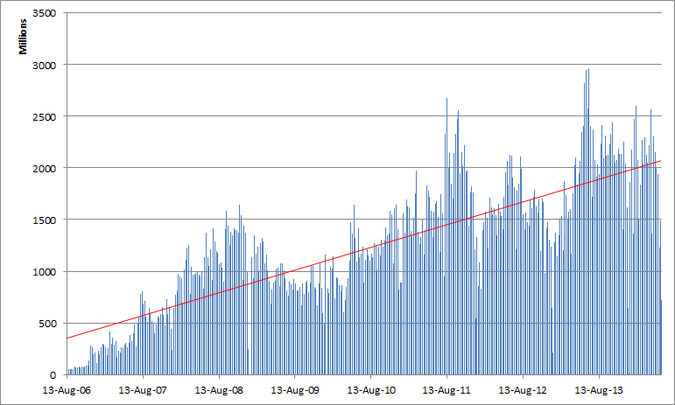
How To Handle The Growing Data Trend…

Slide 9
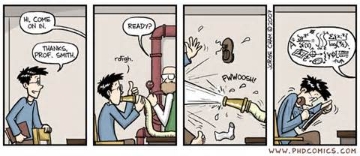
So this makes you feel like…

Slide 10
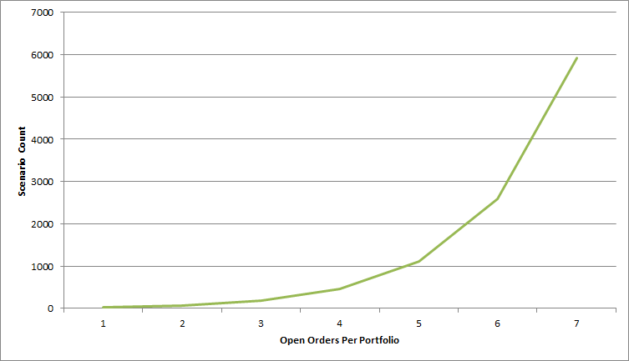
The effect of heavy data
Take the case that 2.5Bln order messages are received in a single trading session (120 hours), which is approx. 6 order messages/ms, assuming the rate is evenly distributed

Slide 11
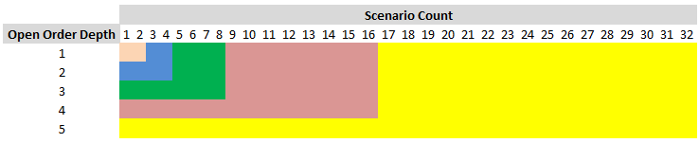
Taking a closer look at the data

Slide 12
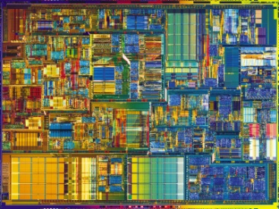
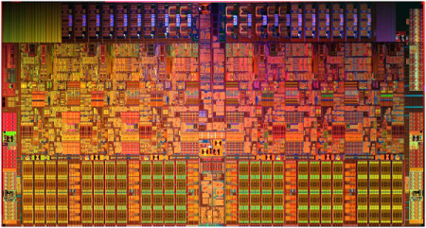
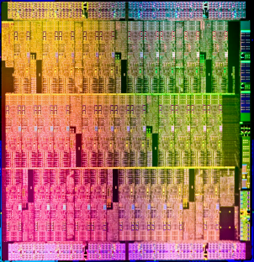
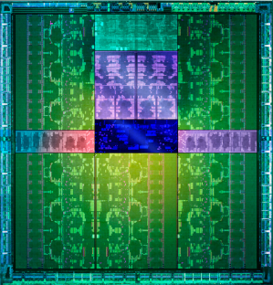
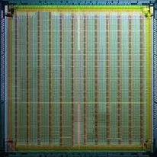
Choosing a solution: Spectrum of Technology Options
Single-Core CPU
Multi-Core
Several-Cores
Many-Cores
Dataflow
Increasing Parallelism (#cores)
Increasing Core Complexity
Decreasing Clock Frequency
Intel, AMD
GPU (NVIDIA, AMD)
Tilera, XMOS etc...
(Xilinx, Altera, Tabula, Achronix)
32nm - 22 nm CMOS Process Technology

Slide 13
One common approach
Traditional control flow approach
Tasks distributed among many time-slices of CPU cores
Contributor to large datacenter footprint and overall total cost of ownership
Task
Task
Task
Process Task
Process Task
CORE
CORE
Process Task
Process Task
CORE
CORE
Process Task
Process Task
CORE
CORE

Slide 14
One common approach (Better, more efficient)
GPU or Coprocessor
Host Memory
Book State
Receive Data, Distribute Tasks, Assemble Results
Data
Another traditional control flow approach
Tasks distributed among the cores / threads of a GPU or Coprocessor

Slide 15
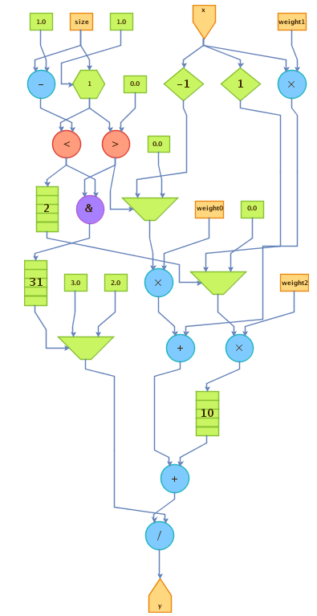
Another approach is Dataflow using OpenSPL
Space
What is dataflow and what is OpenSPL?
  Allows programs to operate more effectively and efficiently by utilizing the space rather than depending only on time
  Embrace the natural parallelism of the substrate
  Data is transformed as it flows through the fabric
  Improve computational density
  Provides general purpose development semantics
  Integrates well into existing SDLC
Thinking in 2 dimensions: space and time
Change the mindset from thinking about work as chunks of tasks
Flow / Time

Slide 16
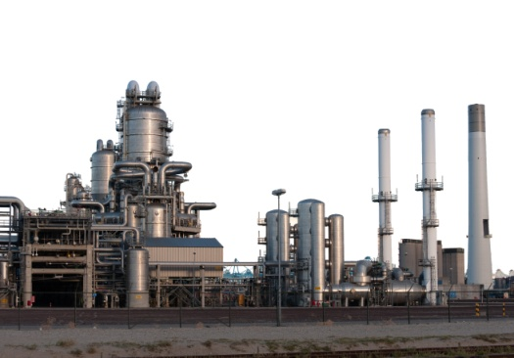
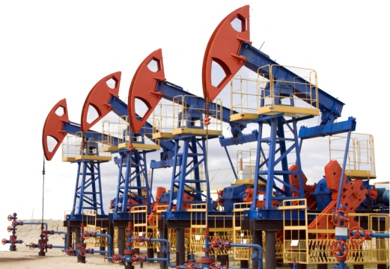
Quick Dataflow Introduction
Processor
Memory
Oil Refinery
Oil Well
Let’s take the time to build a pipeline
Let’s build a dataflow computer for this application.
Once we starting pumping, it takes a while to fill up...
The latency of the first result can be high...

Slide 17
Quick Dataflow Introduction (cont.)
Oil Refinery
Oil Well
But then the oil flows constantly.
And we get a result every clock cycle.

Slide 18
OpenSPL Introduction – www.openspl.org
Controlflow and Dataflow are decoupled
  Both are fully programmable
Operations exist in space and by default run in parallel
  Their number is limited only by the available space
All operations can be customized at various levels
  e.g., from algorithm down to the number representation (variable exponent and mantissa definition)
Multiple operations constitute kernels
Data streams through the operations / kernels
Data transport and compute can be balanced
All resources work all of the time for max performance
In/Out data rates determine the operating frequency

Slide 19



Basic Structure of OpenSPL
Integration: Application setup, environment configuration, etc.
Manager: Substrate configuration, stream definitions, kernel configuration, etc.
Kernel(s): Application Logic

Slide 20
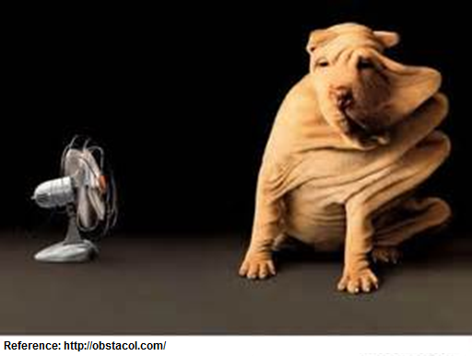
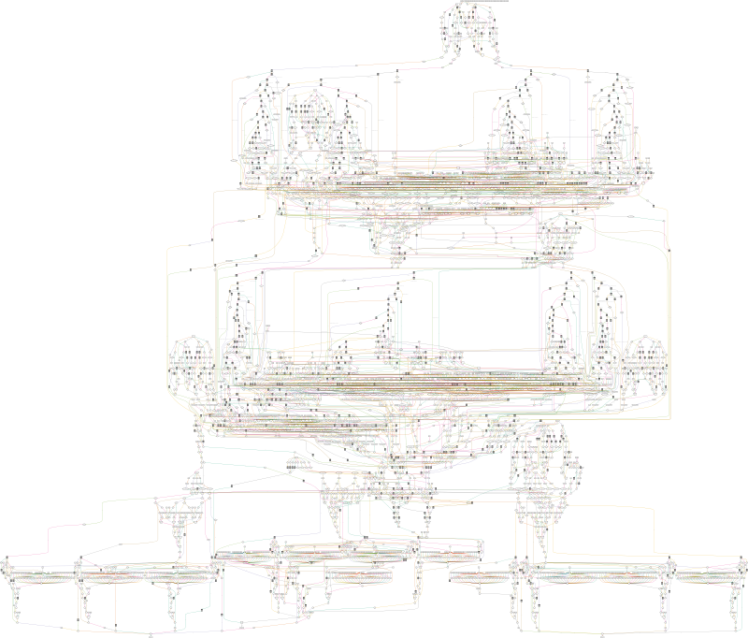
Back to the problem… and one solution to it, the boring way
FPGA DFE
Host Memory
Really?
Book State
Receive Data, Distribute Tasks, Assemble Results
Data

Slide 21
A different approach, with a little mechanical sympathy
PCIe Device
DRAM, SRAM
Book State
FPGA / DFE
Data
10GbE
Kernel
Kernel
Kernel

Slide 22
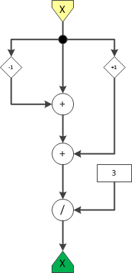
OpenSPL Example #1 – Moving Average
public class MovingAverageKernel extends Kernel {
public MovingAverageKernel(KernelParameters parameters, int N) {
super(parameters);
//Input
SCSVar x = io.input(“x”);
//Data
SCSVar prev = stream.offset(x, -1);
SCSVar next = stream.offset(x, 1);
SCSVar sum = prev+x+next;
SCSVar result = sum/3;
//Output
io.output(“y”, result);
}
}

Slide 23
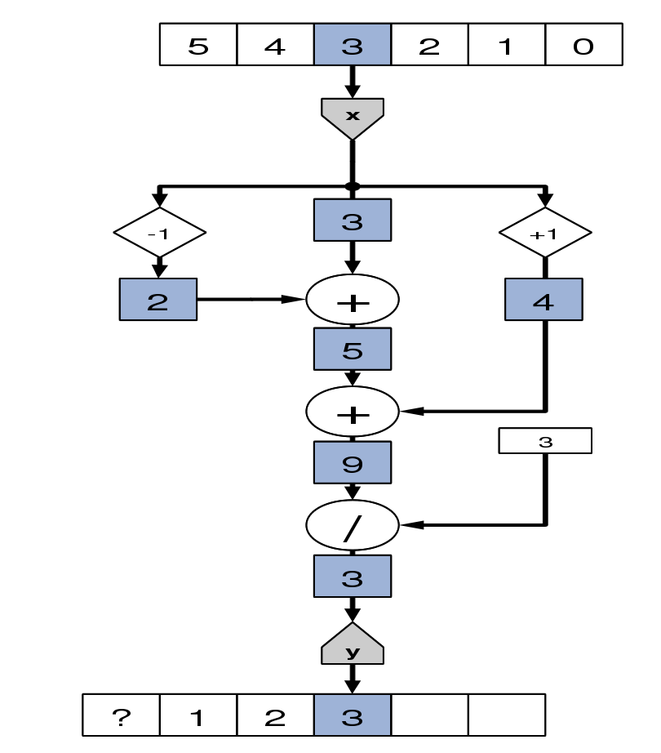
OpenSPL Example #2 – Working with streams
class MovingAvgKernel extends Kernel {
MovingAvgKernel() {
SCSVar x = io.input(“x”);
SCSVar prev = stream.offset(x, -1);
SCSVar next = stream.offset(x, 1);
SCSVar sum = prev + x + next;
SCSVar result = sum / 3;
io.output(“y”, result);
}
}

Slide 24
Your algorithm matters. Here’s an example for generating implied market data prices
Spread Type A
Calendar Spread
Spread Type B
Butterfly Spread
Buy 1
Expiry₀
Sell 1
Expiry_{n}
Buy 1
Expiry₀
Sell 1
Expiry₁
Sell 1
Expiry₁
Buy 1
Expiry₂

Slide 25
Performance comparison of implementations
*Simplified explanation
Algorithm A: Serial
Algorithm B: Parallel
Data
Results
Data
Results
Compared to baseline software serial implementation
Implementation on FPGA has some degree of parallelism due to the dataflow paradigm but there is a lot of locking which results in dropped packets on the ingress at the given test rate
Test | Implementation | Speedup Improvement
 |  | 95th | Tail / Max
30k + 200tps Burst | A: FPGA (Serial) | 3x | 3x
30k + 200tps Burst | B: SW (Parallel Matrix) | 1200x | 16x

Slide 26
OpenSPL Example #3 – Implied Volatility
// Based on: "A New Formula for Computing Implied Volatility" by Steven Li
SCSVar impliedVol(SCSVar optionPrice,
SCSVar futurePrice,
SCSVar strikePrice,
SCSVar timeToExpiration,
SCSVar interestRate) {
SCSVar discountFactor = exp(interestRate*timeToExpiration);
optionPrice = optionPrice * discountFactor;
SCSVar sqrtT = sqrt(timeToExpiration);
SCSVar KmS = strikePrice - futurePrice;
SCSVar SpK = futurePrice + strikePrice;
SCSVar alpha = (sqrt(2.0*Math.PI) / SpK) * (optionPrice + optionPrice + KmS);
SCSVar tempB = max(0, alpha*alpha - 4.0*KmS*KmS/(futurePrice*SpK));
return 0.5*(alpha + sqrt(tempB)) / sqrtT;
}
Running time: ~700ns

Slide 27
Challenges with development (FPGA substrates)
Tools built for digital designers
Description for a digital system
Designed for describing hardware not describing computation
Good for really squeaking out the performance of the substrate, but can we depend on the compiler to make enough optimization for us?
entity NAME_OF_ENTITY is [ generic generic_declarations);]
port (signal_names: mode type;
signal_names: mode type;
:
signal_names: mode type);
end [NAME_OF_ENTITY] ;
architecture architecture_name of NAME_OF_ENTITY is
-- Declarations
-- components declarations
-- signal declarations
-- constant declarations
-- function declarations
-- procedure declarations
-- type declarations
:
begin
-- Statements
:
end architecture_name;

Slide 28
A view into complexity
Dataflow Graph with
5,000 nodes
Easy with VHDL / Verilog?

Slide 29
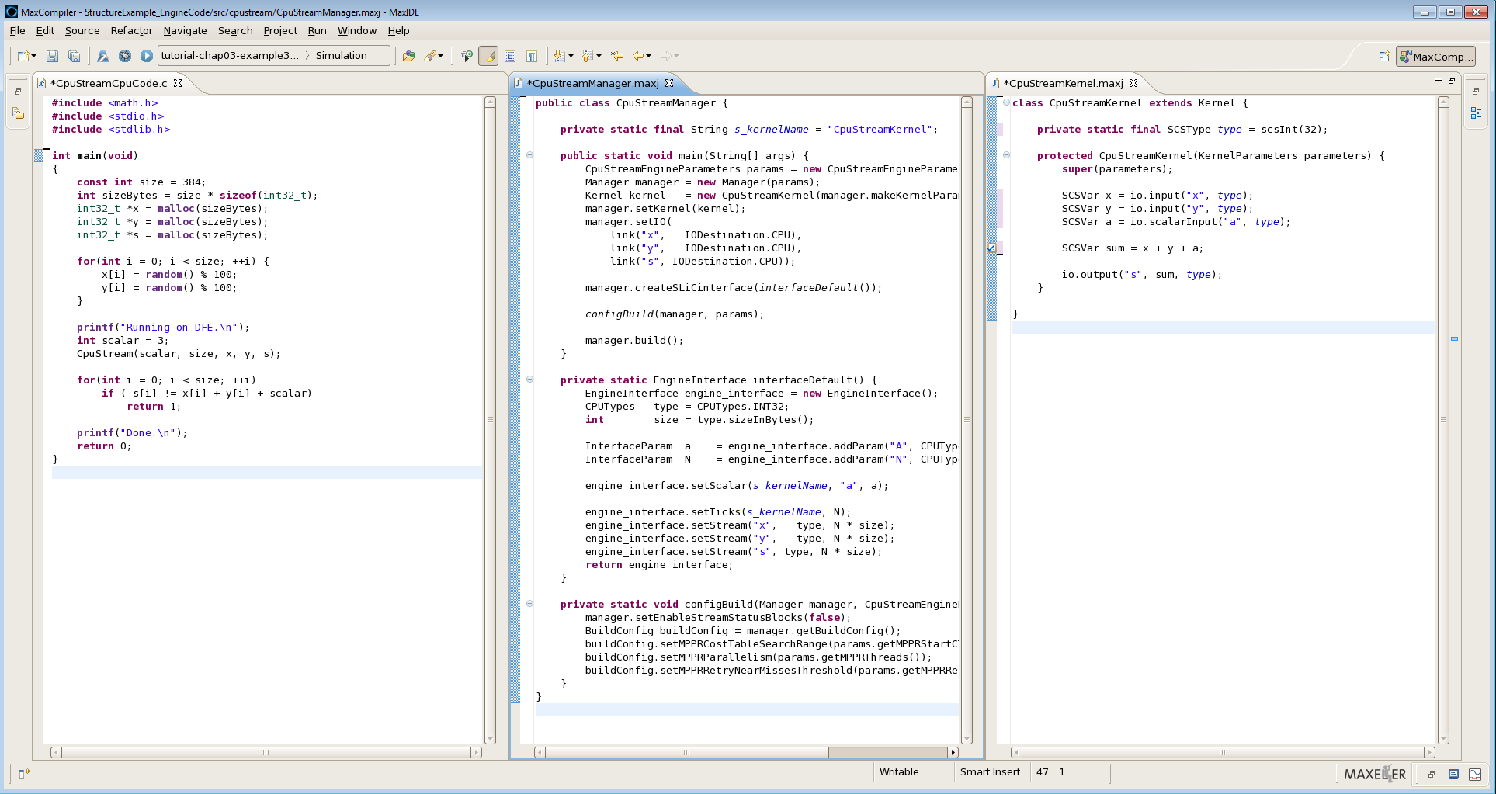
OpenSPL – General purpose programming technique
Integration Code
Manager Code
Kernel Code

Slide 30
Motivation for programming in space
Core clock frequencies evened out in the few GHz range
Energy / Power consumption of modern HPC systems became huge economic burden not to be ignored any longer
Specialization has proven its power efficiency potentials
The requirements for annual performance improvements keep growing steadily
SoCs are now exploiting also the third dimension (3D-int)
However, the majority of programmers build upon the legacy, 1D linear view and sequential execution
Many clever proposals but no good solution to date (e.g., Cilk, Sequoia, OmpSs and OpenCL)

Slide 31
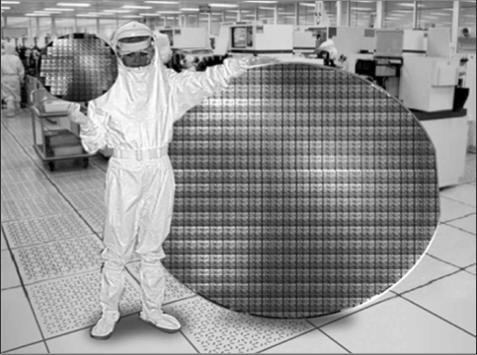
Moore motivation…
The number of transistors on a chip keeps scaling
  Between 2003 and 2013 it went up from 400M (Itanium 2) to 5 Bln (Xeon Phi) in the case of modern processors
Exploding data volumes while memory can’t follow
  In the same period DRAM latency improved by less than 3x
One’s “dream” about more of Moore
(courtesy of Intel)

Slide 32
Summary
Your algorithm matters – Need to transform the mindset
Programming model to better utilize the substrate
Operations exist in space and by default run in parallel
Transform the boring argument of “my FPGA tools are better”
Community participation for OpenSPL
  Looking to enhance the specification
  Promoting SCS diversity
Roadmap
  Present: Only the specification is open
  Future: Reference implementations and open tool chain
References
  http://www.openspl.org

Slide 33
Thank you

