Slide 1
Java SE 8 for Tablets, Pis, and Legos
Stephen Chin
Java Technology Ambassador
JavaOne Content Chair
@steveonjava
Notes:
Feel free to reuse this presentation for your local user groups. Some helpful comments are in the notes section, but feel free to embellish.
For more details on JavaFX/Raspberry Pi hacking, check out this post:
http://javafx.steveonjava.com/javafx-on-raspberry-pi-3-easy-steps/

Slide 2
http://commons.wikimedia.org/wiki/File:Genting_Highlands_theme_park.jpg

Slide 3
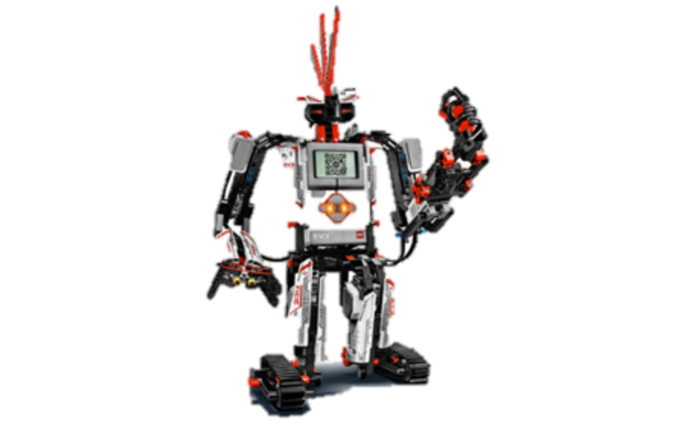
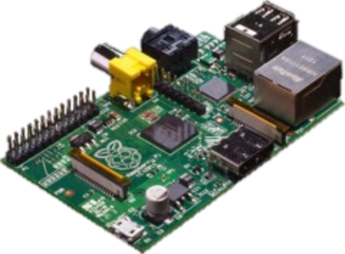
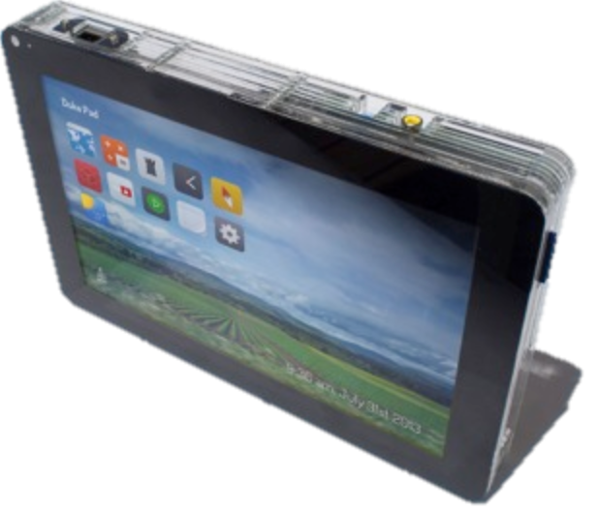
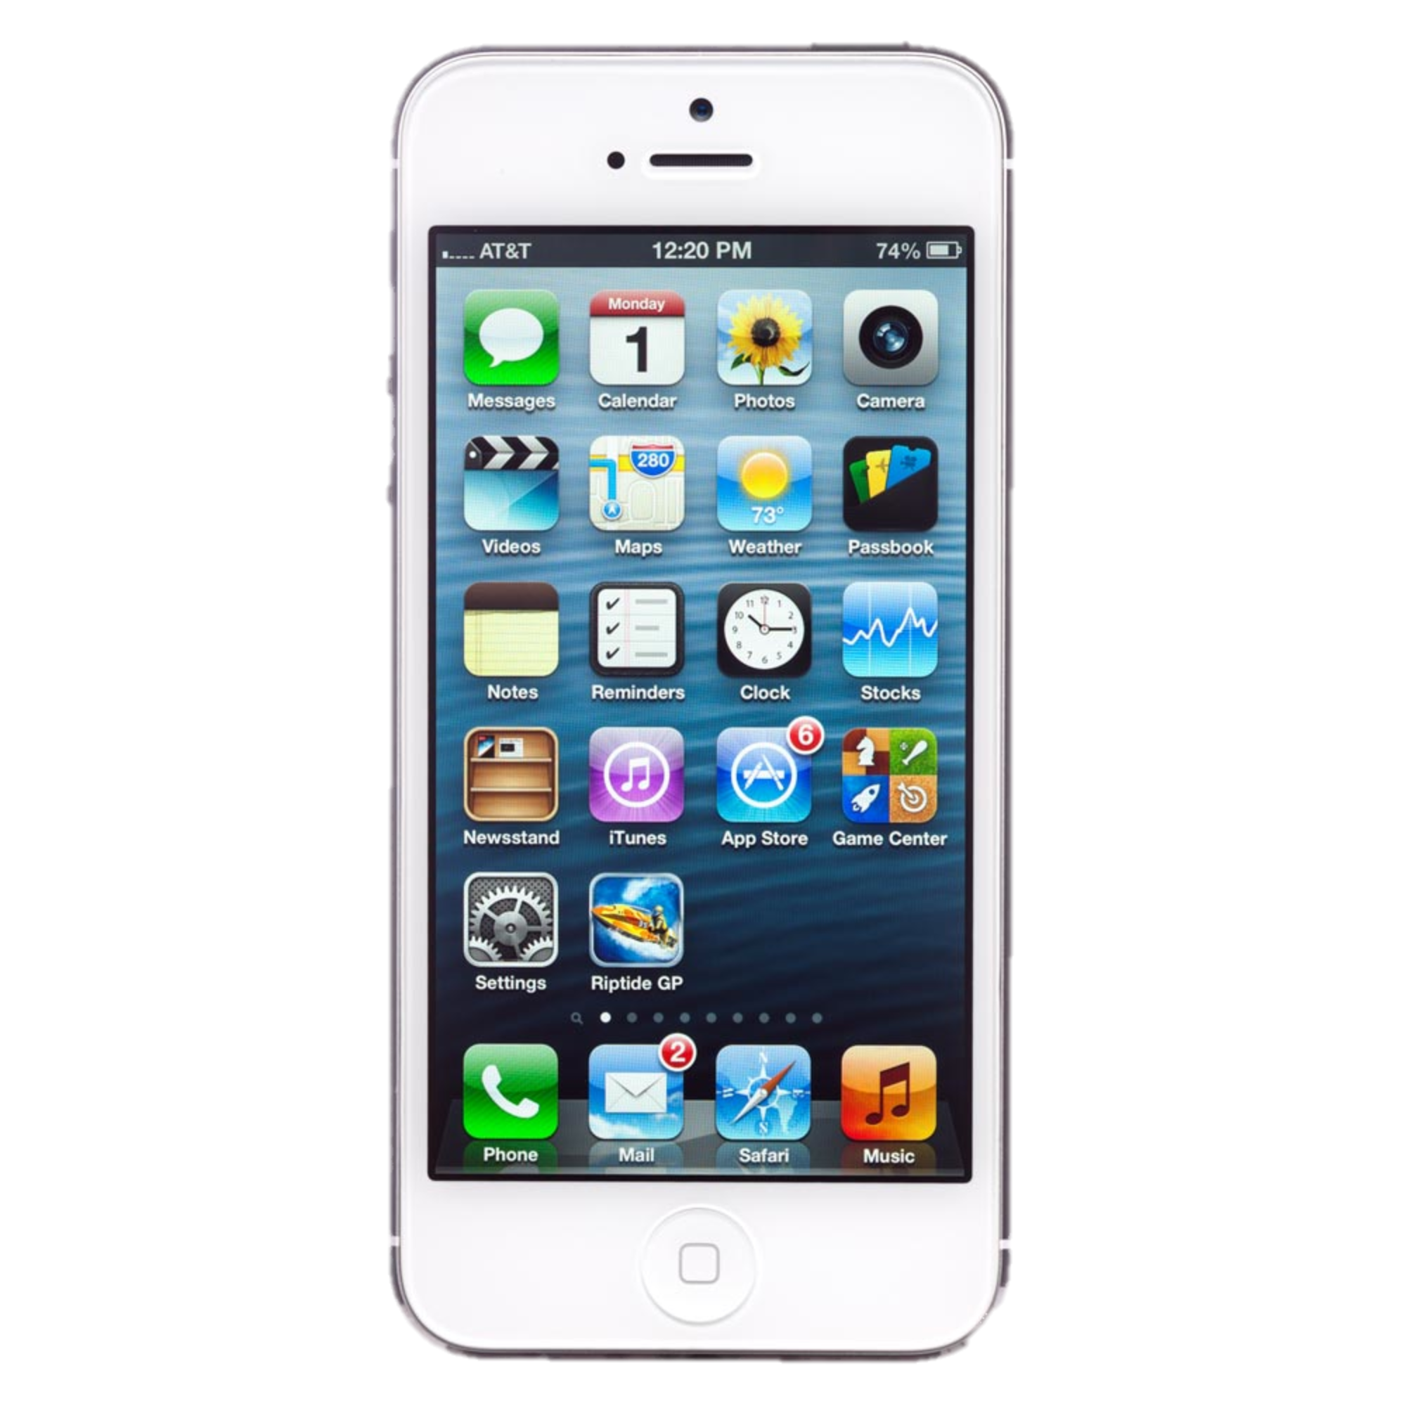
Lego
Mindstorms
Dev
Boards
DukePad
iOS
Android

Slide 4
World Population
6.3 Billion
6.8 Billion
7.2 Billion
7.6 Billion
Connected Devices
500 Million
12.5 Billion
25 Billion
50 Billion
Connected Devices
per Person
0.08
1.84
3.47
6.58
1x
3x
5x
2003
2010
2015
2020
Source: Cisco
Notes:
At the same time mobility and social combine to increase data volumes, the number of non-human connected devices is poised to increase dramatically. There are many different estimates on how many “things” will be connected by 2020, and they all are in the tens of billions… actually anything over a billion is significant as far as I am concerned. Over the course of the last couple of years the devices are becoming much cheaper, more powerful and probably most significantly connected. We are headed to the nexus of everyone being connected to everything. The internet of things is a major game changer for all of us. All those mobile devices that we use today… will become the ultimate remote controls… helping us interact and control the world around us. They will all produce even more data, they will all need software, and they will all need developers to weave them into the larger internet fabric. They will need to communicate, be secured and managaged….

Slide 5
From…
Things Connected to the Internet
www.
Notes:
Right now most of the focus from businesses and people is to connect things to the internet; white goods, video surveillance cameras, vehicles, airplanes and personal devices – it’s mostly devices in their own silo connecting via the web to provide info to humans on a web browser.
These opportunities are just the beginning.

Slide 6
To…
The Internet of Things
Notes:
This is the change: the internet of things means that things can talk to things, processes interconnect and interop locally or globally, decisions are made according to pre-determined rules, actions can be automated. – We need to enable breaking down the Silo’s and build disruptive technologies and new use casesacross information from multiple verticals.
In the home GSMA indicates we’ve moving from currently on average having X things connected to the internet to, in next Y years of Z
This is the change we are currently in, and that has some significant implications on us all
The most significant being in the manner that services are defined, built and delivered. Services - reflect on that - define it (something delivered on an ongoing basis to a defined set of expectations) – important to indicate we’re not talking technically (eg web services), we are talking services as in tertiary sector. You drive the car off the lot and you’re relationship with the manufacturer is just beginning. This will enable new subscription business model’s coupled with greater customer usage intelligence which can address loyalty and repeat business.
Hardware cost’s are not the single most important thing now as we have to consider what additional value over the product lifecycle could my product x bring if I added more memory or additional sensor’s.

Slide 7
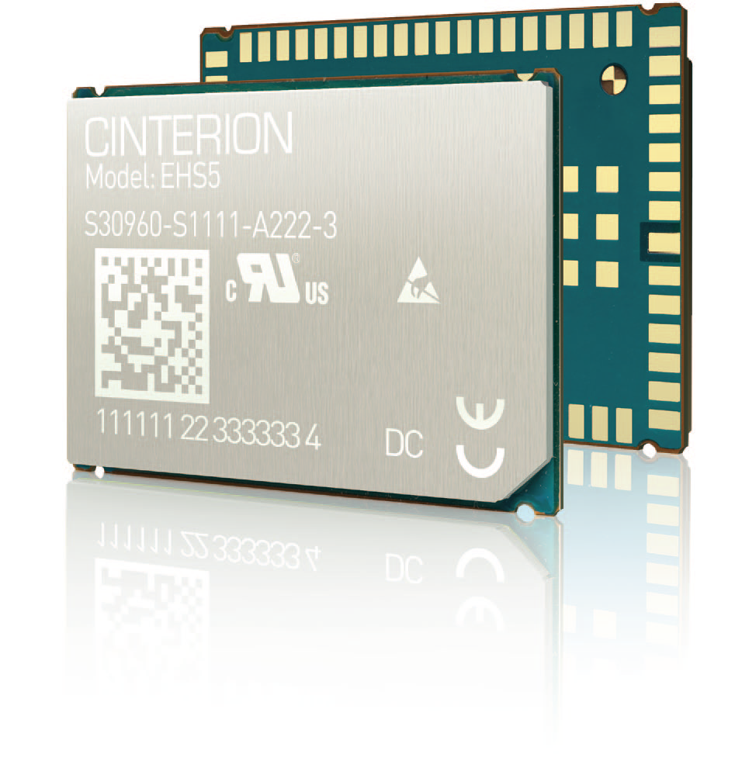
Java and 3G in a Tiny Package
Cinterion EHS5

Slide 8
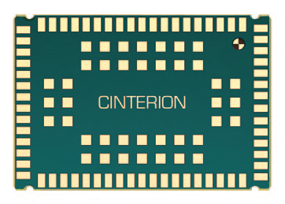
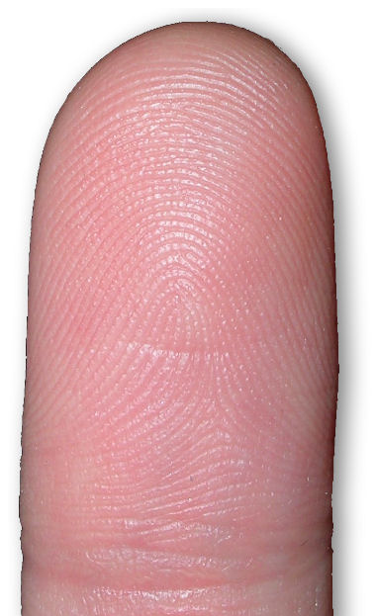
Really Tiny…
27.6mm
18.8mm

Slide 9
http://upload.wikimedia.org/wikipedia/commons/3/3d/Cloud_forest_Ecuador.jpg

Slide 10
Today
APIs
Language
Java SE 7
Java SE 7
CDC 1.1
(based on SE 1.4.2)
CDC 1.1
CLDC 1.1
CLDC 1.1
(based on SE 1.3)
Notes:
Nandini: If you look at the current state of APIs across the 3 implementations, there’s some commonality of but mostly there’s differences. This is true even within Java ME, with differences between CDC and CLDC. From a language perspective Java ME have not evolved at the same pace as Java SE (click to next slide)

Slide 11
Java 8
APIs
Language
Java SE 8
Java SE 8
Java ME 8
Java ME 8
Notes:
Nandini: Java 8 is a huge milestone towards platform unification. CDC will replaced by JavaSE compact profiles, eliminating one of the implementations, while at the same time greatly increasing commonality of APIs. The differences in APIs will mostly be restricted to things like device access. From a language perspective, Java ME 8 will be on parity with Java SE 8, with a few exceptions such as Lambda. The platforms will have common tooling as well.
Peter: So, Nandini to be clear with Java 8 we get code portability from Java ME running on small devices, to Java SE running all the way up on the server side, common APIs, language parity,
Nandini: Yes. . And what this really means is developers will be able to apply their Java skills, where the platform will allow them to fully address opportunities from small devices up to servers.

Slide 12
Beyond Java 8
APIs
Language
Java SE
Java SE
Small Devices
Small
Devices
Notes:
Nandini: Looking out further beyond Java 8, we will continue to unify the platform and as you mentioned, with moore’s law, the smaller devices are getting more capable. There will be a tighter integration between the platforms and the underlying implementation will be further abstracted away for developers. This means you are no longer a Java SE developer or a Java ME developer, but a Java developer who can apply your Java skills to write applications across a broad spectrum of device.
Peter: This is great, Nandini. So, I know there are other cornerstones for our platform strategy. Can you walk all of us through some of those?

Slide 13
 | Java Embedded | Native/C/C++
Cross-platform/multi-architecture/ | Yes | No
Sandbox security model | Yes | No
Robustness | Excellent | Varied
Multi-tasking/multi-threading | Built-in | Add-on, platform-specific
Automatic memory management | Yes | No
Pre-integrated and customizable | Yes | Varied
Performance | Optimized | Varied
Code updatability | Excellent | Varied
Efficient, scalable development model from small embedded to large systems | Yes | No
Developer community | Large | Fragmented
TM

Slide 14
More Information
Twitter
Facebook
Java Blog
LinkedIn
YouTube
@Java Embedded
ILoveJava
blogs.oracle.com/java
Embedded Java Developers Network
YouTube Java Channel
iotcommunity.net
oracle.com/goto/javaembedded
oracle.com/iot

Slide 15
LeJOS
How it works on the EV3

Slide 16
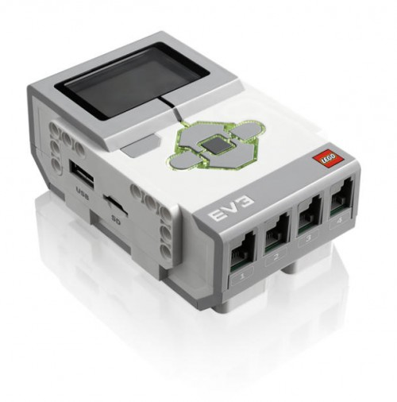
The Heart of the EV3
TI Sitara AM1808
ARM9, 300Mhz
64MB RAM / 16MB Flash
Analog to Digital Converter
4 Motor Ports
4 Sensor Ports
Bluetooth / USB
MicroSD

Slide 17
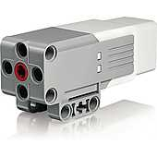
EV3 Motors

Slide 18
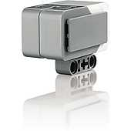
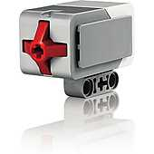
EV3 Sensors

Slide 19
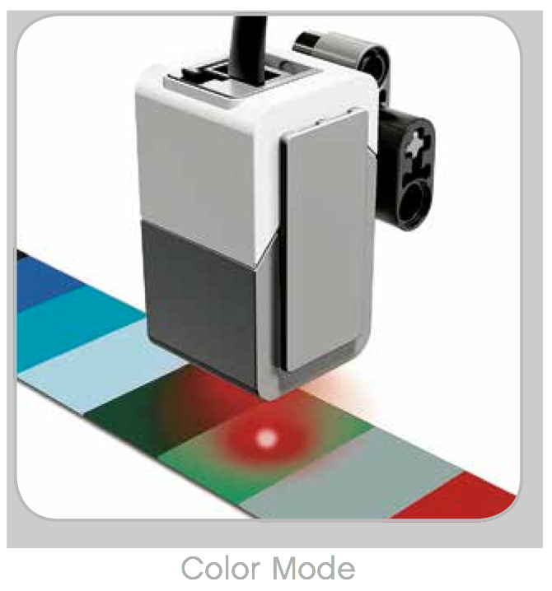
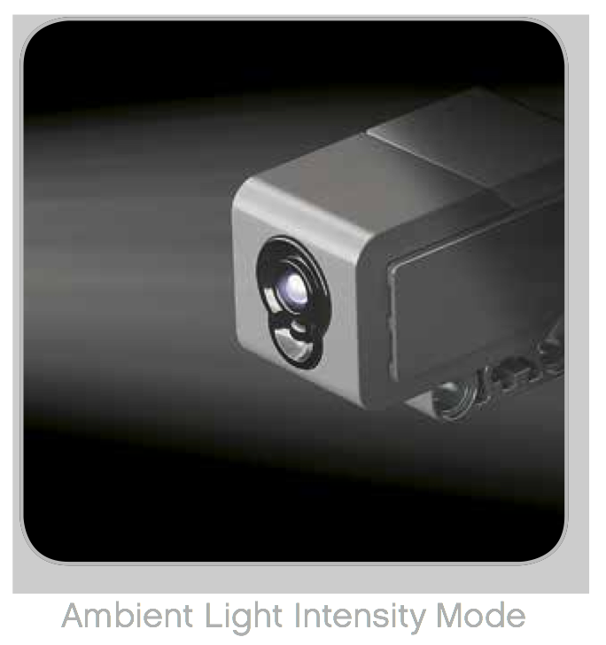
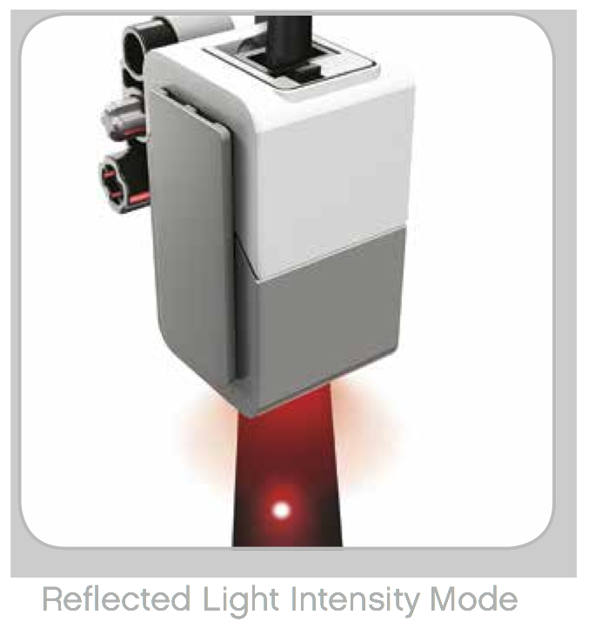
Color and Light Sensor

Slide 20
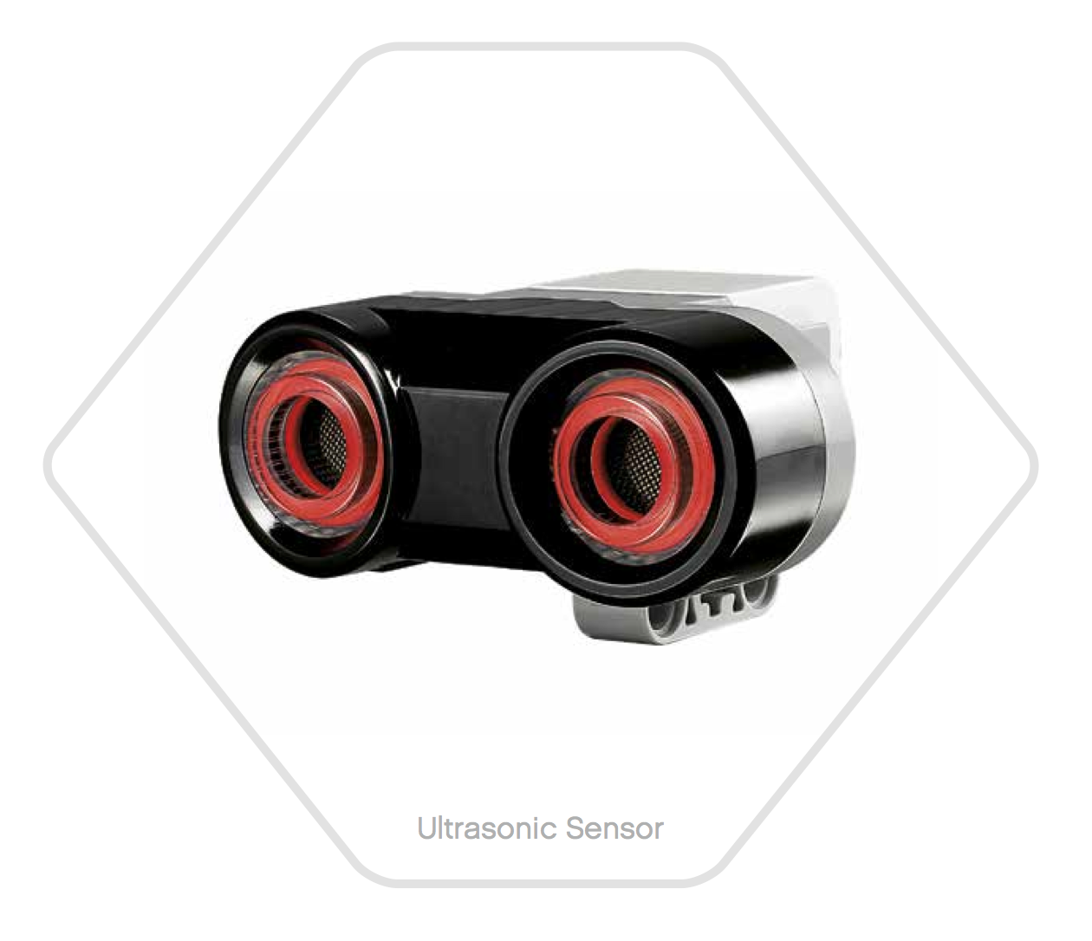
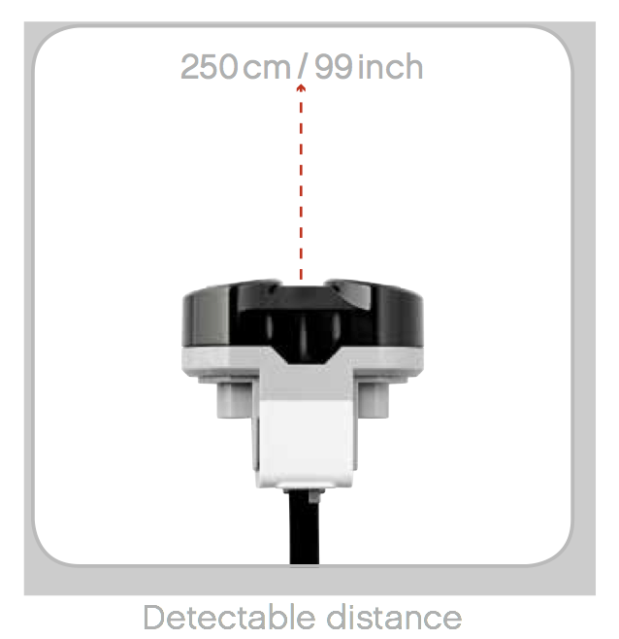
Ultrasonic Sensor
High frequency
sound waves
Measuring mode Vs Presence Mode

Slide 21
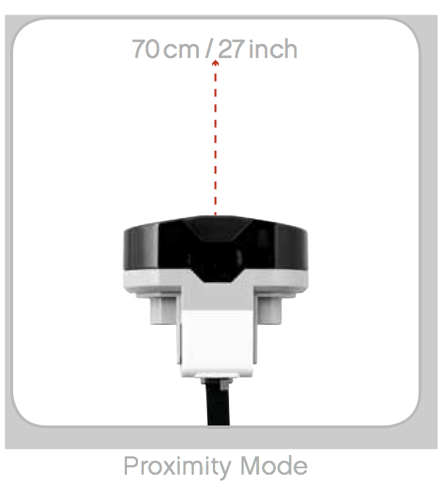
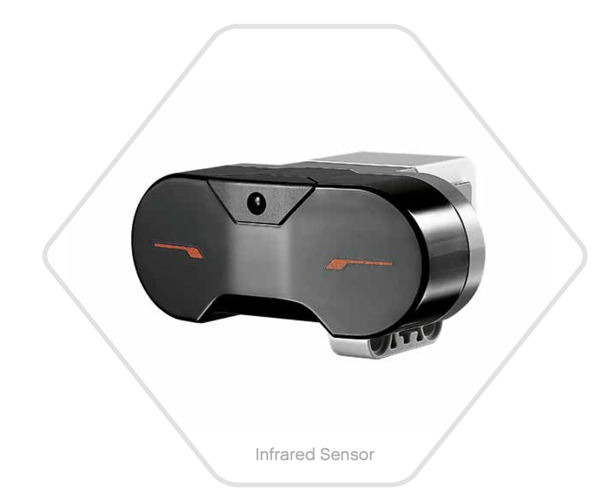
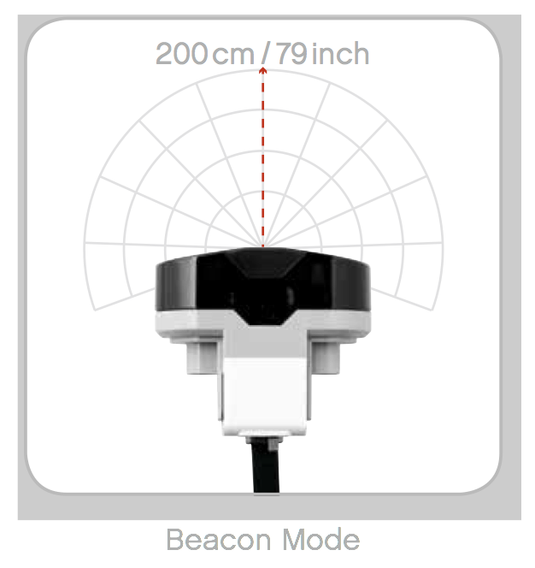
Infrared Sensor

Slide 22
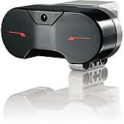
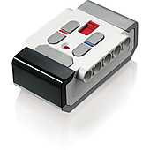
Remote Control

Slide 23
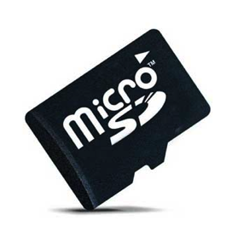
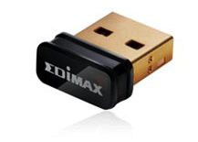
Getting Started with LeJOS
Creating Your SD Card
Micro SD Card (> 2GB)
Compatible WIFI adapter
NetGear WNA1100
EDIMAX EW-7811Un
Linux (or a Linux VM)
Details here:
http://sourceforge.net/p/lejos/wiki/Home/

Slide 24
Getting Started with LeJOS
Setting Up Your Dev Environment
IDE
Eclipse Kepler (needed to compile LeJOS source)
Jars you need:
OpenJDK Java 7 Runtime
Java Native Access (libjna)
Download/compile LeJOS Code
Repo: git://git.code.sf.net/p/lejos/ev3
Creates ev3classes.jar

Slide 25
Simple LeJOS Application
import lejos.nxt.Button;
import lejos.nxt.LCD;
public class EV3FirstProgram {
public static void main(String[] args) {
LCD.clear();
LCD.drawString("First EV3 Program", 0, 5);
Button.waitForAnyPress();
LCD.clear();
LCD.refresh();
}
}

Slide 26
Running on Device
Copy your jar to device:
Desktop$ scp EV3FirstProgram.jar root@<ev3 ip>:~
SSH to device (password is blank):
Desktop$ ssh root@<ev3 ip>
Run program:
EV3$ jrun –cp EV3FirstProgram.jar EV3FirstProgram

Slide 27
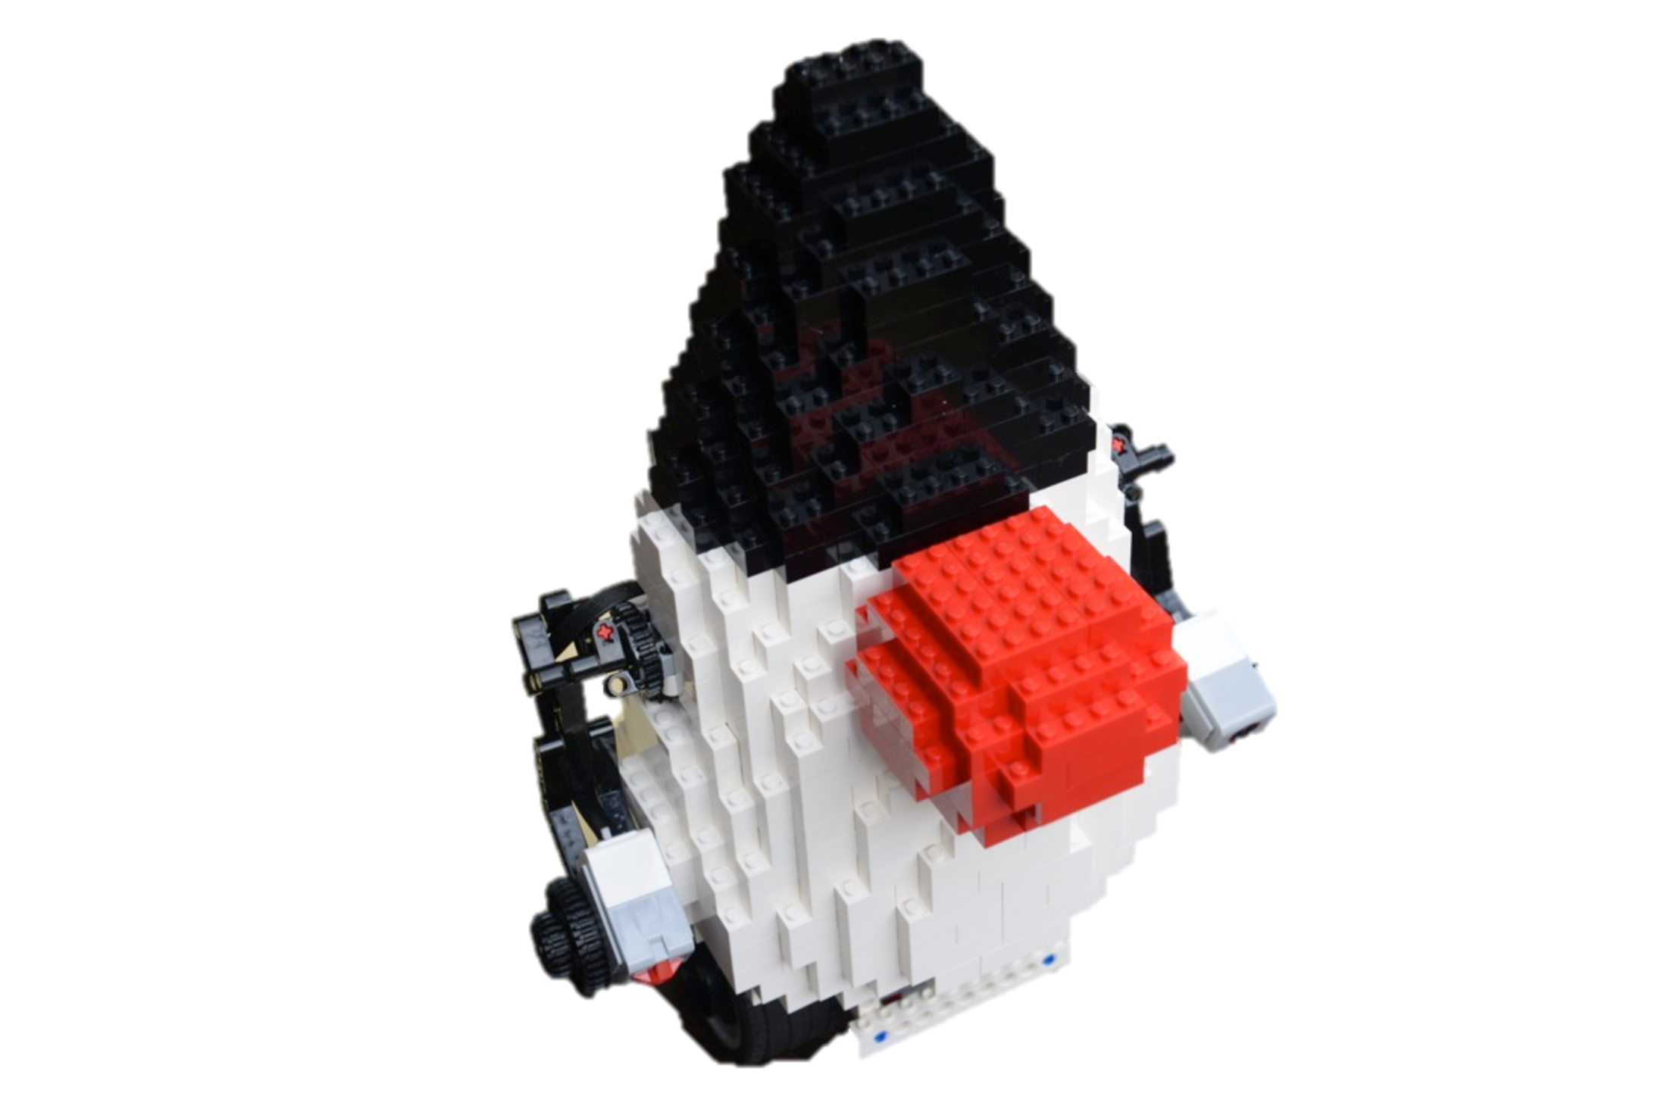
Lego Duke Segway

Slide 28
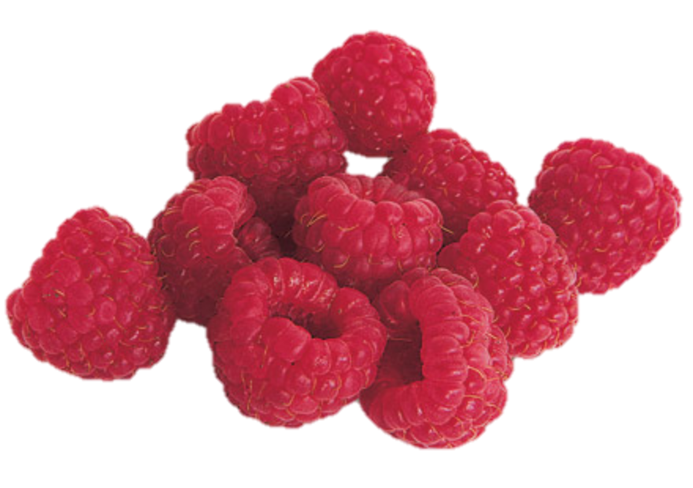
Have Java With Your Dessert
Raspberry Pi
=
Notes:
The Raspberry Pi is a single board computer developed in UK by Raspberry Pi Foundation with the intention to stimulate the teaching of basic computer science in schools. It has a slightly slower ARM processor (ARMv6 700Mhz), but a better GPU than the BeagleBoard. Connectivity is via HDMI/Component, USBx2, Ethernet, and Audio out.

Slide 29
http://elinux.org/File:Raspi-Model-AB-Mono-2-699x1024.png
Notes:
Specs:
700 Mhz ARM1176JZF-S core, Broadcom VideoCore IV, OpenGL EX 2.0
512mb RAM, 3.5Watts@5v, 8 x GPIO, UART, I2C bus, SPI bus
2 USB 2.0, SD / MMC / SDIO, 10/100 Ethernet
HDMI, DSI, Composite VideoCore IV, 3.5 mm Audio Jack
Cost $35 + Shipping

Slide 30
And what are these for?
http://i.imgur.com/k0Puu.jpg

Slide 31
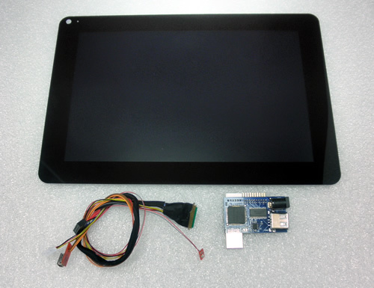
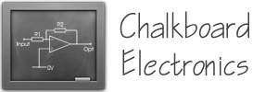
Chalkboard Electronics Touchscreen
10" or 7" Form Factor
Connects via HDMI/USB
Tested with JavaFX 8
10% Exclusive Discount:
G1F0U796Z083

Slide 32
How to Setup Your Pi
Step 1: Install Linux
Step 2: Download/Copy Java 8 for ARM EA
Step 3: Deploy and Run JavaFX Apps
http://steveonjava.com/
javafx-on-raspberry-pi-3-easy-steps/
Notes:
And getting JavaFX is as simple as downloading Java 7 (it has been bundled since Java 7u4). Also, it is supported across different desktop platforms (shown in the picture).

Slide 33
Connecting/Using Sensors & I/O Devices
Demo Setup
Raspberry Pi
LCD Pi Plate
ADC 1015 Converter
Force Pressure Sensor
Photo Cell Sensor
Pull-up Resistors and LED
Small Switch to Power Up LED

Slide 34
DukePad
http://j.mp/dukepad

Slide 45
Getting Involved
http://j.mp/dukepad

Slide 46
RoboVM
JavaFX on iOS
+
=

Slide 48
JavaFX on Android
It is about time!
Notes:
* Community effort, based on the code in OpenJFX (the same code that will be in Java 8).
* contains most JavaFX API's, including FXML, animations, properties,
controls (no media and webkit at this moment)
* runs on top of Dalvik
* Applications should be compiled with Java 7. Lambda's can be used and
backported using RetroLambda.
* Scripting tools are available for converting existing JavaFX projects
into Android APK's.
* Runtime + scripts + instructions available at https://bitbucket.org/javafxports/android/wiki/Home
* Work in Progress: the NetBeans Android plugin will contain support for
JavaFX.

Slide 49
Open Source Effort
https://bitbucket.org/javafxports/android/wiki/Home

Slide 50
NightHacking Tour
Stephen Chin
tweet: @steveonjava
blog: http://steveonjava.com
Real Geeks
Live Hacking
nighthacking.com

Slide 51
The preceding is intended to outline our general product direction. It is intended for information purposes only, and may not be incorporated into any contract. It is not a commitment to deliver any material, code, or functionality, and should not be relied upon in making purchasing decisions. The development, release, and timing of any features or functionality described for Oracle’s products remains at the sole discretion of Oracle.

