Slide 1
Async JavaScript at Netflix
Jafar Husain
@jhusain
Matthew Podwysocki
@ReactiveX

Slide 2
Who is Jafar?
Cross-Team Technical Lead for the Netflix UIs
Created the async data platform for Netflix UI’s
Member of TC39
13 years in the industry, formerly worked at Microsoft and GE
Notes:
Cross-Team Technical Lead for Netflix UI’s
12 years in the industry, formerly worked at Microsoft and GE
4 years of experience building systems with Functional Reactive Programming

Slide 3
Who is Matthew Podwysocki?
Not a member of TC39
Software Engineer at Microsoft
Works with MS Open Tech on Reactive Extensions
Organizes conferences such as RobotsConf, JSConf

Slide 4
This is the story of how Netflix solved
BIG async problems
by thinking differently about
Events.

Slide 5
1
3
2
201
4

Slide 6
The Netflix App is Asynchronous
App Startup
Player
Data Access
Animations
View/Model binding

Slide 7
Async Problems
Memory Leaks
Race Conditions
Callback Hell
Complex state machines
Error Handling

Slide 8
Async is Hard
function play(movieId, cancelButton, callback) {
var movieTicket,
playError,
tryFinish = function() {
if (playError) {
callback(null, playError);
}
else if (movieTicket && player.initialized) {
callback(null, ticket);
}
};
cancelButton.addEventListener(“click”, function() { playError = “cancelled”; }
if (!player.initialized) {
player.init(function(error) {
playError = error;
tryFinish();
}
}
authorizeMovie(function(error, ticket) {
playError = error;
movieTicket = ticket;
tryFinish();
});
});
function play(movieId, cancelButton, callback) {
var movieTicket,
playError,
tryFinish = function() {
if (playError) {
callback(null, playError);
}
else if (movieTicket && player.initialized) {
callback(null, ticket);
}
};
cancelButton.addEventListener(“click”, function() { playError = “cancelled”; }
if (!player.initialized) {
player.init(function(error) {
playError = error;
tryFinish();
});
}
authorizeMovie(function(error, ticket) {
playError = error;
movieTicket = ticket;
tryFinish();
});
});
function play(movieId, cancelButton, callback) {
var movieTicket,
playError,
tryFinish = function() {
if (playError) {
callback(null, playError);
}
else if (movieTicket && player.initialized) {
callback(null, ticket);
}
};
cancelButton.addEventListener(“click”, function() { playError = “cancelled”; }
if (!player.initialized) {
player.init(function(error) {
playError = error;
tryFinish();
});
}
authorizeMovie(function(error, ticket) {
playError = error;
movieTicket = ticket;
tryFinish();
});
});
function play(movieId, cancelButton, callback) {
var movieTicket,
playError,
tryFinish = function() {
if (playError) {
callback(null, playError);
}
else if (movieTicket && player.initialized) {
callback(null, ticket);
}
};
cancelButton.addEventListener(“click”, function() { playError = “cancelled”; }
if (!player.initialized) {
player.init(function(error) {
playError = error;
tryFinish();
}
}
authorizeMovie(function(error, ticket) {
playError = error;
movieTicket = ticket;
tryFinish();
});
});

Slide 10
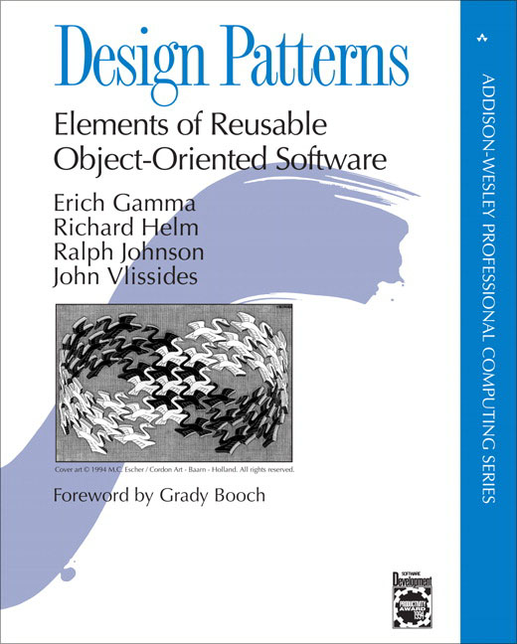

Slide 11
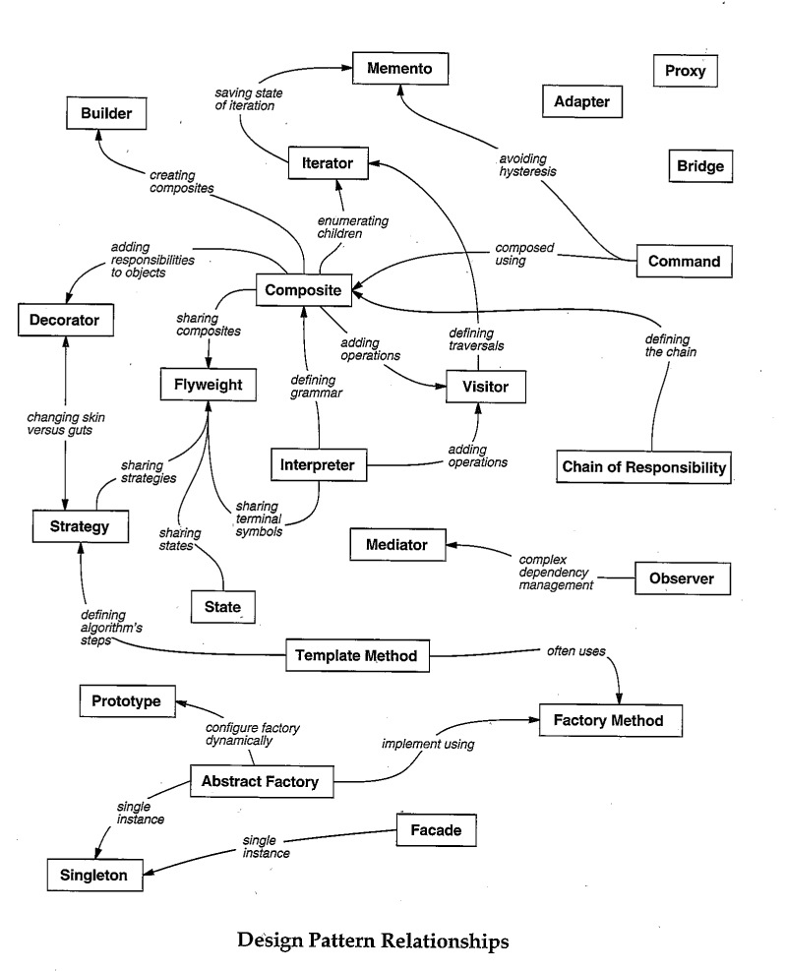
Iterator
?
Observer

Slide 12
Iterator
> var iterator = getNumbers();
> console.log(iterator.next());
> { value: 1, done: false }
>
> console.log(iterator.next());
> { value: 2, done: false }
>
> console.log(iterator.next());
> { value: 3, done: false }
>
> console.log(iterator.next());
> { done: true }
>

Slide 13
Observer Pattern
> document.addEventListener(
“mousemove”,
function next(e) {
console.log(e);
});
> { clientX: 425, clientY: 543 }
> { clientX: 450, clientY: 558 }
> { clientX: 455, clientY: 562 }
> { clientX: 460, clientY: 743 }
> { clientX: 476, clientY: 760 }
> { clientX: 476, clientY: 760 }
> { clientX: 476, clientY: 760 }
> { clientX: 476, clientY: 760 }

Slide 14
Iterator
progressively send information to consumer
Observer

Slide 15
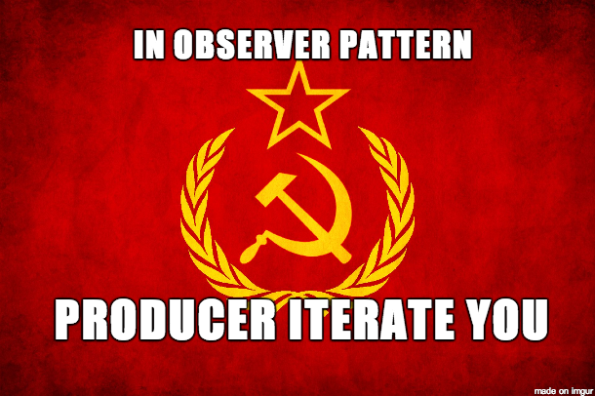

Slide 16
“What’s the difference between an Array…
[{x: 23, y: 44}, {x:27, y:55}, {x:27, y:55}]

Slide 17
… and an Event?
{x: 23, y: 44}...{x:27, y:55}.... {x:27, y:55}......

Slide 18
Events and Arrays are both collections.

Slide 19
Now for a brief
JavaScript 6 tutorial…

Slide 20
Functions
function(x, y) { return x + y; }
function(x) { return x + 1; }
x
=>
x + 1
(x, y)
=>
x + y
JS
5
6

Slide 21
Fin.

Slide 22
The majority of Netflix’s async code is written with just a few flexible functions.

Slide 23
ForEach
> [1, 2, 3].forEach(x => console.log(x))
> 1
> 2
> 3
>

Slide 24
Map

Slide 25
Map
> [1, 2, 3].map(x => x + 1)
> [2, 3, 4]
>

Slide 26
Filter

Slide 27
Filter
> [1, 2, 3].filter(x => x > 1)
> [2, 3]
>

Slide 28
concatAll

Slide 29
concatAll
> [ [1], [2, 3], [], [4] ].concatAll()
> [1, 2, 3, 4]
>

Slide 30
Map/Filter/ConcatAll
> [1, 2, 3].map(x => x + 1)
> [2, 3, 4]
> [1, 2, 3].filter(x => x > 1)
> [2, 3]
> [ [1], [2, 3], [], [4] ].concatAll()
> [1, 2, 3, 4]
>

Slide 31
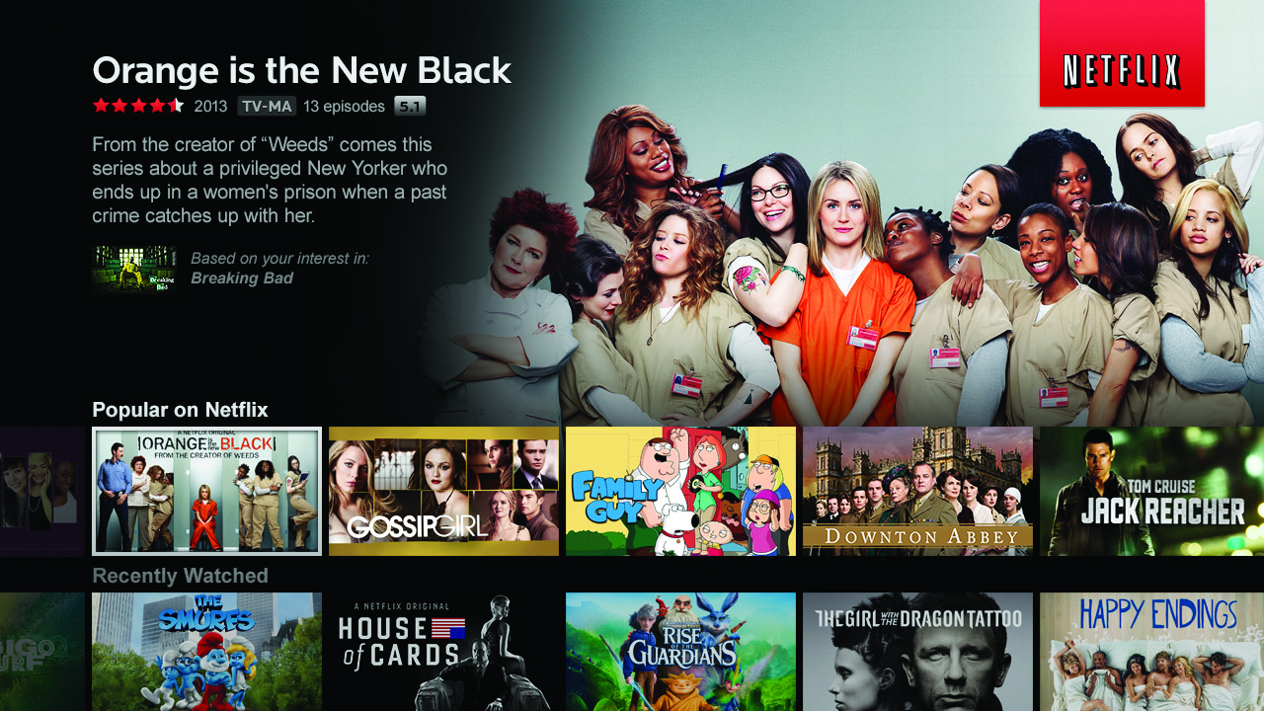

Slide 32
Let’s use map, filter, and concatAll to get a list of your favorite Netflix titles.

Slide 33
Top-rated Movies Collection
var getTopRatedFilms = user =>
user.videoLists.
map(videoList =>
videoList.videos.
filter(video => video.rating === 5.0)).
concatAll();
getTopRatedFilms(user).
forEach(film => console.log(film));

Slide 34
What if I told you…
…that you could create a drag event…
…with nearly the same code?

Slide 35
Top-rated Movies Collection
var getTopRatedFilms = user =>
user.videoLists.
map(videoList =>
videoList.videos.
filter(video => video.rating === 5.0)).
concatAll();
getTopRatedFilms(user).
forEach(film => console.log(film));

Slide 36
Mouse Drags Collection
var getElementDrags = elmt =>
elmt.mouseDowns.
map(mouseDown =>
document.mouseMoves.
filter takeUntil(document.mouseUps)).
concatAll();
getElementDrags(image).
forEach(pos => image.position = pos);

Slide 37
Introducing Observable
Observable === Collection + Time

Slide 38
Reactive Extensions
Observable Type + Array Functions (and more)
Open Source
Ported to…
C
C#/VB.Net
Javascript
Java (Netflix)

Slide 39
Observables can model…
Events
Animations
Async IO

Slide 40
Events to Observables
var mouseMoves =
Observable.
fromEvent(element, “mousemove”);

Slide 41
Event Subscription
// “subscribe”
var handler = (e) => console.log(e);
document.addEventListener(“mousemoves”, handler);
// “unsubscribe”
document.removeEventListener(“mousemoves”, handler);

Slide 42
Observable.forEach
// “subscribe”
var subscription =
mouseMoves.forEach(console.log);
// “unsubscribe”
subscription.dispose();

Slide 43
Expanded Observable.forEach
// “subscribe”
var subscription =
mouseMoves.forEach(
// next data
event => console.log(event),
// error
error => console.error(error),
// completed
() => console.log(“done”));
// “unsubscribe”
subscription.dispose();
optional

Slide 44
Observable Literal
{1……2…………3}
time
JS6

Slide 45
ForEach
> {1……2…………3}.forEach(console.log)
> {1……2…………3}
time
> 2
>
> 3
>
> 1
>

Slide 46
Map
> {1……2…………3}.map(x => x + 1)
time
> 3
>
> 4
>
> 2
>

Slide 47
Filter
> {1……2…………3}.filter(x => x + 1)
time
> 2
> 3
>
> 2
>
>

Slide 48
concatAll
[
[1]
[2, 3],
[],
[4]
].concatAll()
[1, 2, 3, 4]

Slide 49
concatAll
{
…{1}
………{2………………3},
……………{}
………………{4}
}.concatAll()
{…1…2………………3…4}
time

Slide 50
TakeUntil
{…1…2…………3}.takeUntil(
{……………4})
{…1…2…}
Source collection
time
Stop collection

Slide 51
Don’t unsubscribe from Events.
Complete them when another event fires.

Slide 52
Mouse Drags Collection
var getElementDrags = elmt =>
elmt.mouseDowns.
map(mouseDown =>
document.mouseMoves.
takeUntil(document.mouseUps)).
concatAll();
getElementDrags(image).
forEach(pos => image.position = pos);

Slide 53
Netflix Search

Slide 54
Netflix Search
var searchResultSets =
keyPresses.
throttle(250).
map(key =>
getJSON(“/searchResults?q=” + input.value).
retry(3).
takeUntil(keyPresses)).
concatAll();
searchResultSets.forEach(
resultSet => updateSearchResults(resultSet),
error => showMessage(“the server appears to be down.”));

Slide 55
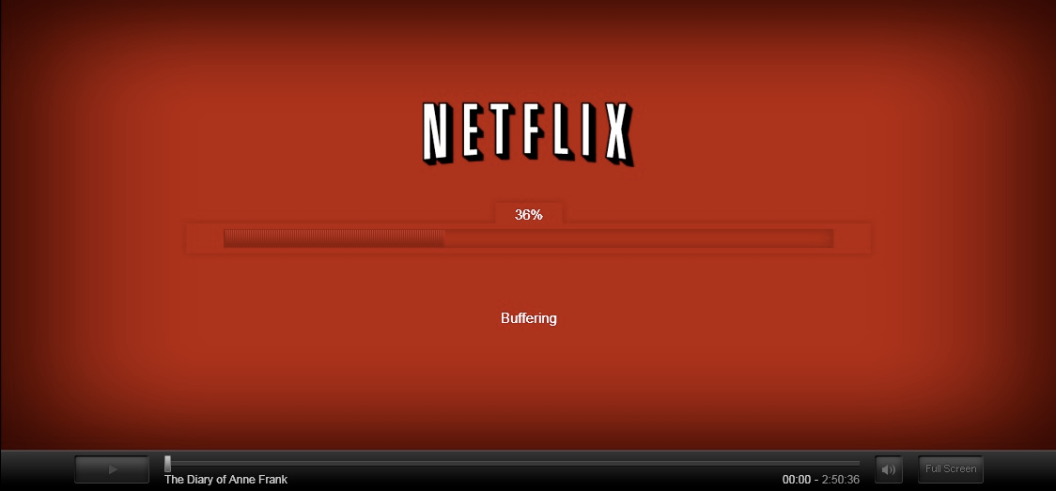
Netflix Player

Slide 56
Player Callback Hell
function play(movieId, cancelButton, callback) {
var movieTicket,
playError,
tryFinish = function() {
if (playError) {
callback(null, playError);
}
else if (movieTicket && player.initialized) {
callback(null, ticket);
}
};
cancelButton.addEventListener(“click”, function() { playError = “cancel”; });
if (!player.initialized) {
player.init(function(error) {
playError = error;
tryFinish();
}
}
authorizeMovie(movieId, function(error, ticket) {
playError = error;
movieTicket = ticket;
tryFinish();
});
});

Slide 57
Player with Observable
var authorizations =
player.
init().
map(() =>
playAttempts.
map(movieId =>
player.authorize(movieId).
catch(e => Observable.empty).
takeUntil(cancels)).
concatAll())).
concatAll();
authorizations.forEach(
license => player.play(license),
error => showDialog(“Sorry, can’t play right now.”));

Slide 58
Netflix: Observable Everywhere
App Startup
Player
Data Access
Animations
View/Model binding

Slide 59
Resources
reactivetrader.azurewebsites.net
https://github.com/Reactive-Extensions/RxJS
RxJava
http://jhusain.github.io/learnrx/
@jhusain
@ReactiveX
@MattPodwysocki

Slide 60
Questions

